Slide 1
EVERYDAY COMMISSION PRODUCT OF DISCIPLESHIP
LOVE GOD
LOVE PEOPLE
(Luke 10:27)

Slide 2
(Matthew 28:18-20) And Jesus came and spake unto them, saying, All power is given unto Me in heaven and in earth.
Go ye therefore, and teach all nations, baptizing them in the Name of the Father, and of the Son, and of the Holy Ghost:
Teaching them to observe all things whatsoever I have commanded you: and, lo, I am with you alway, even unto the end of the world. Amen.

Slide 3
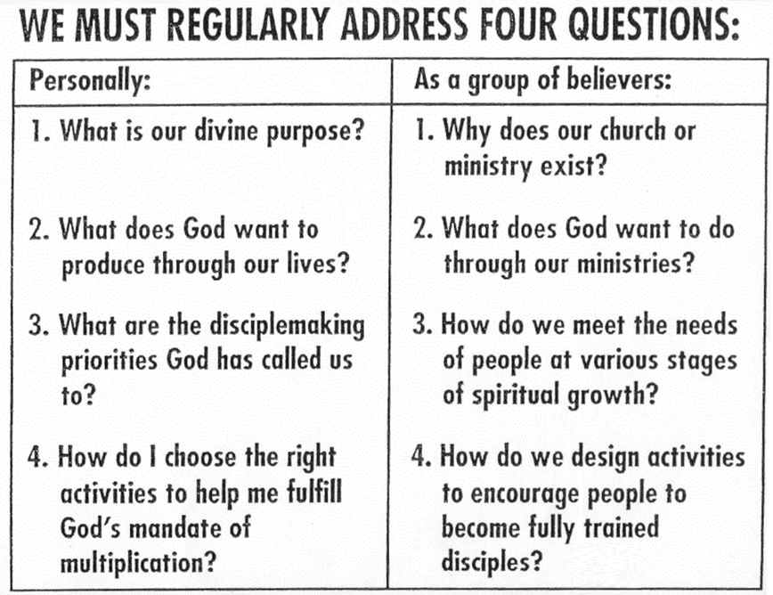

Slide 4
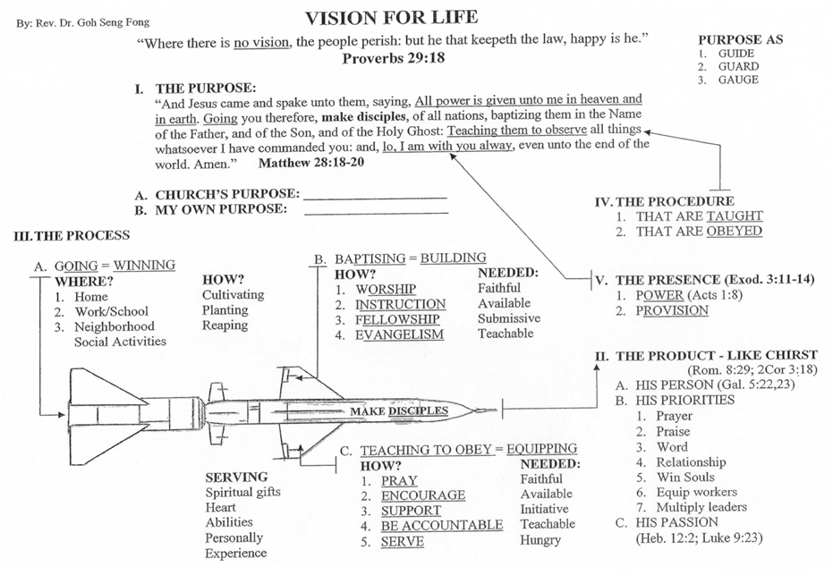

Slide 5
PURPOSE GUIDE, GUARD AND GAUGE
MY PURPOSE IS TO GLORIFY GOD BY BEING A GROWING DISCIPLE SO THAT I CAN MAKE DISCIPLES TO MAKE DISCIPLES.
EVERYDAY COMMISSION BIBLE CHURCH IS TO GLORIFY GOD BY BUILDING A COMMUNITY OF CHRIST-LIKE DISCIPLES THROUGH WORSHIP, INSTRUCTION, FELLOWSHIP AND EVANGELISM IN SINGAPORE AND INTO THE WORLD.

Slide 6
PRODUCT TO BE LIKE CHRIST
A. HIS PERSON (Gal. 5:22,23 – Fruit)
B. HIS PRIORITIES
1. PRAYER 2. PRAISE
3. WORD 4. RELATIONSHIP
5. SOUL WINNER 6. EQUIP WORKERS
7. MULTIPLY LEADERS
C. HIS PASSION (Heb. 12:2; Luke 9:23)
(Heb 12:2) Looking unto Jesus the author and finisher of our faith; who for the joy that was set before him endured the cross, despising the shame, and is set down at the right hand of the throne of God.

Slide 7
PRODUCT LIFE AS RELATIONSHIPS
(Luke 10:27) And He answering said,
Thou shalt love the Lord thy God
with all thy heart,
and with all thy soul,
and with all thy strength,
and with all thy mind;
and thy neighbour as thyself.

Slide 8
LOVE
1. Love is the most desired of all emotions.
2. To love and to be loved is sought sometimes by sex appeal, popularity or be using the right products, etc.
3. What we believe about love (true or false) will affect (a) all types of relationships, (b) shaping of behaviour and response, and (c) the determining of present and future well-being.

Slide 9
KINDS OF LOVE
1. EROS – PASSIONATE SELFISH SEXUAL LOVE
2. STERGO – NATURAL FAMILY LOVE (Rom. 1:31; 2 Tim. 3:3)
3. PHILEO – FOND AFFECTION WITH COMMON INTEREST (John 21:17)
4. AGAPE – DENIAL OF SELF AND GIVING OF SELF (John 3:16)

Slide 10
AGAPE LOVE
(Jn 3:16) For God so loved the world, that He gave His only Begotten Son, that whosoever believeth in Him should not perish, but have everlasting life.
(1 Jn 4:10) Herein is love, not that we loved God, but that He loved us, and sent His Son to be the propitiation for our sins.

Slide 11
AGAPE LOVE
1. ETERNAL AND INFINITE
(John 17:23) I in them, and Thou in Me, that they may be made perfect in one; and that the world may know that Thou hast sent Me, and hast loved them, as Thou hast loved Me.
(John 17:24) Father, I will that they also, whom Thou hast given Me, be with Me where I am; that they may behold My glory, which Thou hast given Me: for Thou lovedst Me before the foundation of the world.

Slide 12
AGAPE LOVE
1. ETERNAL AND INFINITE
HE LOVES US ETERNALLY – EVEN BEFORE THE WORLD BEGAN.
THERE NEVER IS A TIME HE DOES NOT LOVE US.
THE FATHER LOVES THE SON INFINITELY FOR THEY ARE ONE IN ESSENCE SO HE LOVES US SO.

Slide 13
AGAPE LOVE
2. MORE THAN A PASSION
“GOD IS LOVE” 1 John 4:16
A. HIS NATURE IS LOVE. His love is not from without but from within.
B. HE DEALS WITH US IN UNCHANGING LOVE. His love cannot be destroyed from outside.

Slide 14
AGAPE LOVE
3. LOVE WITH FORESIGHT
(Jer 31:3) The LORD hath appeared of old unto me, saying, Yea, I have loved thee with an everlasting love: therefore with lovingkindness have I drawn thee.
A. LOVE IS NOT BLIND. HE knows our fallen nature and life circumstances.
B. CALVARY SETTLES IT ALL!
(Rom 5:8) But God commendeth His love toward us, in that, while we were yet sinners, Christ died for us.

Slide 15
AGAPE LOVE
4. LESSONS
A. WHO CAN SEPARATE US FROM HIS LOVE?
B. WE NEED TO PERSEVERE IN HIS LOVE.
(Jn 15:10) If ye keep My commandments, ye shall abide in My love; even as I have kept My Father's commandments, and abide in His love.
C. WHAT A MISERY WITHOUT HIS LOVE!

Slide 16
LOVE STRENGTHENED BY KNOWING
(Jn 13:3) Jesus knowing that the Father had given all things into His Hands, and that He was come from God, and went to God;
1. LOVE STRENGTHENED BY KNOWING
2. OBEDIENCE IS EVIDENCE OF LOVE.
(Heb 5:8) Though He were Son, yet learned He obedience by the things which He suffered;

Slide 17
LOVE STRENGTHENED BY KNOWING
(Jn 13:3) Jesus knowing that the Father had given all things into His hands, and that He was come from God, and went to God;
THE FATHER WAS IN CONTROL.
THE FATHER HAD GIVEN HIM ALL THINGS.
NOTHING TO PROVE
NOTHING TO GAIN
NOTHING TO HIDE

Slide 18
NOTHING TO PROVE
Jesus knew who He was didn’t have to play any game to prove Himself or role-play to fool others.
Beware of the performance trap.

Slide 19
NOTHING TO PROVE
Know who I AM and whose I AM.
My Identity in Christ:
Because of Christ’s redemption,
I am a new creation, of infinite worth.
I am deeply loved, completely forgiven, fully pleasing,
totally accepted and absolutely complete in Christ,
one of a kind, nobody just like me,
a designer original.

Slide 20
NOTHING TO LOSE
Jesus knew what He was to accomplish and did not fear losing His reputation, image or friends, in order to please His Father and return to Him.
Beware of the approval addiction.

Slide 21
NOTHING TO HIDE
Jesus knew that He was empowered to fulfill His mission and did not need to rely upon position, intimidation or manipulation to achieve it.
Beware of the blame/shame game.

Slide 22
LOVE STRENGTHENED BY KNOWING
3. KNOWING WHO I AM AND WHOSE I AM
a. Sense of security and value – infinite worth and deeply loved.
b. Sense of satisfaction and stability – completely forgiven, fully pleasing.
c. Sense of significance and sufficiency – absolutely complete and approved by God.

Slide 23
LOVE STRENGTHENING BY SERVING
NECESSITY TO WASH FEET
(Jn 13:4) He riseth from supper, and laid aside His garments; and took a towel, and girded Himself.
(Jn 13:5) After that He poureth water into a bason, and began to wash the disciples' feet, and to wipe them with the towel wherewith He was girded.

Slide 24
LOVE STRENGTHENING BY SERVING
NECESSITY TO WASH FEET
LIFE IS LIVED IN EVERYDAY EVENTS.
HEARTS ARE ALSO SMELLY.
TRUE LOVE IS HUMBLE SERVING.
TREAT OTHERS MORE THAN THEY DESERVE.
SERVE IN DUTIES EVEN BENEATH US.
JESUS’ SERVING – FOUNDATION OF WORK.

Slide 25
LOVE STRENGTHENING BY SERVING
(Jn 13:16) Verily, verily, I say unto you, The servant is not greater than his lord; neither he that is sent greater than he that sent him.
(Jn 13:17) If ye know these things, happy are ye if ye do them.
KNOW + DO = BLESSED

Slide 26
INTIMACY V. LOST LOVE
1. R. Foster - “Superficiality is the curse of our age.”
2. One of the growing concerns is the busyness, the tyranny of the urgent that leaves us feeling strung out, impatient, resentful and even worse, empty. Other robbers are routine rut, unexamined life and “churchianity”.
3. The core issue is a lack of intimacy – an absence of connection and engagement with the Almighty.

Slide 27
INTIMACY V. LOST LOVE
INTENTIONALLY LONG AFTER GOD
As the hart pants after the water brooks, so pants my soul after Thee, O God.
My soul thirsts for God, for the living God: when shall I come and appear before God? (Psalm 42:1,2)
COMMUNION, COMMUNICATION, TRANSPARENCY AND SHARED INTEREST

Slide 28
INTIMACY V. LOST LOVES
I. INTENTIONALLY LONG AFTER GOD
1. The first danger is busyness, the noise and hurry – complicated living.
(Ecc 7:29) Lo, this only have I found, that God hath made man upright; but they have sought out many inventions.
2. The other enemy is covetousness (Exod. 20:17) – judging, comparing, vindicating and regretting.

Slide 29
INTIMACY V. LOST LOVE
3. The secret is to live simple and simply for God – our divine Centre.
a. The first inner attitude is that what we are a and have come as a gift from God.
(1Co 4:7) For who maketh thee to differ from another? and what hast thou that thou didst not receive? now if thou didst receive it, why dost thou glory, as if thou hadst not received it?

Slide 30
INTIMACY V. LOST LOVE
3. The secret is to live simple and simply for God – our divine Centre.
b. The second is that it is God’s business to care for us. He is able to keep (2 Tim. 1:12).
(Mat 6:31-33) Therefore take no thought, saying, What shall we eat? or, What shall we drink? or, Wherewithal shall we be clothed? (For after all these things do the Gentiles seek:) for your heavenly Father knoweth that ye have need of all these things. But seek ye first the kingdom of God, and his righteousness; and all these things shall be added unto you.

Slide 31
INTIMACY V. LOST LOVE
3. The secret is to live simple and simply for God – our divine Centre.
c. The third is that we are to share with others.
(Act 20:35) I have shewed you all things, how that so labouring ye ought to support the weak, and to remember the words of the Lord Jesus, how He said, It is more blessed to give than to receive.
d. Simplicity frees us from the tyranny of self, people and things to push us to attention, self-recognition and applause of man.

Slide 32
II. PURPOSEFULLY FOCUS ON GOD ALONE.
Now therefore, I pray thee, if I have found grace in Thy sight, shew me now Thy way, that I may know Thee, that I may find grace in Thy sight: and consider that this nation is Thy people.
And He said, My presence shall go with thee, and I will give thee rest. (Exodus 33:13,14)
(Php 3:10) That I may know Him, and the power of His resurrection, and the fellowship of His sufferings, being made conformable unto His death;

Slide 33
II. PURPOSEFULLY FOCUS ON GOD ALONE.
Primary purpose is to embrace the Almighty God by faith and worship Him in spirit and truth.
1. Intimacy is not primarily about what He will do for us when we are close.
a. He has already done more than we deserve. The Cross is enough.
b. He is probably doing a lot that we do not even know.
c. He will intervene only for His Kingdom purposes.

Slide 34
II. PURPOSEFULLY FOCUS ON GOD ALONE
2. Intimacy is not about an informal buddy-buddy relationship.
a. Though we call Him “Abba, Father” (Gal. 4:6), yet there should be awe and respect.
b. Scenes of Isaiah (6:5), John (Rev. 1:7) – “fell at His feet as dead”.
3. Issues of care, comfort and control
a. Be careful of the push, pace and noise of life and people.
b. Guard the fire in the souls! Be sensitive to His nudges.

Slide 35
II. PURPOSEFULLY FOCUS ON GOD ALONE
4. It is a heart love relationship, with seasons of Word, meditation and prayer.
a. “Be still and know that I am God” (Ps. 46:10). (versus Compare, contrast and control)
b. Solitude/Silence is inner fulfillment – more than a state of mind than it is a place.
c. Feelings falls between highly charged emotional experience and deep, quiet, personal encounters at the depth of soul.
d. No one size fits all – could be due to varying temperament, culture and background.

Slide 36
III. BE POURED OUT FOR GOD AND FOR SOULS
1. Moses:
(Heb 11:24-26) By faith Moses, when he was come to years, refused to be called the son of Pharaoh's daughter; Choosing rather to suffer affliction with the people of God, than to enjoy the pleasures of sin for a season; Esteeming the reproach of Christ greater riches than the treasures in Egypt: for he had respect unto the recompense of the reward.

Slide 37
III. BE POURED OUT FOR GOD AND FOR SOULS
2. Esther: “If I perish, I perish !”(4:16).
3. Paul:
(2Ti 4:6-8) For I am now ready to be offered, and the time of my departure is at hand. I have fought a good fight, I have finished my course, I have kept the faith: Henceforth there is laid up for me a crown of righteousness, which the Lord, the righteous judge, shall give me at that day: and not to me only, but unto all them also that love His appearing.

Slide 38
III. BE POURED OUT FOR GOD AND FOR SOULS
4. Paul’s soul winning, full counsel and leaders
(Act 20:26,27) Wherefore I take you to record this day, that I am pure from the blood of all men. (1Cor. 9:22)
For I have not shunned to declare unto you all the counsel of God. (2 Tim. 4:2)
(2Ti 2:2) And the things that thou hast heard of me among many witnesses, the same commit thou to faithful men, who shall be able to teach others also.

Slide 39
LOVE ONE ANOTHER
(1 John 4:7-12) Beloved, let us love one another: for love is of God; and every one that loves is born of God, and knows God. He that loves not knows not God; for God is love.
In this was manifested the love of God toward us, because that God sent His Only Begotten Son into the world, that we might live through Him.
Herein is love, not that we loved God, but that He loved us, and sent His Son to be the propitiation for our sins.
Beloved, if God so loved us, we ought also to love one another. No man hath seen God at any time. If we love one another, God dwells in us, and his love is perfected in us.

Slide 40
TRUE LOVE - AGAPE
1. As contrasted to feelings:
a. It is rational – unites reason with emotions (not obsessional). I can understand love and grow in understanding and abundance of love.
b. Love is a choice, not easy or simple – an art that I must desire to learn and pour out my life – I can will to learn to love.

Slide 41
TRUE LOVE - AGAPE
1. As contrasted to feelings
c. Love is an active power that I can control by my own will. I am not a helpless slave. I can choose to love and it requires discipline to give myself?
d. Love is the power that
will produce love and more
love as I learn to give it
Rather than strain to attract it.

Slide 42
TRUE LOVE - AGAPE
As personified by our Lord Jesus Christ
a. Unconditional and free
(Romans 5:8) But God commends His love toward us, in that, while we were yet sinners, Christ died for us.
b. Volitional
(Ephesians 1:6,7) To the praise of the glory of His grace, wherein He hath made us accepted in the beloved. In whom we have redemption through His blood, the forgiveness of sins, according to the riches of His grace;

Slide 43
TRUE LOVE - AGAPE
As personified by our Lord Jesus Christ
c. Intense and Unending
(John 13:1) Now before the feast of the Passover, when Jesus knew that His
hour was come that He should depart
out of this world unto the Father, having
loved His own which were in the world,
He loved them unto the end.

Slide 44
TRUE LOVE - AGAPE
As personified by our Lord Jesus Christ
d. Unselfish and Purposeful
(Ephesians 5:25-27) Husbands, love your wives, even as Christ also loved the church, and gave Himself for it;
That He might sanctify and cleanse it with the washing of water by the Word,
That He might present it to Himself a glorious church, not having spot, or wrinkle, or any such thing; but that it should be holy and without blemish.

Slide 45
TRUE LOVE - AGAPE
As personified by our Lord Jesus Christ
e. Manifested and practical
(John 10 – shepherd)
Prays, protects, comforts and provides.
f. Sacrificial
(Romans 5:6) For when we were yet without strength, in due time Christ died for the ungodly.

Slide 46
TRUE LOVE - AGAPE
3. As produced in us by God
a. Capacity
(Romans 5:5) And hope makes not ashamed; because the love of God is shed abroad in our hearts by the Holy Ghost who is given unto us.
b. Desire and ability given
(Philippians 2:13) For it is God which works in you both to will and to do of His good pleasure.

Slide 47
TRUE LOVE - AGAPE
3. As produced in us by God
Our Responses:
a. Pray and claim by faith His promises.
God will work both to desire and to do.
b. Seek His desire and obey.
(Matthew 6:33) But seek ye first the Kingdom of God, and His righteousness; and all these things shall be added unto you.

Slide 48
TRUE LOVE - AGAPE
3. As produced in us by God
c. Do what God says whether we feel like it or not.
(Matthew 5:44, 45) But I say unto you, Love your enemies, bless them that curse you, do good to
them that hate you, and pray for them which despitefully use you, and persecute you;
That you may be the children of your Father
who is in Heaven: for He makes His sun to rise
on the evil and on the good, and sends rain on
the just and on the unjust.

Slide 49
SPEAK LOVE LANGUAGES
1. Inside us is an emotional tank to be filled.
2. Each has a primary love language.
3. A husband and wife rarely have the same primary love language.
4. By nature, we speak our own language.
a. In what ways do I regularly express love to others?
b. What do others do or fail to do that hurt me most deeply?
c. What do I most often requested of others?

Slide 50
SPEAK LOVE LANGUAGES
5. We must learn to speak the languages of others.
6. Rekindling Love for one another:
a. Confessing, we should re-commit ourselves.
b. Learn languages of others n speak regularly.
c. With full tank, we can solve problems and grow in intimacy.
d. No need for obsessive stages, we can grow in warm emotional love.
e. Ask of each other what three needs for 3 for three months.
f. Ask Daily: How is the tank like? How can I help?

Slide 51
THE FIVE LOVE LANGUAGES (PROFILE)
 |  | A | B | C | D | E
1 | I like to receive notes of affirmation from you | X
 | I like it when you hug me |  |  |  |  | X
2 | I like to spend one-to-one time with you |  | X
 | I feel loved when you give practical help to me |  |  |  | X
3 | I like it when you give me gifts |  |  | X
 | I like taking long walks with you |  | X
4 | I feel loved when you do things to help me |  |  |  | X
 | I feel loved when you touch me |  |  |  |  | X
5 | I feel loved when you hold me in your arms |  |  |  |  | X
 | I feel loved when I receive a gift from you |  |  | X
6 | I like to go places with you |  | X
 | I like to hold hands with you |  |  |  |  | X
7 | Visible symbols of love (gifts) are very important to me |  |  | X
 | I feel loved when you affirm me | X
8 | I like to sit close to you |  |  |  |  | X
 | I like for you to tell me I'm attractive/handsome | X
9 | I like to spend time with you |  | X
 | I like to receive little gifts from you |  |  | X
10 | Your words of acceptance are important to me | X
 | I know you love me when you help me |  |  |  | X
11 | I like to be together when we do things |  | X
 | I like the kind words you say to me | X
12 | What you do affects me more than what you say |  |  |  | X
 | I feel whole when we hug |  |  |  |  | X
13 | I value your praise and try to avoid your criticism | X
 | Several inexpensive gifts from you mean more to me than one large gift |  |  | X
14 | I feel close when we are talking or doing something together |  | X
 | I feel closer to you when you touch me often |  |  |  |  | X
15 | I like for you to compliment my achievements | X
 | I know you love me when you do things for me that you don't enjoy doing |  |  |  | X
16 | I like for you to touch me when you walk by |  |  |  |  | X
 | I like it when you listen to me sympathetically |  | X
 |  | A | B | C | D | E
17 | I feel loved when you help me with my jobs around the house |  |  |  | X
 | I really enjoy receiving gifts from you |  |  | X
18 | I like for you to compliment my appearance | X
 | I feel loved when you take time to understand my feelings |  | X
19 | I feel secure when you are touching me |  |  |  |  | X
 | Your acts of service make me feel loved |  |  |  | X
20 | I appreciate the many things you do for me |  |  |  | X
 | I like receiving gifts that you make |  |  | X
21 | I really enjoy the feeling I get when you give me your undivided attention |  | X
 | I really enjoy the feeling I get when you do some act or service for me |  |  |  | X
22 | I feel loved when you celebrate my birthday with a gift |  |  | X
 | I feel loved when you celebrate my birthday with meaningful words (written or spoken) | X
23 | I know you are thinking of me when you give me a gift |  |  | X
 | I feel loved when you help out with my chores |  |  |  | X
24 | I appreciate it when you listened patiently and don't interrupt me |  | X
 | I appreciate it when you remember special days with a gift |  |  | X
25 | I like to know you are concerned enough to help with my daily tasks |  |  |  | X
 | I enjoy extended trips with you |  | X
26 | Kissing me unexpectedly excites me |  |  |  |  | X
 | Giving me a gift for no special occasion excites me |  |  | X
27 | I like to be told that you appreciate me | X
 | I like for you to look at me when we are talking |  | X
28 | Your gifts are always special to me |  |  | X
 | I feel good when you are touching me |  |  |  |  | X
29 | I feel loved when you enthusiastically do some task I have requested |  |  |  | X
 | I feel loved when you tell me how much you appreciate me | X
30 | I need to be touched every day |  |  |  |  | X
 | I need your words of affirmation daily | X
 | Total each column (all five columns should equal 30)

Slide 52
 |  | A | B | C | D | E
12 | What you do affects me more than what you say |  |  |  | X
 | I feel whole when we hug |  |  |  |  | X
13 | I value your praise and try to avoid your criticism | X
 | Several inexpensive gifts from you mean more to me than one large gift |  |  | X
14 | I feel close when we are talking or doing something together |  | X
 | I feel closer to you when you touch me often |  |  |  |  | X
15 | I like for you to compliment my achievements | X
 | I know you love me when you do things for me that you don't enjoy doing |  |  |  | X
16 | I like for you to touch me when you walk by |  |  |  |  | X
 | I like it when you listen to me sympathetically |  | X
 |  | A | B | C | D | E
17 | I feel loved when you help me with my jobs around the house |  |  |  | X
 | I really enjoy receiving gifts from you |  |  | X
18 | I like for you to compliment my appearance | X
 | I feel loved when you take time to understand my feelings |  | X
19 | I feel secure when you are touching me |  |  |  |  | X
 | Your acts of service make me feel loved |  |  |  | X
20 | I appreciate the many things you do for me |  |  |  | X
 | I like receiving gifts that you make |  |  | X
21 | I really enjoy the feeling I get when you give me your undivided attention |  | X
 | I really enjoy the feeling I get when you do some act or service for me |  |  |  | X
22 | I feel loved when you celebrate my birthday with a gift |  |  | X
 | I feel loved when you celebrate my birthday with meaningful words (written or spoken) | X
23 | I know you are thinking of me when you give me a gift |  |  | X
 | I feel loved when you help out with my chores |  |  |  | X
24 | I appreciate it when you listened patiently and don't interrupt me |  | X
 | I appreciate it when you remember special days with a gift |  |  | X
25 | I like to know you are concerned enough to help with my daily tasks |  |  |  | X
 | I enjoy extended trips with you |  | X
26 | Kissing me unexpectedly excites me |  |  |  |  | X
 | Giving me a gift for no special occasion excites me |  |  | X
27 | I like to be told that you appreciate me | X
 | I like for you to look at me when we are talking |  | X
28 | Your gifts are always special to me |  |  | X
 | I feel good when you are touching me |  |  |  |  | X
29 | I feel loved when you enthusiastically do some task I have requested |  |  |  | X
 | I feel loved when you tell me how much you appreciate me | X
30 | I need to be touched every day |  |  |  |  | X
 | I need your words of affirmation daily | X
 | Total each column (all five columns should equal 30)

Slide 53
 |  | A | B | C | D | E
23 | I know you are thinking of me when you give me a gift |  |  | X
 | I feel loved when you help out with my chores |  |  |  | X
24 | I appreciate it when you listened patiently and don't interrupt me |  | X
 | I appreciate it when you remember special days with a gift |  |  | X
25 | I like to know you are concerned enough to help with my daily tasks |  |  |  | X
 | I enjoy extended trips with you |  | X
26 | Kissing me unexpectedly excites me |  |  |  |  | X
 | Giving me a gift for no special occasion excites me |  |  | X
27 | I like to be told that you appreciate me | X
 | I like for you to look at me when we are talking |  | X
28 | Your gifts are always special to me |  |  | X
 | I feel good when you are touching me |  |  |  |  | X
29 | I feel loved when you enthusiastically do some task I have requested |  |  |  | X
 | I feel loved when you tell me how much you appreciate me | X
30 | I need to be touched every day |  |  |  |  | X
 | I need your words of affirmation daily | X
 | Total each column (all five columns should equal 30)
A = Words of Affirmation C = Receiving Gifts E = Physical Touch B = Quality Time D = Acts of Service

Slide 54
SPEAK LOVE LANGUAGES (G. Chapman)
1. WORDS OF AFFIRMATION
2. QUALITY TIME
3. RECEIVING GIFTS
4. ACTS OF SERVICE
5. PHYSICAL TOUCH

Slide 55
How to relay to a person with this love language | Communication | Actions | What to Avoid
Words of affirmation Proverbs 15:1 and 18:21 Focus on saying | Compliments Affirmation Kind words/ gentle | Send notes/ cards Affirm before others | Criticism Condemning Judgmental
Quality time Deuteronomy 6: 6, 7 Psalms 139: 1, 2 Focus on listening with support | One-to-one time Not interrupting Face-to-face conversation (self-revelation) | Take long walks together Doing things together Taking trips | Long periods of being apart More time with friends than with spouse
Receiving gifts 2 Corinthians 9: 7, 15 James 1: 17 | Positive Fact-orientated information Gift especially of self- power of presence | Give gifts on special occasions and not so special occasions | Forgetting special days
Acts of service Galatians 5:13 Mark 10: 45 John 13 - overcome stereotypes | Action words like “I can,” “I will,” “What else can I do?” | Helping with house and yard chores Repair/maintenance Acts of kindness | Ignoring spouses' requests while helping others
Physical touch Mark 10: 13, 16 Can communicate hate or love | A lot of nonverbals Verbals need to be word pictures Crisis and touch | Touches Hugs Pats Kisses | Physical neglect or abuse Physically there but emotionally absent
PROFOUND CONCLUSION
Learning the primary love language of your spouse and your children and choosing to speak it regularly will greatly enhance the emotional climate in your family.

Slide 56
1. WORDS OF AFFIRMATION
(Matthew 25:21) His lord said unto him, Well done, thou good and faithful servant: thou hast been faithful over a few things, I will make thee ruler over many things: enter thou into the joy of thy lord.
(Proverbs 18:21) Death and life are in the power of the tongue: and they that love it shall eat the fruit thereof.
FOCUS ON SAYING WORDS OF AFFECTION, PRAISE AND ENCOURAGEMENT.

Slide 57
1. WORDS OF AFFIRMATION
WORDS – POWER OF LIFE OR DEATH
FOCUS ON SAYING:
A. Of Affection
B. Of Praise
C. Of Encouragement
D. Of Guidance

Slide 58
QUALITY TIME
(Deuteronomy 6:6,7) And these words, which I command thee this day, shall be in thine heart:
And thou shalt teach them diligently unto thy children, and shalt talk of them when thou sit in thine house, and when thou walk by the way, and when thou lie down, and when thou rise up.
FOCUS ON LISTENING WITH SUPPORT.

Slide 59
QUALITY TIME – FULLY PRESENT
FOCUS ON LISTENING WITH SUPPORT
A. One-to-one Time
B. Not Interrupting
C. Face-to-Face
D. Quality Self-revelation
E. Sharing of Thoughts and Feelings

Slide 60
RECEIVING GIFTS
(James 1:17) Every good gift and every perfect gift is from above, and cometh down from the Father of lights, with whom is no variableness, neither shadow of turning.
(2 Corinthians 9:7) Every man according as he purposes in his heart, so let him give; not grudgingly, or of necessity: for God loves a cheerful giver.
GIFTS ARE TANGIBLE EVIDENCE OF EMOTIONAL LOVE.

Slide 61
RECEIVING GIFTS
A. Positive – not Bribes or Substitutes
B. Life-long learning Experiences
C. Gift of Self – Power of Presence
D. Excess – burden & not special

Slide 62
ACTS OF SERVICE
(Mark 10:45) For even the Son of man came not to be ministered unto, but to minister, and to give his life a ransom for many.
(Galatians 5:13) For, brethren, ye have been called unto liberty; only use not liberty for an occasion to the flesh, but by love serve one another.
ACTS ARE TO BE DONE WITH LOVING SERVICE NOT JUST OUT OF DUTY OR OBLIGATION.

Slide 63
ACTS OF SERVICE
A. Overcome Stereotypes
B. Daily, mundane Acts for long term Effects
C. Action words: I can, will. What else?
D. Age appropriate

Slide 64
5. PHYSICAL TOUCH
(Mark 10:13) And they brought young children to Him, that He should touch them: and His disciples rebuked those that brought them.
(Mark 10:16) And He took them up in His arms, put His hands upon them, and blessed them.
PROVIDES SENSE OF TRUST, CONNECTEDNESS AND ACCEPTANCE.

Slide 65
PHYSICAL TOUCH
A. Can communicate hate or love
B. Lots of non-verbals – touch, pat
C. Crises and Touch
D. Physically there but emotionally
absent

Slide 66
SPEAK LOVE LANGUAGES
Problems:
a. Hard to speak? Love is giving self.
God will provide the capacity.
b. Do not feel like it? Do it as God commanded. (Matt. 5:44).
(Matthew 5:44) But I say unto you, Love your enemies, bless them that curse you, do good to them that hate you, and pray for them which despitefully use you, and persecute you;

Slide 67
SPEAK LOVE LANGUAGES
Problems:
c. What if the other does not respond?
Do it for Jesus. God will bless.
If ye know these things, happy are ye if ye do them.
(John 13:17)
Profound conclusion:
Putting learning and choosing to act will
enhance emotional climate at home, work, and church.

Slide 68
ASSIGNMENTS
1. By which two languages do you speak to your Heavenly Father?
2. Ask of each other what three needs to be filled up for the next three months.
3. Please ask daily: How is your love tank like? How can I help to fill it?

Slide 69
INVEST IN GOD !
One life to make the choice for eternity!
The choice is yours!
“I call heaven and earth to record this day against you,
that I have set before you life and death,
blessing and cursing:
therefore choose life,
that both thou and thy seed may live.” (Deu 30:19)

Slide 70
PRODUCT
WHAT ONE LESSON HAVE I LEARNT?
WHAT WILL ONE PRAYER BE?

Slide 71
Email: gohsengfong@hotmail.com
WhatsApp: +65-98207783
Website: www.FaithAtWorkFellowship.org

