Slide 1
JESUS – MASTER DISCIPLER
“HE HAD CALLED UNTO HIM
HIS TWELVE DISCIPLES” (MATT. 10:1)

Slide 2
(Matthew 28:18-20) And Jesus came and spake unto them, saying, All power is given unto Me in heaven and in earth.
Go ye therefore, and teach all nations, baptizing them in the Name of the Father, and of the Son, and of the Holy Ghost:
Teaching them to observe all things whatsoever I have commanded you: and, lo, I am with you alway, even unto the end of the world. Amen.

Slide 3
Cheap grace is “the preaching of forgiveness without requiring repentance, baptism without church discipline, communion without confession, absolution without personal confession.
Cheap grace is grace without discipleship, grace without the Cross, grace without Jesus Christ, living and incarnate … When Christ calls a man, He bids him come and die.” (Bonhoeffer).

Slide 4
EVERYDAY COMMISSION
1. Mandated to a call to high level of obedience and commitment.
2. The Greek verb “to disciple” (used some 260 times in Gospel and Acts) means “to learn, to increase knowledge” under someone.
3. To be a disciple refers to one who puts himself under the teaching of someone else, learning and following his example.
4. Disciple-making may be termed as the intentional and purposeful training of disciples with transparency and accountability on the basis of loving relationships (1 Thess. 5:14).

Slide 5
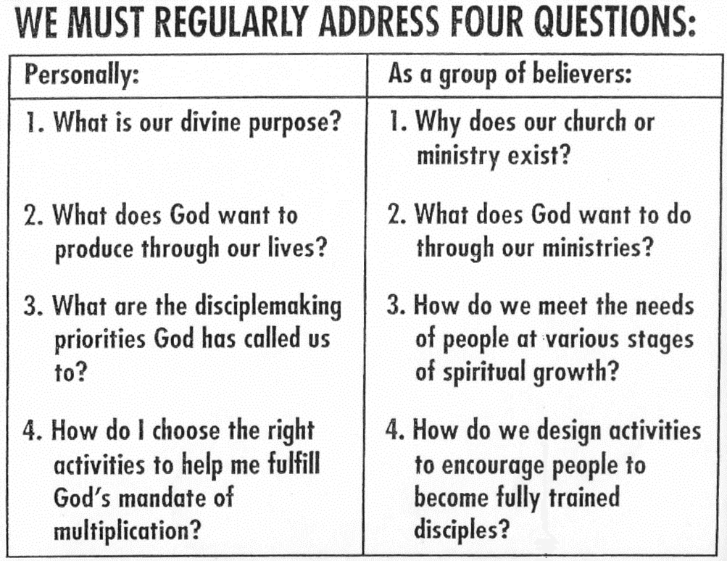

Slide 6
PRODUCT: INTO HIS IMAGE
(Gen 1:27) So God created man in His own Image, in the Image of God created He him; male and female created He them.
(Rom 8:29) For whom He did foreknow, He also did predestinate to be conformed to the Image of His Son, that He might be the firstborn among many brethren.
(Eph 4:24) And that ye put on the new man, which after God is created in righteousness and true holiness.

Slide 7
I. JESUS – THE PERSON
1. Called God – 7 times in the New Testament (cf. John 1:1)
“And Thomas answered and said unto Him, My Lord and my God” (John 20:28).
One God … and One Mediator (1 Tim. 2:5)
God … manifested in the flesh (1 Tim. 3:16)
True God and Eternal Life (1 John 5:20)
Great God and our Savior (Titus 2:13)
Thy Throne, O God, is forever (Heb. 1:8)

Slide 8
I. JESUS – THE PERSON
2. Eternal God – being in existence in the beginning
“In the beginning was the Word,
and the Word was with God,
and the Word was God” (John 1:1).

Slide 9
I. JESUS – THE PERSON
The Creator and Sustainer (Heb. 1:10; Col. 1:17)
“All things were made by Him; and without Him was not any thing made that was made” (John 1:3).
4. He is everywhere – He fills all (Eph. 1:23).

Slide 10
I. JESUS – THE PERSON
5. He is all-knowing – He know all things (John 16:30) and the heart of man (John 2:24,25).
6. He is all-powerful - The Lord God Almighty (Rev. 1:8), over demons, diseases, nature and death.
7. He is unchanging – the same, yesterday, today and forever (Heb. 13:8).

Slide 11
I. JESUS – THE PERSON
8. He forgives sin (Matt 9:6) and raises the future dead (John 11:25).
He is coming again – to judge and rule over all (Rev. 19:11-16).
“So Christ was once offered to bear the sins of many; and unto them that look for Him shall He appear the second time without sin unto salvation” (Heb. 9:28).

Slide 12
II. JESUS – IN COMMUNION
1. THE TRINITY IN COMMUNION TOGETHER
(Matthew 28:19) Go ye therefore, and teach all nations, baptizing them in the Name of the Father, and of the Son, and of the Holy Ghost:
(2 Corinthians 13:14) The grace of the Lord Jesus Christ, and the love of God, and the communion of the Holy Ghost, be with you all. Amen.
The Trinity – One God, one essence, and yet the tri-personality of divine nature – One in Three and Three in One.

Slide 13
II. JESUS – IN COMMUNION
2. THE FATHER AND SON IN COMMUNION TOGETHER
(John 17:21-22) That they all may be one; as Thou, Father, art in Me, and I in Thee, that they also may be one in Us: that the world may believe that Thou hast sent Me. And the glory which Thou gave Me I have given them; that they may be one, even as We are one.
(John 17:25-26) O Righteous Father, the world hath not known Thee: but I have known Thee, and these have known that Thou hast sent Me. And I have declared unto them Thy Name, and will declare it: that the love wherewith Thou hast loved Me may be in them, and I in them.

Slide 14
II. JESUS – IN COMMUNION
3. THE SON IN COMMUNION
Jesus’ Example: Prayer to Him was more important than:
1. Rest (Mark 1:35)
2. Sleep (Luke 6:12)
3. Working of miracles (Luke 22:32)
4. Teaching (Luke 5:15,16)
Money or machinery in securing workers (Matt. 9:37,38).
Jesus has a continuing ministry (Heb 7:25).

Slide 15
II. JESUS – IN COMMUNION
GOD’S PEOPLE IN COMMUNION
(Isaiah 30:15) For thus saith the Lord GOD, the Holy One of Israel; In returning and rest shall ye be saved; in quietness and in confidence shall be your strength.
PRAYER DESIRES – TO BE ONE WITH HIM
1. Rehearsing God’s will
2. Picturing God’s desire
3. Listening to God
4. Anticipating God’s answers
5. Praising and worshipping
– ever lives to make intercession.

Slide 16
III. JESUS – INTO THE WRITTEN WORD
THE WORD TESTIFIES OF JESUS CHRIST.
(John 5:39) Search the Scriptures; for in them ye think ye have eternal life: and they are they which testify of Me.
(John 20:31) But these are written, that ye might believe that Jesus is the Christ, the Son of God; and that believing ye might have life through His Name.

Slide 17
III. JESUS – INTO THE WRITTEN WORD
2. JESUS KNEW AND MADE USE OF THE WORD.
(Luke 24:25-27) Then He said unto them, O fools, and slow of heart to believe all that the prophets have spoken:
Ought not Christ to have suffered these things, and to enter into His glory?
And beginning at Moses and all the prophets, He expounded unto them in all the scriptures the things concerning Himself.

Slide 18
III. JESUS – INTO THE WRITTEN WORD
JESUS FULFILLED THE WRITTEN WORD.
(Luke 24:44-46) And He said unto them, These are the words which I spake unto you, while I was yet with you, that all things must be fulfilled, which were written in the law of Moses, and in the prophets, and in the psalms, concerning Me.
Then opened He their understanding, that they might understand the Scriptures,
And said unto them, Thus it is written, and thus it behoved Christ to suffer, and to rise from the dead the third day:

Slide 19
III. JESUS – INTO THE WRITTEN WORD
4. WE MUST KNOW AND INTERNALIZE THE WORD.
A. Read, memorize, meditate, personalize and harmonize Word.
1. Generative (Jam. 1:18; 1 Pet. 1:23) Life
2. Revealing (James 1:23-25) Mirror
3. Cleansing (Eph. 5:25-27) Washing
4. Guiding (Ps. 119:105) Lamp, Light
5. Enriching & adorning (Ps. 19:10) Gold
6. Nourishing (1 Pet. 2:2) Milk
7. Warring (Heb. 4:12; Jer. 23:29) Fire, Sword

Slide 20
III. JESUS – INTO THE WRITTEN WORD
4. WE MUST KNOW AND INTERNALIZE THE WORD.
(Psalms 119:11) Thy word have I hid in mine heart, that I might not sin against Thee.
B. Experiencing His Presence
1. Turn to simple and practical passage (eg. Gospel of Mark).
2. Come to the Lord quietly and humbly.
3. Read a small portion and sense the heart of it.
4. Take that and turn it to prayer.
5. Move on to the next small portion, a verse or two.

Slide 21
IV. JESUS – HIS PASSION
1. ONE GREAT PASSION OF THE LORD:
HE fulfilled prophecy - "I delight to do Thy will" (Ps. 40:8).
Age 12 – "I must be about My Father's business.” (Lk.2:49).
Age 30 – "My meat is to do the will of Him that sent ME and to finish His work (John 4:24).
Age 32-33 – "I came down from Heaven, not to do mine own will, but the will of Him that sent Me." “THY WILL BE DONE.” (Jn 6:38; Luke 22:42).

Slide 22
IV. JESUS – HIS PASSION
2. JESUS WAS OBEDIENT EVEN UNTO DEATH
(Hebrews 5:8) Though He were The Son, yet learned He obedience by the things which He suffered.
(Philippians 2:7-8) But made Himself of no reputation, and took upon Him the form of a servant, and was made in the likeness of men:
And being found in fashion as a man, He humbled Himself, and became obedient unto death, even the death of the Cross.

Slide 23
IV. JESUS – HIS PASSION
3. JESUS SAW THE JOY THAT WAS SET BEFORE HIM
(Hebrews 12:2) Looking unto Jesus the Author and Finisher of our faith; who for the joy that was set before Him endured the Cross, despising the shame, and is set down at the Right Hand of the Throne of God.
(Matthew 28:18) And Jesus came and spake unto them, saying, All power is given unto Me in heaven and in earth.

Slide 24
IV. JESUS – HIS PASSION
4. WE MUST HAVE THE GREAT PASSION OF THE LORD.
(Philippians 1:21) For to me to live is Christ, and to die is gain.
(2 Timothy 4:7-8) I have fought a good fight, I have finished my course, I have kept the faith.
Henceforth there is laid up for me a crown of righteousness, which the Lord, the Righteous Judge, shall give me at that day: and not to me only, but unto all them also that love His appearing.

Slide 25
V. JESUS – HIS PREPARATION
30 YEARS OF PREPARATION
(Luke 2:52) And Jesus increased in wisdom and stature, and in favour with God and man.
A. Wisdom – knowledge, discernment and just judgement
B. Stature – physical growth with diet, exercise and rest
C. Favour with God – intimacy, meditation and passive obedience
D. Favour with man – Understanding of culture and specific practices
How are we developing and increasing in these areas?

Slide 26
V. JESUS – HIS PREPARATION
SOME INSIGHTS
A. At 12, He had more understanding than the doctors (Luke 2:47).
B. He was obedient to the parents and took his father’s trade (Luke 2:51; Mark 6:3).
C. At His baptism, He had the pleasure of the Father and the favour and anointing of the Holy Spirit (Matt. 3:16,17).
D. At His testing, He was led by the Spirit and resisted Satan with the Word of the Lord God (Matt. 4:1-11).

Slide 27
V. JESUS – HIS ABSOLUTES
OBEY JESUS FIRST (Luke 14:26; Matt. 10:34-36; John 15:9,10).
(Luke 14:26) If any man come to Me, and hate not his father, and mother, and wife, and children, and brethren, and sisters, yea, and his own life also, he cannot be My disciple.
2. CROSS-BEARING – Renunciation of devotion, desire and dominion
(Luke 9:23) And He said to them all, If any man will come after Me, let him deny himself, and take up his cross daily, and follow Me.
3. GIVE UP EVERYTHING (Luke 14:33; Matt. 19:29).
(Luke 14:33) So likewise, whosoever he be of you that forsake not all that he hath, he cannot be My disciple.

Slide 28
V. JESUS – HIS ABSOLUTES
GROW UP INTO CHRIST (John 8:31; 15:4-7).
(John 15:4) Abide in Me, and I in you. As the branch cannot bear fruit of itself, except it abide in the vine; no more can ye, except ye abide in Me.
5. ABIDE IN HIS WORD (John 15:7; Col. 3:16).
(John 15:7) If ye abide in Me, and My words abide in you, ye shall ask what ye will, and it shall be done unto you.
6. FRUIT BEARING (John 15:8; 15:1,2; Gal. 5:22) – witnessing and Fruit
7. LOVE FOR ONE ANOTHER (John 13:34,35; 14:15).
(John 13:34) A new commandment I give unto you, That ye love one another; as I have loved you, that ye also love one another.

Slide 29
VI. JESUS – HIS PRACTICE
DISCIPLESHIP TO THE INDIVIDUAL (Matt. 4:18,19; John 1:40,43)
1. Call to follow (John 1:40,43; Matt. 16:24)
2. Call to faith (John 1:12; John 3:1-21; 4:1-26)
3. Call to apply faith (Matt. 16:15)
4. Call to growth (Luke 10:38-42; John 11:17-44)
5. Call to personal talk (John 14:22-31; 14:5-7; 21:15-22)

Slide 30
VI. JESUS – HIS PRACTICE
DISCIPLESHIP AMONG THE TWELVE (Matt. 10)
1. Call to special training, instruction, assignments and obedience.
2. Approach: Selection, Association, Consecration, Impartation, Demonstration, Delegation, Supervision and Reproduction (Robert Coleman).
3. Small group for Edification, Equipping, Effective Ministry, Evangelism and Expansion of leadership base.
4. Resulting in love (John 13:34,35), obedience (John 14:31), faithfulness (John 15:5-16), unselfish service (Matt. 25:34-40; John 13:14), prayer (John 8:31) and witness (Acts 1:8).

Slide 31
VI. JESUS – HIS PRACTICE
DISCIPLESHIP AMONG THE SEVENTY (Luke 10:1-24)
1. Told how to pack, how to proceed, what to say and do and where to stay.
2. Came back with rejoicing and for assessment (Luke 10:23,24).
3. Principle of IDEA – Instruction, Demonstration, Experience and Assessment.
4. Interpersonal relationship may not that as close, but the larger group may do more in ministry and exert a wider influence.

Slide 32
VI. JESUS – HIS PRACTICE
DISCIPLING THE CROWD (Mark 6:30-44; Matt. 9:35-38)
1. Fed, healed and taught the crowd (John 6:8-11).
2. Taught the Sermon of the Mount (Matt. 5-7; Luke 6:17-49).
(Mat 9:35-36) And Jesus went about all the cities and villages, teaching in their synagogues, and preaching the gospel of the kingdom, and healing every sickness and every disease among the people.
But when He saw the multitudes, He was moved with compassion on them, because they fainted, and were scattered abroad, as sheep having no shepherd.

Slide 33
VI. JESUS – HIS PRACTICE
SEQUENTIAL SEGMENTED STRATEGY
1. COME AND SEE (John 1:35-4:46), 4-6 months
Attraction, Salvation and Challenge
2. COME AND FOLLOW (Mark 1:16,17; Matt. 4:19), 10-11 months
Basic follow-up, Assurances and Ministry
3. COME AND BE WITH ME (Mark 3:13,14), 20 months
Continued Spiritual Growth and Leadership Development
4. REMAIN WITH ME (John 13-16), a few hours then and life time
Continued Growth and Reproducing other disciples

Slide 34
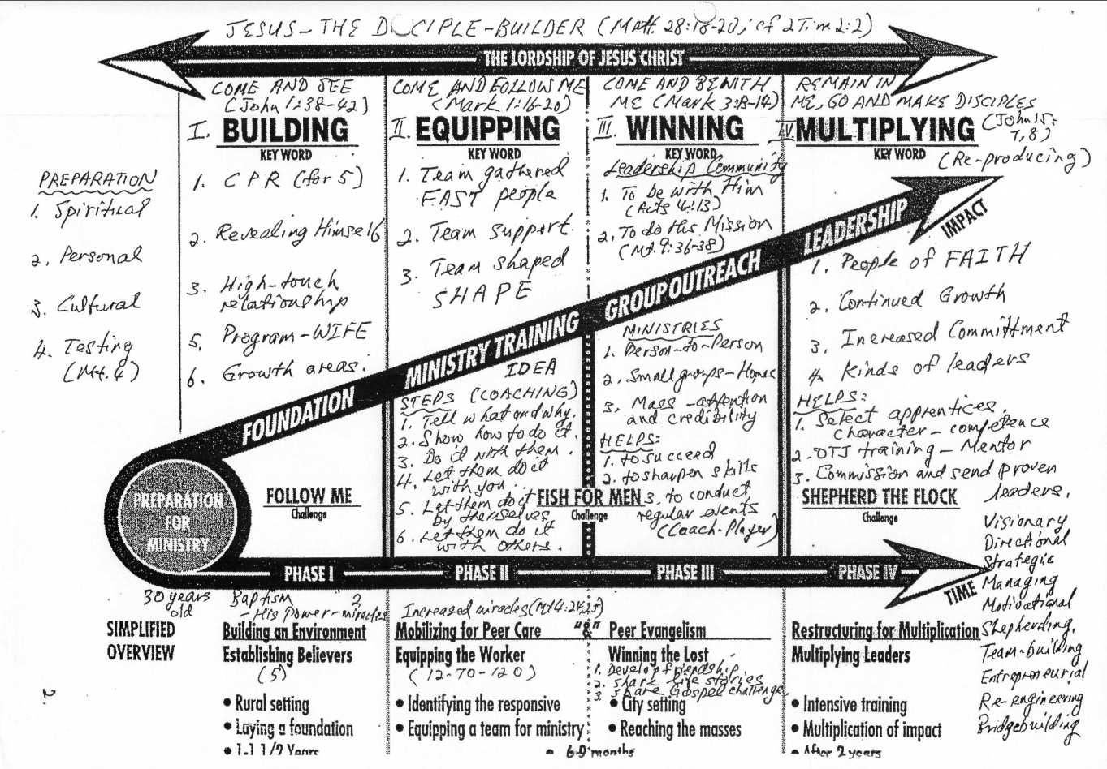

Slide 35
ASSIGNMENT 1
1. (Luke 2:52) And Jesus increased in wisdom and stature, and in favour with God and man.
Please choose two of the four growth areas.
B. In each of the two choices, list down what three activities you will do the next three months to grow more and better.

Slide 36
ASSIGNMENT 2
A Mission statement serves as a guide, guard and gauge. Please write a Mission Statement for your church or ministry.
Example: Everyday Commission Bible Church desires to glorify God by building a community of Christ-like disciples through worship, instruction, fellowship and evangelism in Singapore and into the world.

Slide 37
EVERYDAY COMMISSION
1. WHAT ONE LESSON HAVE I LEARNT?
WHAT WILL ONE PRAYER BE?

Slide 38
Email: gohsengfong@hotmail.com
WhatsApp: +65-98207783
Website: www.FaithAtWorkFellowship.org

