Slide 1
EVERYDAY COMMISSION
PRESENCE OF HOLY SPIRIT
(John 14:16) And I will pray the Father, and He shall give you another Comforter, that He may abide with you for ever.

Slide 2
(Matthew 28:18-20) And Jesus came and spake unto them, saying, All power is given unto Me in heaven and in earth.
Go ye therefore, and teach all nations, baptizing them in the Name of the Father, and of the Son, and of the Holy Ghost:
Teaching them to observe all things whatsoever I have commanded you: and, lo, I am with you alway, even unto the end of the world. Amen.

Slide 3
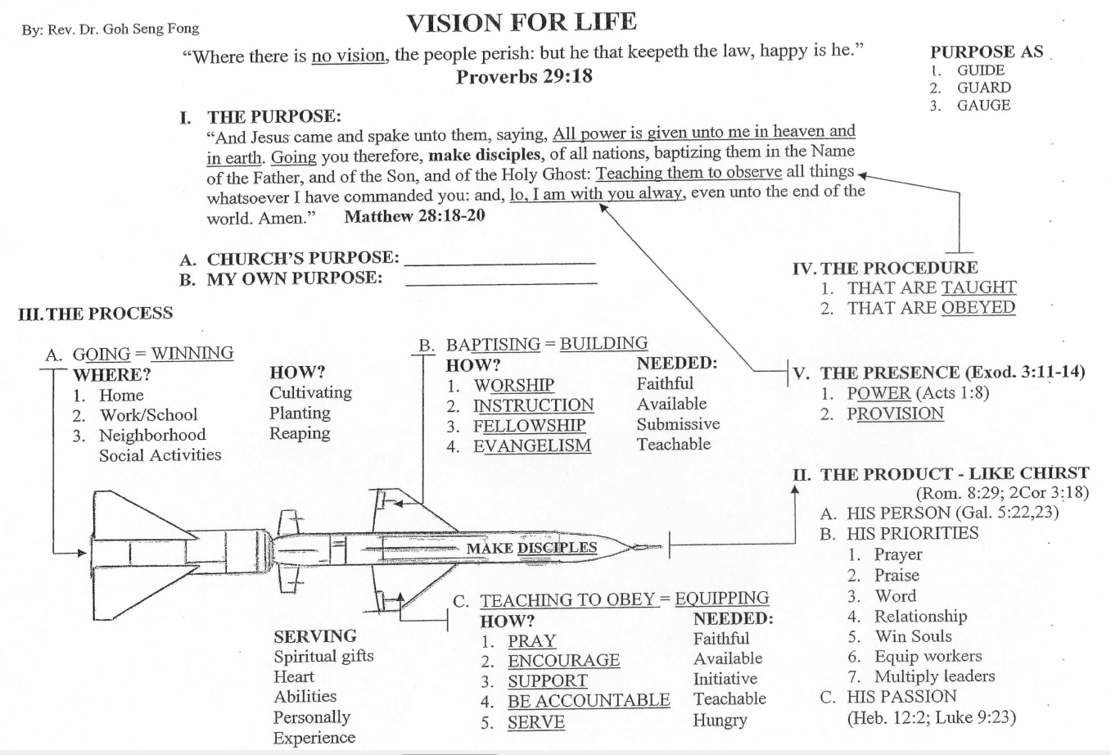

Slide 4
PURPOSE GUIDE, GUARD AND GAUGE
MY PURPOSE IS TO GLORIFY GOD BY BEING A GROWING DISCIPLE SO THAT I CAN MAKE DISCIPLES TO MAKE DISCIPLES.
EVERYDAY COMMISSION BIBLE CHURCH IS TO GLORIFY GOD BY BUILDING A COMMUNITY OF CHRIST-LIKE DISCIPLES THROUGH WORSHIP, INSTRUCTION, FELLOWSHIP AND EVANGELISM IN SINGAPORE AND INTO THE WORLD.

Slide 5
PRODUCT TO BE LIKE CHRIST
A. HIS PERSON (Gal. 5:22,23 – Fruit)
B. HIS PRIORITIES
1. PRAYER 2. PRAISE
3. WORD 4. RELATIONSHIP
5. SOUL WINNER 6. EQUIP WORKERS
7. MULTIPLY LEADERS
C. HIS PASSION (Heb. 12:2; Luke 9:23)
(Heb 12:2) Looking unto Jesus the author and finisher of our faith; who for the joy that was set before him endured the cross, despising the shame, and is set down at the right hand of the throne of God.

Slide 6
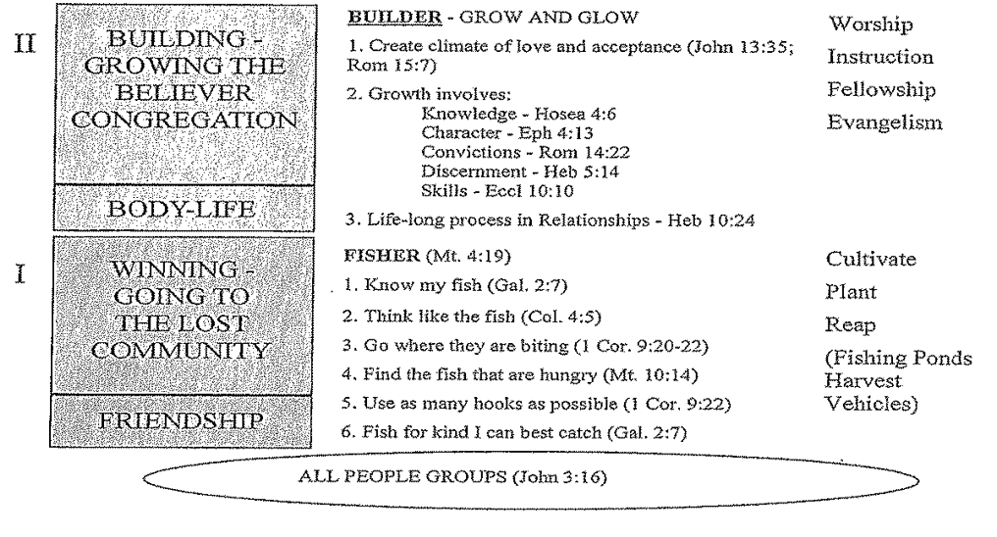

Slide 7
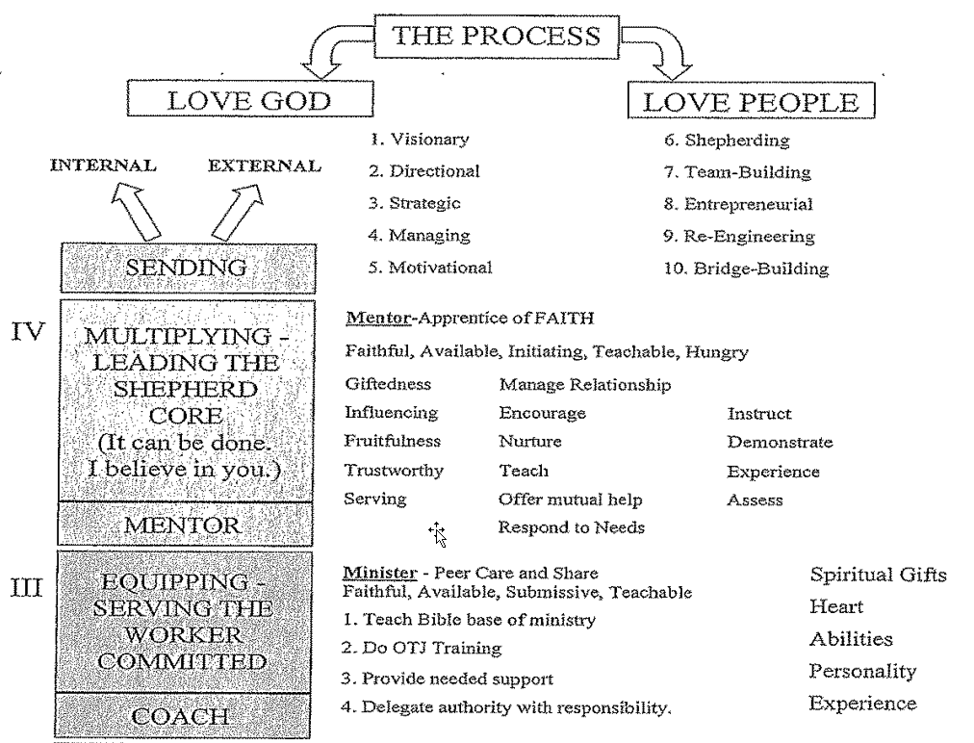

Slide 8
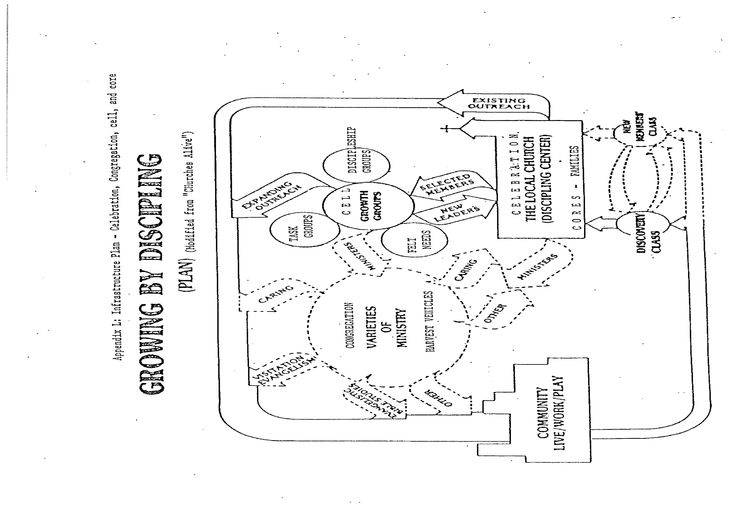

Slide 9
I. INTRODUCTION
WE ARE MADE FOR RELATIONSHIP WITH GOD AND WITH ONE ANOTHER!
REVELATION IS NEEDED!

Slide 10
I. INTRODUCTION
God has revealed Himself as One God, Who is existing eternally as One God in three distinct Persons in the Oneness in essence, in nature.
(Matthew 28:19) Go ye therefore, and teach all nations, baptizing them in the Name of the Father, and of the Son, and of the Holy Ghost:

Slide 11
I. INTRODUCTION
Each functions in His own unique role:
God the Father as the Originator; the Son, the Agent; the Holy Spirit, the Administrator.
The Father, the Architect; The Son, the Buyer; The Holy Spirit, the Occupier.

Slide 12
II. PROMISE OF THE GIFT
1) Promise of the Father (John 14:16, 26; Luke 24:49) – Heaven’s Throne Gift.
(John 14:26) But the Comforter, who is the Holy Ghost, whom the Father will send in My name, He shall teach you all things, and bring all things to your remembrance, whatsoever I have said unto you.

Slide 13
II. PROMISE OF THE GIFT
2) Promise of the Son (John 16:7) – sent by Jesus Christ.
(John 16:7) Nevertheless I tell you the truth; It is expedient for you that I go away: for if I go not away, the Comforter will not come unto you; but if I depart, I will send Him unto you.

Slide 14
II. PROMISE OF THE GIFT
3) Person and Purposes:
“Another” – of the same kind, just like Jesus (John 14:16, cf. Matt. 3:16,17; 28:19).
“Comforter” – One along-side to protect, comfort and provide – with and in us.
Spirit of Truth – to teach all truths and to glorify Jesus (John 14:17; 16:13-14).
Power for witnessing (John 16:8-11; Acts 1:8).

Slide 15
III. Two great Promises for Growth and Service
A. Security. Seek to know and understand how the Spirit provides security.
1. The Holy Spirit gives us the new birth and indwells in us (John 3:5; 1 Cor. 6:19).
2. We receive the Holy Spirit by faith (Gal. 3:2; Rom. 10:17; John 20:31).
(Galatians 3:2) This only would I learn of you, Received ye the Spirit by the works of the law, or by the hearing of faith?

Slide 16
III. Two great promises for growth and service
A. Security
3. We are sealed by the Holy Spirit (Eph. 1:13; 4:30). True ownership and acceptance.
4. He is our witness and our Spirit of Adoption.
(Romans 8:15,16) For ye have not received the spirit of bondage again to fear; but ye have received the Spirit of adoption, whereby we cry, Abba, Father. The Spirit Himself bears witness with our spirit, that we are the children of God:

Slide 17
III. Two great promises for growth and service
A. Security
6. He glorifies Christ and enables us to grow to be like Christ (John 16:13,14; Eph. 3:16).
(John 16:14) He shall glorify Me: for He shall receive of Mine, and shall shew it unto you.
(Eph 3:16) That He would grant you, according to the riches of His glory, to be strengthened with might by His Spirit in the inner man.

Slide 18
III. Two great promises for growth and service
B. Partnership. Learn what He promises and how He works.
1. He will always be with us (Psa. 139:7). Live in His Presence, moment by moment.
2. He searches our hearts (Rom. 8:27; 1 Cor. 2:10). Change my heart, O Lord.
(Psalms 139:7) Whither shall I go from Thy Spirit? or whither shall I flee from Thy Presence?

Slide 19
III. Two great promises for growth and service
B. Partnership. Learn what He promises and how He works.
3. He leads and guides (John 16:13; Acts 13:4; 16:6). Lead me and I will follow.
4. He will teach us (John 14:26; 16:13; 1 Cor. 2:13). Teach me, O Lord.
(Acts 16:6) Now when they had gone throughout Phrygia and the region of Galatia, and were forbidden of the Holy Ghost to preach the Word in Asia,

Slide 20
III. Two great promises for growth and service
B. Partnership. Learn what He promises and how He works
5. He will counsel and help us (John 14:26; 15:26; 16:13). Give me your wisdom.
6. He will fill us and control us (Rom. 8:6; Eph. 5:18). Control my will.
(Ephesians 5:18) And be not drunk with wine, wherein is excess; but be filled with the Spirit;

Slide 21
III. Two great promises for growth and service
B. Partnership
7. He will convict and correct us (John 16:8; Rom. 9:1; 1 Cor. 4:4). Convict me.
(John 16:8-11) And when He is come, He will reprove the world of sin, and of righteousness, and of judgment:
Of sin, because they believe not on Me;
Of righteousness, because I go to My Father, and ye see me no more;
Of judgment, because the prince of this world is judged.

Slide 22
III. Two great promises for growth and service
B. Partnership
8. He will change us (2 Cor. 3:18; Gal. 3:3). Make me like Jesus.
9. He helps us live His life (Rom. 8:2; 4-6; 9,11,13,26). Live in and through me.
(2 Corinthians 3:18) But we all, with open face beholding as in a glass the Glory of the Lord, are changed into the same Image from glory to glory, even as by the Spirit of the Lord.

Slide 23
III. Two great promises for growth and service
B. Partnership
10. He gives us gifts for ministry (1 Cor. 12:2-12). Enable me to be faithful.
S – SPIRITUAL GIFTS
H – HEART
A – ABILITY
P – PERSONALITY
E – EXPERIENCE

Slide 24
HIS ACTS – GIFTING
(i) Varieties of gifts: speaking, people intensive and services (1 Cor. 12:4-11; 14:20-33; Eph. 4:11-16; 1 Peter 4:10-11; Romans 12:-8).
(ii) Purposes
1. To glorify God (Rev 4:11; 1 Pet. 4:10-11)
2. To build up the church (Eph. 4:1-7; 1 Cor. 12:7; 14:12)
3. To extend witness and ministry (Eph. 4:1-12; 1 Cor. 14:20-25)

Slide 25
BE BEING FILLED!
(Ephesians 5:18-21) And be not drunk with wine, wherein is excess; but be filled with the Spirit;
Speaking to yourselves in psalms and hymns and spiritual songs, singing and making melody in your heart to the Lord;
Giving thanks always for all things unto God and the Father in the name of our Lord Jesus Christ;
Submitting yourselves one to another in the fear of God.

Slide 27
BE BEING FILLED!
A. Study of the word “fill”:
1. Wind’s filling a sail to move a ship along (2 Peter 1:21).
2. Idea of permeation – salt permeating meat (cf. Acts 4:13).
3. Idea of control of someone or some emotions (John 16:6; Luke 5:26; 6:11).
4. Filling of Jesus (Luke 4:1), of men (Acts 6:5), of Stephen (Acts 7:55).

Slide 28
BE BEING FILLED!
B. The Greek verb – present, passive imperative – “Be being filled by the Spirit.”
1. Imperative – a biblical command, not an option
2. Present – a moment by moment present continuous filling or controlling
3. Passive – believer is the receiver. He is controlled by the Spirit.

Slide 29
HOW TO BE FILLED!
1. Make sure of right relationships with God and man.
(Psalms 66:18) If I regard iniquity in my heart, the Lord will not hear me:
(1 John 1:9) If we confess our sins, He is faithful and just to forgive us our sins, and to cleanse us from all unrighteousness.

Slide 30
BE BEING FILLED!
2. Surrender and yield to Spirit’s control .
A) (1 Corinthians 15:31) I die daily.
B) (Romans 6:13) Neither yield ye your members as instruments of unrighteousness unto sin: but yield yourselves unto God, as those that are alive from the dead, and your members as instruments of righteousness unto God.
C) Be controlled by the Holy Spirit (Eph. 5:18; Gal. 2:20).

Slide 31
DYING AND YIELDING
Lord, here is my mind. (other members too)
I die to what I am thinking.
Please think in and through me.
(Lord, live, love and labour in and through me.)
(Gal 2:20) I am crucified with Christ: nevertheless I live; yet not I, but Christ lives in me: and the life which I now live in the flesh I live by the faith of the Son of God, who loved me, and gave Himself for me.

Slide 32
HOW TO BE FILLED!
3. Saturate in and meditate on God’s Word.
(Ephesians 5:18,19) … but be filled with the Spirit;
Speaking to yourselves in psalms and hymns and spiritual songs, singing and making melody in your heart to the Lord.
(Colossians 3:16) Let the Word of Christ dwell in you richly in all wisdom; teaching and admonishing one another in psalms and hymns and spiritual songs, singing with grace in your hearts to the Lord.

Slide 33
HOW TO BE FILLED!
4. Obey Him and Act on that obedience
(Hebrews 5:8) Though He were the Son, yet learned He obedience by the things which He suffered;
(1 John 3:21) Beloved, if our heart condemn us not, then have we confidence toward God.
(1 John 3:22) And whatsoever we ask, we receive of Him, because we keep His commandments, and do those things that are pleasing in His sight.

Slide 34
RESULTS OF FILLING
1. Inward – Singing and Praising Saints (Eph. 5:19; Col. 3:16).
(Ephesians 5:19) Speaking to yourselves in psalms and hymns and spiritual songs, singing and making melody in your heart to the Lord;

Slide 35
RESULTS OF FILLING
2. Upward – Praying and Giving thanks
(Ephesians 6:18) Praying always with all prayer and supplication in the Spirit, and watching thereunto with all perseverance and supplication for all saints;
(1 Thessalonians 5:18) In every thing give thanks: for this is the will of God in Christ Jesus concerning you.

Slide 36
RESULTS OF FILLING
3. Outward – Submitting Saints
(Ephesians 5:21) Submitting yourselves one to another in the fear of God.
(James 4:6) But He gives more grace. Wherefore He says, God resists the proud, but gives grace unto the humble. (No pretence, presumption, pushing).
(James 4:7) Submit yourselves therefore to God. Resist the devil, and he will flee from you.

Slide 37
RESULTS OF FILLING
4. Godward – Glorifying Jesus (John 16:13,14) in witness (Acts 4:31).
(Acts 4:31 ) And when they had prayed, the place was shaken where they were assembled together; and they were all filled with the Holy Ghost, and they spoke the Word of God with boldness.

Slide 38
RESULTS OF FILLING
5. INNER Strengthening in fruit (Eph. 3:16; Gal. 5:22,23).
(Galatians 5:22,23) But the fruit of the Spirit is love, joy, peace, longsuffering, gentleness, goodness, faith,
Meekness, temperance: against such there is no law.

Slide 39
FRUIT
Fruit – symbolic use, wealth of images.
Pleasant association, appealing to senses of touch, sight, smell and taste.
Belongs to the garden, to the world of beauty, fragrance, growth and maturity.
Thus the product of human nature can be beautiful, useful and satisfying.
Priority to bear fruit of good words (Mt. 12:33-35), deeds (Mt. 7:15-23) and virtue (Eph. 5:9, good, right and true).

Slide 40
FRUIT
Fruit, not fruits – singular
Evil is plural (Gal. 5:19-21), at least 15 works of the flesh.
In reconciliation, the Spirit integrates and unifies the personality in Christ.
The one reality to which we response to is love (Rom. 8:39; 5:5), the other eight are graces or aspects of love; just as there is one rainbow and many colors.
There is no growth apart from the growth of all others as a whole.
However there is place for the practice and exercise of each if each has already been received as gift from God..

Slide 41
THE GREATEST IS LOVE
Fifteen facets of Love (1 Cor. 13) – look at Jesus and Him crucified.
Two affirmations are followed by eight negatives and one positive.
Four descriptions of what loves does, each including the word “all”.

Slide 42
THE GREATEST IS LOVE
(1Co 13:4) Charity suffers long, and is kind; charity envies not; charity vaunts not itself, is not puffed up,
(1Co 13:5) Doth not behave itself unseemly, seeks not her own, is not easily provoked, thinks no evil;
(1Co 13:6) Rejoices not in iniquity, but rejoices in the truth;
(1Co 13:7) Bears all things, believes all things, hopes all things, endures all things.

Slide 43
THE GREATEST IS LOVE
3. Four Reasons for its Primacy
(1) Love includes the other virtues.
There is one fruit, the love of God shed abroad our hearts by the Spirit (Rom. 5:5).
The eight virtues are aspects, ways in which love responds to God and to people.
(2) Love binds everyone and everything together.
Above all, put on love (Col. 3:12-14) – to keep all virtues together.
Love corrects any distortions, complements defects and maintains proper relationships.
In context of community of various races and genders, love binds in perfect harmony.

Slide 44
THE GREATEST IS LOVE
(3) Love fulfills the Law (Deut. 6:4-5; Mark 12:28-30).
Loving God and loving people go together; they are inseparable (1 John 4:20).
On these two depend all the law and prophets (Mt. 22:40; Gal. 5:14; Rom. 13:9).
(4) Love makes fruitful
The gifts of the Spirit are effective when exercised in love (1 Cor. 8:1).
Without love, even the greatest gifts are worthless (1 Cor. 13:1-3).

Slide 45
WORKING WITH THE HOLY SPIRIT
WAYS TO GROW IN LOVE - taught by God (1 Thess. 4:8-9).
(1) Response – Loving God is our response to His initiative in Christ.
We cannot produce love for God by act of will.
Looking upon Jesus, we love Him as we have love from the Spirit (Rom. 5:5).
(2) Indebtedness – intensity depends upon the depth of our experience of forgiveness.
As our awareness of our indebtedness increases, so does our love.
These two “a great sinner” and “a great Savior” increases and deepens our love.

Slide 46
WORKING WITH HOLY SPIRIT
(3) Attention: We must establish the habit of attending to the things of God (Rom. 8:5).
Set our minds (Col. 3:1, 2) – attitude of the mind.
Run the race, with eyes fixed on Jesus (Heb. 2:2).
Keep on exposing self to light of God’s glory (2 Cor. 3:18).

Slide 47
WORKING WITH HOLY SPIRIT
(4) Devotion: Practice His Presence, by recollection, private prayer and public worship.
Near to beginning and end of day, set aside time to read Word and pray (Acts 4:13).
Mini-times in the day: Stop, Focus, Be silent, Song or Scriptures.
Celebrate with God’s people in small groups, fellowship groups and church services.

Slide 48
WORKING WITH HOLY SPIRIT
(5) Restraint: Between the old man and the new man, there is tension, conflict (Col. 3:9,10).
Die to self daily (1 Cor. 15:31).
Yield members of body to Him (Rom. 6:13)
Be controlled by the Holy Spirit (Eph. 5:18; Gal. 2:20).
Believe and thank Him (Gal. 3:14; Rom. 14:23; Luke 11:13).

Slide 49
WORKING WITH HOLY SPIRIT
(6) Practice: Exercise is necessary to physical as well as spiritual growth and health.
Love grows by actions, by means of intentionally doing good, like Jesus (Acts. 10:38cf. Acts 9:36).
God supplies the garments, the armour and we must put them on (Eph. 6:11).
To become a Christian, is to enter into fellowship with Christ and community, for comfort, strength and accountability (2 Tim. 2:22; Heb. 10:24,25).
The tree on which the nine aspects are produced is the community. How we related to others is the supreme test of our character(1 John 4:20)

Slide 50
FRUIT OF THE HOLY SPIRIT IN COMMUNITY (Acts 2:41-47)
(Acts 2:41) Then they that gladly received his word were baptized: and the same day there were added unto them about three thousand souls.
(Acts 2:42) And they continued steadfastly in the apostles' doctrine and fellowship, and in breaking of bread, and in prayers.

Slide 51
FRUIT OF THE HOLY SPIRIT IN COMMUNITY (Acts 2:41-47)
(Acts 2:43) And fear came upon every soul: and many wonders and signs were done by the apostles.
(Acts 2:44) And all that believed were together, and had all things common;
(Acts 2:45) And sold their possessions and goods, and parted them to all men, as every man had need.

Slide 52
FRUIT OF THE HOLY SPIRIT IN COMMUNITY (Acts 2:41-47)
(Acts 2:46) And they, continuing daily with one accord in the temple, and breaking bread from house to house, did eat their meat with gladness and singleness of heart,
(Acts 2:47) Praising God, and having favour with all the people. And the Lord added to the church daily such as should be saved.

Slide 53
I. THE REALITY ON THE GROUND
WORK IN PROGRESS
a. Counterfeits (Acts 5:1-11). God took care.
(Acts 5:4) Whiles it remained, was it not thine own? and after it was sold, was it not in thine own power? why hast thou conceived this thing in thine heart? thou hast not lied unto men, but unto God.
(Acts 5:5) And Ananias hearing these words fell down, and gave up the ghost: and great fear came on all them that heard these things.

Slide 54
I. THE REALITY ON THE GROUND
WORK IN PROGRESS
b. Fears and Persecution (Acts 5, 8).
Prayed and counted it joy to suffer.
(Acts 5:41) And they departed from the presence of the council, rejoicing that they were counted worthy to suffer shame for his name.
(Acts 5:42) And daily in the temple, and in every house, they ceased not to teach and preach Jesus Christ.

Slide 55
I. THE REALITY ON THE GROUND
WORK IN PROGRESS
c. Widows not taken care of (Acts 6)
Leaders elected … judgment calls made.
(Acts 6:1,2) And in those days, when the number of the disciples was multiplied, there arose a murmuring of the Grecians against the Hebrews, because their widows were neglected in the daily ministration.
Then the twelve called the multitude of the disciples unto them, and said, It is not reason that we should leave the Word of God, and serve tables.

Slide 56
I. THE REALITY ON THE GROUND
WORK IN PROGRESS
d. New believers from Gentiles (Acts 10)
Gospel for all. God decided.
(Acts 15:13,14) And after they had held their peace, James answered, saying, Men and brethren, hearken unto me:
Simeon hath declared how God at the first did visit the Gentiles, to take out of them a people for His Name.

Slide 57
I. THE REALITY ON THE GROUND
WORK IN PROGRESS
e. New leaders added (Acts 13, Paul and Barnabas)
Leadership took time… Paul two years in desert.
Leadership problems – Paul and Barnabas
(Acts 15:39) And the contention was so sharp between them, that they departed asunder one from the other: and so Barnabas took Mark, and sailed unto Cyprus;

Slide 58
FOUR ELEMENTS OF STEDFASTNESS
(Acts 2:42) And they continued steadfastly in the Apostles' doctrine
and fellowship,
and in breaking of bread,
and in prayers.

Slide 59
II. FOUR ELEMENTS OF STEDFASTNESS
A. Apostles’ Doctrines
1. Main source of nurture and strength
2. Faith and lives developed
3. Serving from overflow.

Slide 60
II. FOUR ELEMENTS OF STEDFASTNESS
B. Fellowship
1. Unity with the Lord and one another
Open hearts, giving freedom to grow – Commitment, Accountability and transparency.
CARE needed – C – Connect; A – Accept; R – Respond; E – Endure

Slide 61
II. FOUR ELEMENTS OF STEDFASTNESS
B. Fellowship
Open hearts – one another
Open hands, giving to needs –
Physical needs and comfort
(e.g. Dorcas, Acts 9:36; Jesus, Acts 10:38)

Slide 62
II. FOUR ELEMENTS OF STEDFASTNESS
Fellowship
Building relationships
a. Listen attentively with third ear.
b. Self-give with understanding and patience.
c. Serve in practical ways.
d. Forgive as we have been forgiven.

Slide 63
II. FOUR ELEMENTS OF STEDFASTNESS
C. Breaking of Bread
1. Love meal, communal feast.
2. Time for fellowship, at temple and from house to house.
3. Caring, sharing and working through problems.
(Acts 6, murmurings ; 15, gentiles problem)

Slide 64
II. FOUR ELEMENTS OF STEDFASTNESS
D. Prayer
1. Relationship with God nurtures worship, love and service.
2. Calling and waiting upon His resources
3. Changes us, people and circumstances.
4. Nurturing involvement in things prayed for.

Slide 65
III. PATTERN OF SPIRIT’S VISITATION
Great Grace
(Acts 4:33) And with great power gave the Apostles witness of the resurrection of the Lord Jesus: and great grace was upon them all.
(2 Corinthians 9:8) And God is able to make all grace abound toward you; that ye, always having all sufficiency in all things, may abound to every good work:

Slide 66
III. PATTERN OF SPIRIT’S VISITATION
A. Great Grace
1. In Perfect Concord
(Acts 4:32) And the multitude of them that believed were of one heart and of one soul: neither said any of them that ought of the things which he possessed was his own; but they had all things common.

Slide 67
III. PATTERN OF SPIRIT’S VISITATION
Great Grace
2. In Perfect Charity
(Acts 2:44) And all that believed were together, and had all things common;
(Acts 2:45) And sold their possessions and goods, and parted them to all men, as every man had need.

Slide 68
III. PATTERN OF SPIRIT’S VISITATION
Great Grace
3. In Prevailing Calm
(Acts 5:41) And they departed from the presence of the council, rejoicing that they were counted worthy to suffer shame for his name.
(Acts 5:42) And daily in the temple, and in every house, they ceased not to teach and preach Jesus Christ.

Slide 69
III. PATTERN OF SPIRIT’S VISITATION
Great Power
(Acts 4:33) And with great power gave the Apostles witness of the resurrection of the Lord Jesus: and great grace was upon them all.
1. In Wrestling
(Acts 4:31) And when they had prayed, the place was shaken where they were assembled together; and they were all filled with the Holy Ghost, and they spoke the Word of God with boldness.

Slide 70
III. PATTERN OF SPIRIT’S VISITATION
Great Power
In Witnessing
(Acts 4:31) And when they had prayed, the place was shaken where they were assembled together; and they were all filled with the Holy Ghost, and they spoke the Word of God with boldness.

Slide 71
III. PATTERN OF SPIRIT’S VISITATION
Great Power
In Wonders
(Acts 2:44) And all that believed were together, and had all things common;
(Acts 2:45) And sold their possessions and goods, and parted them to all men, as every man had need.

Slide 72
III. PATTERN OF SPIRIT’S VISITATION
Great Fear
Inside the Assembly
(Acts 5:11) And great fear came upon all the church, and upon as many as heard these things.
Outside the Assembly
(Acts 5:13) And of the rest dared no man join himself to them: but the people magnified them.

Slide 73
III. PATTERN OF SPIRIT’S VISITATION
Great Fear (Acts 5:11)
Among the demons
(Acts 5:16) There came also a multitude out of the cities round about unto Jerusalem, bringing sick folks, and them which were vexed with unclean spirits: and they were healed every one.
(Act 19:15) And the evil spirit answered and said, Jesus I know, and Paul I know; but who are ye?

Slide 74
III. PATTERN OF SPIRIT’S VISITATION
Great Increase
(Acts 5:14) And believers were the more added to the Lord, multitudes both of men and women.
1. Addition
(Acts 2:41) Then they that gladly received his word were baptized: and the same day there were added unto them about three thousand souls.
More Addition
(Acts 5:14) And believers were the more added to the Lord, multitudes both of men and women.

Slide 75
III. PATTERN OF SPIRIT’S VISITATION
Great Increase
Multiplication
(Acts 6:7) And the Word of God increased; and the number of the disciples multiplied in Jerusalem greatly; and a great company of the priests were obedient to the faith.
4. Thousands
(Act 21:20) And when they heard it, they glorified the Lord, and said unto him, Thou seest, brother, how many thousands of Jews there are which believe; and they are all zealous of the law:

Slide 76
Holy Spirit, what a wonder You are!
Thank You for making me with such high potential – to think and to act like Jesus and to be One with You.
When I mess up, You do not give up. Thank You for taking my broken life and transforming me to be like Jesus.
Thank You for revealing to me what You want me to be and how I can become what You plan.
Thank You for growing me up into the likeness of Jesus and thank You for the growth that lies ahead.
Thank You for companioning with me daily, and for giving those wonderful weapons to win out in life: Prayer, the Word and Your people.

Slide 77
I desire to be a faithful reflection of You. I desire to be used of You to the maximum.
My life will honour You only by Your work in and through me, so I ask with confidence that you work powerfully Your will and promises.
I desire to walk with You all the days of my life. I do trust and love You.
Here is my life, body, soul and spirit – all of it, past, present and future, for You to do as You please.
I am Yours, gladly and forever.
To the praise of the Glory and Grace of God, the Father, God, the Son and God, the Holy Spirit.
Amen

Slide 78
ASSIGNMENTS
Which of the elements are you and the church doing well and why? 1. Apostles’ Teaching; 2. Fellowship; 3. Breaking of Bread; 4. Prayer; 5. Witnessing
How desperate are you for the Holy Spirit to visit you in which area/s and why?
1. Great Grace 2. Great Power 3. Great Fear 4. Great Increase
C. Please assess your reasons why and how you desire to be being filled with the Spirit.

Slide 79
PRESENCE OF SPIRIT
WHAT ONE LESSON HAVE I LEARNT?
WHAT WILL BE ONE PRAYER I HAVE?

Slide 80
Email: gohsengfong@hotmail.com
WhatsApp: +65-98207783
Website: www.faithatworkfellowship.org

