Slide 1
EVERYDAY COMMISSION PROCESS – WIN THE LOST
(Pro 11:30) The fruit of the righteous is a tree of life; and he that wins souls is wise. Eternal wisdom
(Dan 12:3) And they that be wise shall shine as the brightness of the firmament; and they that turn many to righteousness as the stars for ever and ever.

Slide 2
(Matthew 28:18-20) And Jesus came and spake unto them, saying, All power is given unto Me in heaven and in earth.
Go ye therefore, and teach all nations, baptizing them in the Name of the Father, and of the Son, and of the Holy Ghost:
Teaching them to observe all things whatsoever I have commanded you: and, lo, I am with you alway, even unto the end of the world. Amen.

Slide 3
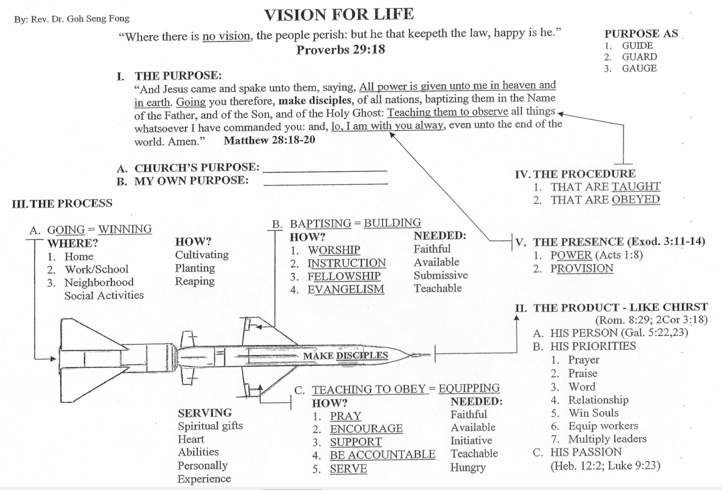

Slide 4
PURPOSE GUIDE, GUARD AND GAUGE
MY PURPOSE IS TO GLORIFY GOD BY BEING A GROWING DISCIPLE SO THAT I CAN MAKE DISCIPLES TO MAKE DISCIPLES.
EVERYDAY COMMISSION BIBLE CHURCH IS TO GLORIFY GOD BY BUILDING A COMMUNITY OF CHRIST-LIKE DISCIPLES THROUGH WORSHIP, INSTRUCTION, FELLOWSHIP AND EVANGELISM IN SINGAPORE AND INTO THE WORLD.

Slide 5
PRODUCT TO BE LIKE CHRIST
A. HIS PERSON (Gal. 5:22,23 – Fruit)
B. HIS PRIORITIES
1. PRAYER 2. PRAISE
3. WORD 4. RELATIONSHIP
5. SOUL WINNER 6. EQUIP WORKERS
7. MULTIPLY LEADERS
C. HIS PASSION (Heb. 12:2; Luke 9:23)
(Heb 12:2) Looking unto Jesus the author and finisher of our faith; who for the joy that was set before him endured the cross, despising the shame, and is set down at the right hand of the throne of God.

Slide 6
Relational in Outreach
What do you think when you hear the word….
EVANGELISM ?
Why do you think that way?
How do you act?

Slide 7
FEARS
1) Rejection
2) Ridicule
3) Failure
4) Bodily Injury
5) Hypocrisy
6) Not knowing what to say
7) Not knowing how a person may response
8) Trying something unfamiliar
9) Not able to answer questions

Slide 8
FEARS
10) Intruding into private lives
11) Bad past experiences
12) Fear my fears will show
13) Not worthy to share
14) May say something wrong
15) Gospel may not be effective in that situation.

Slide 9
EVERYDAY COMMISSION PROCESS – WIN THE LOST
(2Co 5:20) Now then we are ambassadors for Christ, as though God did beseech you by us: we pray you in Christ's stead, be ye reconciled to God.
(1Co 9:22) To the weak became I as weak, that I might gain the weak: I am made all things to all men, that I might by all means save some.

Slide 10
INTRODUCTION
GOD IS IN THE SOUL SAVING BUSINESS
1. God the Father
(John 3:16) For God so loved the world, that He gave His only begotten Son, that whosoever believes in Him should not perish, but have everlasting life.
2. God the Son, Jesus Christ
(Luke 19:10) For the Son of man is come to seek and to save that which was lost.

Slide 11
INTRODUCTION
GOD IS IN THE SOUL SAVING BUSINESS
3. God the Holy Spirit
(Acts 1:8) But you shall receive power, after that the Holy Ghost is come upon you: and you shall be witnesses unto Me both in Jerusalem, and in all Judaea, and in Samaria, and unto the uttermost part of the earth.
NEAREST AND DEAREST TO GOD’S HEART.
ONE IN COMMUNION, UNITY AND MISSION

Slide 12
DEFINITION
Winning souls is life-long process
of sharing the Good News of Jesus Christ,
in the love of God,
by the power of the Holy Spirit
and leaving the results to God.

Slide 13
WHY NO WITNESSING
1. “God gives the increase and we are not accountable for the fruit.” (1 Cor. 3:6; cf. Romans 10:14; Gal. 6:8,9; Acts 14:1, Paul spoke and many believed)
(Gal 6:9) And let us not be weary in well doing: for in due season we shall reap, if we faint not.
2. “Are some called to sow and others to reap?”
(Psa 126:5) They that sow in tears shall reap in joy.

Slide 14
WHY NO WITNESSING
3. “Some are called to simply feed the sheep.” (John 21:15-17; cf. Peter in Acts 2:41; Isa. 53:6; Matt. 9:36, the sheep, the lost)
(Isa 53:6) All we like sheep have gone astray; we have turned every one to his own way; and the LORD hath laid on Him the iniquity of us all.
(Mat 9:36) But when He saw the multitudes, He was moved with compassion on them, because they fainted, and were scattered abroad, as sheep having no shepherd.

Slide 15
WHY NO WITNESSING
4. “Does God give the gift of soul winning to some?”
(Acts 1:8; Acts 20:20,31; Psalm 126:5,6, sowing with tears)
(Luk 14:23) And the lord said unto the servant, Go out into the highways and hedges, and compel them to come in, that my house may be filled.
(Act 20:20) And how I kept back nothing that was profitable unto you, but have shewed you, and have taught you publicly, and from house to house,

Slide 16
WHY NO WITNESSING
5. “Others of other religions are hard to save.”
(Gal. 6:9) Faith of William Carey and A. Judson
(Rom 1:16) For I am not ashamed of the Gospel of Christ: for it is the power of God unto salvation to every one that believeth; to the Jew first, and also to the Greek.
(Psa 126:6) He that goeth forth and weepeth, bearing precious seed, shall doubtless come again with rejoicing, bringing his sheaves with him.

Slide 17
WHY WITNESSING
1. Obedience to Christ (Great Commission, Matt. 28:18-20; Repeated in Rev. 22:16,17)
(Mark 16:15) And He said unto them, Go ye into all the world, and preach the gospel to every creature. To obey is better than sacrifice (1 Sam. 15:22,23). Watch out for sin of omission.
2. Love for Christ (John 14:15, 23, 24; Peter in John 21:15-17, Acts 2:41; Paul in Acts 16)
(Jn 14:15) If ye love me, keep my commandments. With love, we do the first work (Rev. 2:4,5). Watch out for busyness and envy.

Slide 18
WHY WITNESSING
3. Following Christ (Matt. 4:19, to Nicodemus, woman at well, Gadarene demoniac, etc.)
Fishers of men must fish. Go, think and find the fish that are hungry and biting.
4. Paying the Gospel Debt (Matt. 25:14-30; Gen. 4:9; Rom. 1:14,15; Rom. 9:1-3).
(Rom 1:14) I am debtor both to the Greeks, and to the Barbarians; both to the wise, and to the unwise.
Let us occupy till Jesus comes so as to hear His well-done, good and faithful servants

Slide 19
WHY WITNESSING
5. Living a wise life (Prov. 11:30; Daniel 12:2,3)
Souls saved are our glory and joy.
(1 Th 2:20) For ye are our glory and joy.
6. Freedom from the blood of all men (Acts 20:26-31)
(Eze 3:18) When I say unto the wicked, Thou shalt surely die; and thou givest him not warning, nor speakest to warn the wicked from his wicked way, to save his life; the same wicked man shall die in his iniquity; but his blood will I require at thine hand.
Let us go forth with His Gospel with tears in our eyes.

Slide 20
INTRUMENTS INVOLVED
THE GOSPEL – THE SEED CAST FORTH
A. Gospel as Death, Burial and Resurrection of Jesus Christ (1 Cor. 15:1-4)
B. Power of God unto salvation (Rom. 1:16)
C. Born again by the Word (1 Cor. 4:15; 1 Peter 1:23)

Slide 21
INSTRUMENTS INVOLVED
HUMAN INSTRUMENT – THE CARRIERS
1. Ambassadors of Christ (2 Cor. 5:20)
(2Co 5:20) Now then we are ambassadors for Christ, as though God did beseech you by us: we pray you in Christ's stead, be ye reconciled to God.
2. Co-laborers with one another and with God
(1Co 3:9) For we are labourers together with God: ye are God's husbandry, ye are God's building.

Slide 22
INSTRUMENTS INVOLVED
HOLY SPIRIT – THE WORKER
A. Convicts and converts
(Joh 16:8) And when He is come, He will reprove the world of sin, and of righteousness, and of judgment.
B. Born again by the Spirit
(Joh 3:5) Jesus answered, Verily, verily, I say unto thee, Except a man be born of water and of the Spirit, he cannot enter into the kingdom of God.
C. Gospel in His power (1 Thess. 1:5)
(1Th 1:5) For our gospel came not unto you in word only, but also in power, and in the Holy Ghost, and in much assurance.

Slide 23
THE REAL SOUL WINNER
THE HOLY SPIRIT
C. THE TRINITY ASSOCIATED TOGETHER
(Matthew 28:19) Go ye therefore, and teach all nations, baptizing them in the Name of the Father, and of the Son, and of the Holy Ghost:

Slide 24
THE REAL SOUL WINNER
THE HOLY SPIRIT
C. THE TRINITY ASSOCIATED TOGETHER
(2 Corinthians 13:14) The grace of the Lord Jesus Christ, and the love of God, and the communion of the Holy Ghost, be with you all. Amen.
The Trinity – One God, one essence, and yet the tri-personality of divine nature – One in Three and Three in One.

Slide 25
PROBLEMS SOLVED
A. PROBLEM OF OUR ISOLATION
(John 14:16-18) And I will pray the Father, and He shall give you another Comforter, that He may abide with you for ever;
Even the Spirit of truth; whom the world cannot receive, because it sees Him not, neither knows Him: but you know him; for He dwells with you, and shall be in you.

Slide 26
PROBLEMS SOLVED
A. PROBLEM OF OUR ISOLATION
1. His Controlling Ministry
(2 Thessalonians 2:7) For the mystery of iniquity does already work: only He who now restrains will restrain, until He be taken out of the way.
2. His Convicting Ministry
(John 16:8) And when He is come, He will reprove the world of sin, and of righteousness, and of judgment:

Slide 27
PROBLEMS SOLVED
A. PROBLEM OF OUR ISOLATION
3. His Converting Ministry
(Titus 3:5) Not by works of righteousness which we have done, but according to His mercy He saved us, by the washing of regeneration, and renewing of the Holy Ghost;

Slide 28
PROBLEMS SOLVED
A. PROBLEM OF OUR ISOLATION
4. His Conducting Ministry to conform us
a. Enables us to pray (Romans 8:14-17)
b. Strenghtens us (Eph. 3:16)
c. Changes us to same Image (2 Cor. 3:18).

Slide 29
PROBLEMS SOLVED
B. PROBLEM OF OUR IGNORANCE
1. He is our Teacher and gives good memory.
(John 14:26) But the Comforter, which is the Holy Ghost, whom the Father will send in My name, He shall teach you all things, and bring all things to your remembrance, whatsoever I have said unto you.
2. He glorifies Jesus Christ.
(John 16:14) He shall glorify Me: for He shall receive of Mine, and shall shew it unto you.

Slide 30
PROBLEMS SOLVED
C. PROBLEM OF OUR IMPOTENCE
(John 15:26,27) But when the Comforter is come, whom I will send unto you from the Father, even the Spirit of Truth, which proceeds from the Father, He shall testify of Me:
And you also shall bear witness, because you have been with Me from the beginning.

Slide 31
PROBLEMS SOLVED
C. PROBLEM OF OUR IMPOTENCE
Not what we do for God, but what He does in and through us.
We seek His mind, wisdom, guidance, direction and blessings.
We empty of ourselves and be controlled by the Spirit.

Slide 32
PROBLEMS SOLVED
D. PROBLEM OF WORLD’S INDIFFERENCE
(John 16:8-11) And when He is come, He will reprove the world of sin, and of righteousness, and of judgment:
Of sin, because they believe not on Me;
Of righteousness, because I go to My Father, and you see Me no more;
Of judgment, because the prince of this world is judged.

Slide 33
PROBLEMS SOLVED
D. PROBLEM OF WORLD’S INDIFFERENCE
Do not play God in anyone’s life.
Needed, an available Spirit-controlled witness and the spoken Gospel
Renewed faith in prayer and in the power of the Spirt and the Word.

Slide 34
PROBLEMS SOLVED
E. PROBLEM OF OUR OWN IMPERFECTION
(1 John 2:1,2) My little children, these things write I unto you, that you sin not. And if any man sin, we have an Advocate with the Father, Jesus Christ the Righteous:
And He is the propitiation for our sins: and not for ours only, but also for the sins of the whole world.

Slide 35
PROBLEMS SOLVED
E. PROBLEM OF OUR OWN IMPERFECTION
Forgiven and forgotten through confession and cleansing in the shed Blood (1 John 1:7,9).
Throw away all excuses and sort out priorities. Major on the main things!
Watch Word: Till the evangelized become the evangelists.

Slide 36
BE BEING FILLED BY THE SPIRIT (Eph. 5:18)
POSSESSED, PERMEATED OR CONTROLLED BY …
HOW?
Have a strong desire to be filled
Hunger (Matt. 5:6); Thirst (John 7:37-39)
Be willing to confess and forsake all known sin.
Confession and cleansing – 1 John 1:9

Slide 37
BE BEING FILLED BY SPIRIT
POSSESSED, PERMEATED OR CONTROLLED BY …
Have a funeral daily (1 Cor. 15:31) – Die daily!
Yield all members to God (Rom. 12:1: Rom. 6:13).
Ask the Holy Spirit to control by faith (Luke 11:13)
(Gal 3:2) This only would I learn of you, Received ye the Spirit by the works of the law, or by the hearing of faith?

Slide 38
PRAYER FOR THE BURDEN
1. PRAY BELIEVINGLY.
(Mar 11:24) Therefore I say unto you, What things soever ye desire, when ye pray, believe that ye receive them, and ye shall have them.
Faith unlocks the door. God is working in lives.
2. PRAY KNOWING GOD DOES THE IMPOSSIBLE.
(Mar 10:27) And Jesus looking upon them saith, With men it is impossible, but not with God: for with God all things are possible.
No soul too hard for the Lord to save. (Thief on cross)

Slide 39
PRAYER FOR THE BURDEN
3. PRAY ASKING GOD TO GLORIFY HIMSELF.
(Joh 14:13) And whatsoever ye shall ask in My Name, that will I do, that the Father may be glorified in the Son.
Stop sinning and spurning God’s love.
4. PRAY FOR GOD TO AWAKEN THEM.
(Mat 13:13) … because they seeing see not; and hearing they hear not, neither do they understand.
Holy Spirit, please make alive their sight, ear and heart.

Slide 40
PRAYER FOR THE BURDEN
5. PRAY CLAIMING SOULS THAT CHRIST HAD PURCHASED WITH HIS PRECIOUS BLOOD.
(2Ti 2:26) And that they may recover themselves out of the snare of the devil, who are taken captive by him at his will.
Claim and take for God that is rightfully HIS.
6. PRAY CLAIMING THE TEARING DOWN OF STRONGHOLDS.
(2Co 10:4) For the weapons of our warfare are not carnal, but mighty through God to the pulling down of strong holds.
Let Christ’s Light shine into the lies and distractions.

Slide 41
PRAYER FOR THE BURDEN
7. PRAY AND NOT GIVE UP. (Dan. 10:2, three weeks)
(Luk 18:7) And shall not God avenge His own elect, which cry day and night unto Him, though He bear long with them?
In persistent prayer, we push back the forces of evil.
Lord, lay some soul upon my heart
And love that soul through me
And may I nobly do my part
And win that soul to Thee.

Slide 42
SOULS OR FAMILIES BY FAITH
(Mar 11:22) Have faith in God.
I will prepare my life for God to work in and through me, allowing the Spirit to control me with His love and power.
I will ask God daily to give me faith to believe and a heart-thirst for Him and for souls through the reading of His Word and prayer.
I will pray daily for God to impress upon my heart, some souls or families for this year.

Slide 43
SOULS OR FAMILIES BY FAITH
I will do my best, by the Holy Spirit:
a. To pray for them morning and night and anytime God helps me to recall.
b. To build relationships and to do good works.
c. To share present blessings and testimonies.
d. To give tracts, books, tapes of music and sermons.
e. To extend invitations to harvest vehicles.
f. To present the Gospel for positive response.
g. To invite to small groups and church for community and assimilation.
h. To encourage baptism, membership and ministry.
Name of persons/families _______________________

Slide 44
STRATEGY - CULTIVATING
BUILDING RELATIONSHIPS – Circles of Concern
Family, Relatives, Friends, Neighbours, School, Workplace, Acquaintances and Strangers
F – Family members, occupation and home
I – Interests, hobbies, likes and dislikes
R – Religious and cultural background
E – Exploring beliefs in God, life and Heaven

Slide 45
STRATEGY - PLANTING
DOING GOOD TO ADD VALUE
1. Share own interests and present blessings of God.
2. Involve in their times of tension, transition and needs.
Relational and family issues, jobs and moving homes
3. Invite them to home birthdays, sporting events and Christian movie nights.
4. Invite them to home groups and church events, like Christmas, Easter and Anniversary.
5. Share own salvation experiences, before and after.

Slide 46
STRATEGY - REAPING
PERSUADING WITH THE GOSPEL (2 Cor. 5:11)
A. ROMANS ROAD
1. All have sinned (Romans 3:230.
2. Wages of sin is death (Rom. 6:23).
3. Christ died for us (Rom. 5:8).
4. Confess and Believe in Jesus (Rom. 10:9).
5. Call and you will be saved (Rom. 10:13).

Slide 47
B. “Book of Sin” illustration:
Let my left hand represent me and my right hand represents Jesus. (Hold up a book with the left hand.) This book represents my shortcomings, my sins. God loves me but He hates my sins and must punish them. (Point to the book.) Because of His great love, God sent Jesus into the world (Lift up the right hand parallel to the left.) The Bible says, “All we like sheep have gone astray. We have turned everyone to his own way. And the LORD had laid on Him the iniquity of us all” (Isa. 53:6). (As you say the words “laid on Him”, transfer the book from the left to the right hand and leave it there.) When Jesus died on the Cross, God laid on Him all our sins and guilt. Jesus was buried and our sins were buried with Him and He rose again so that we can have life with Him. This is the Good News of God for you and me.

Slide 48
Targeting Your Community For Evangelism

Slide 49
I. How to Define your Target
1. Define your target Geographically.
2. Define your Target Demographically
3. Definition your Target Culturally
4. Define your Target Spiritually
KNOW WHAT YOU ARE FISHING FOR?

Slide 50
II. Learn to Think like a fish
The Problem : The longer I am a believer,
the less I think like an unbeliever.

Slide 51
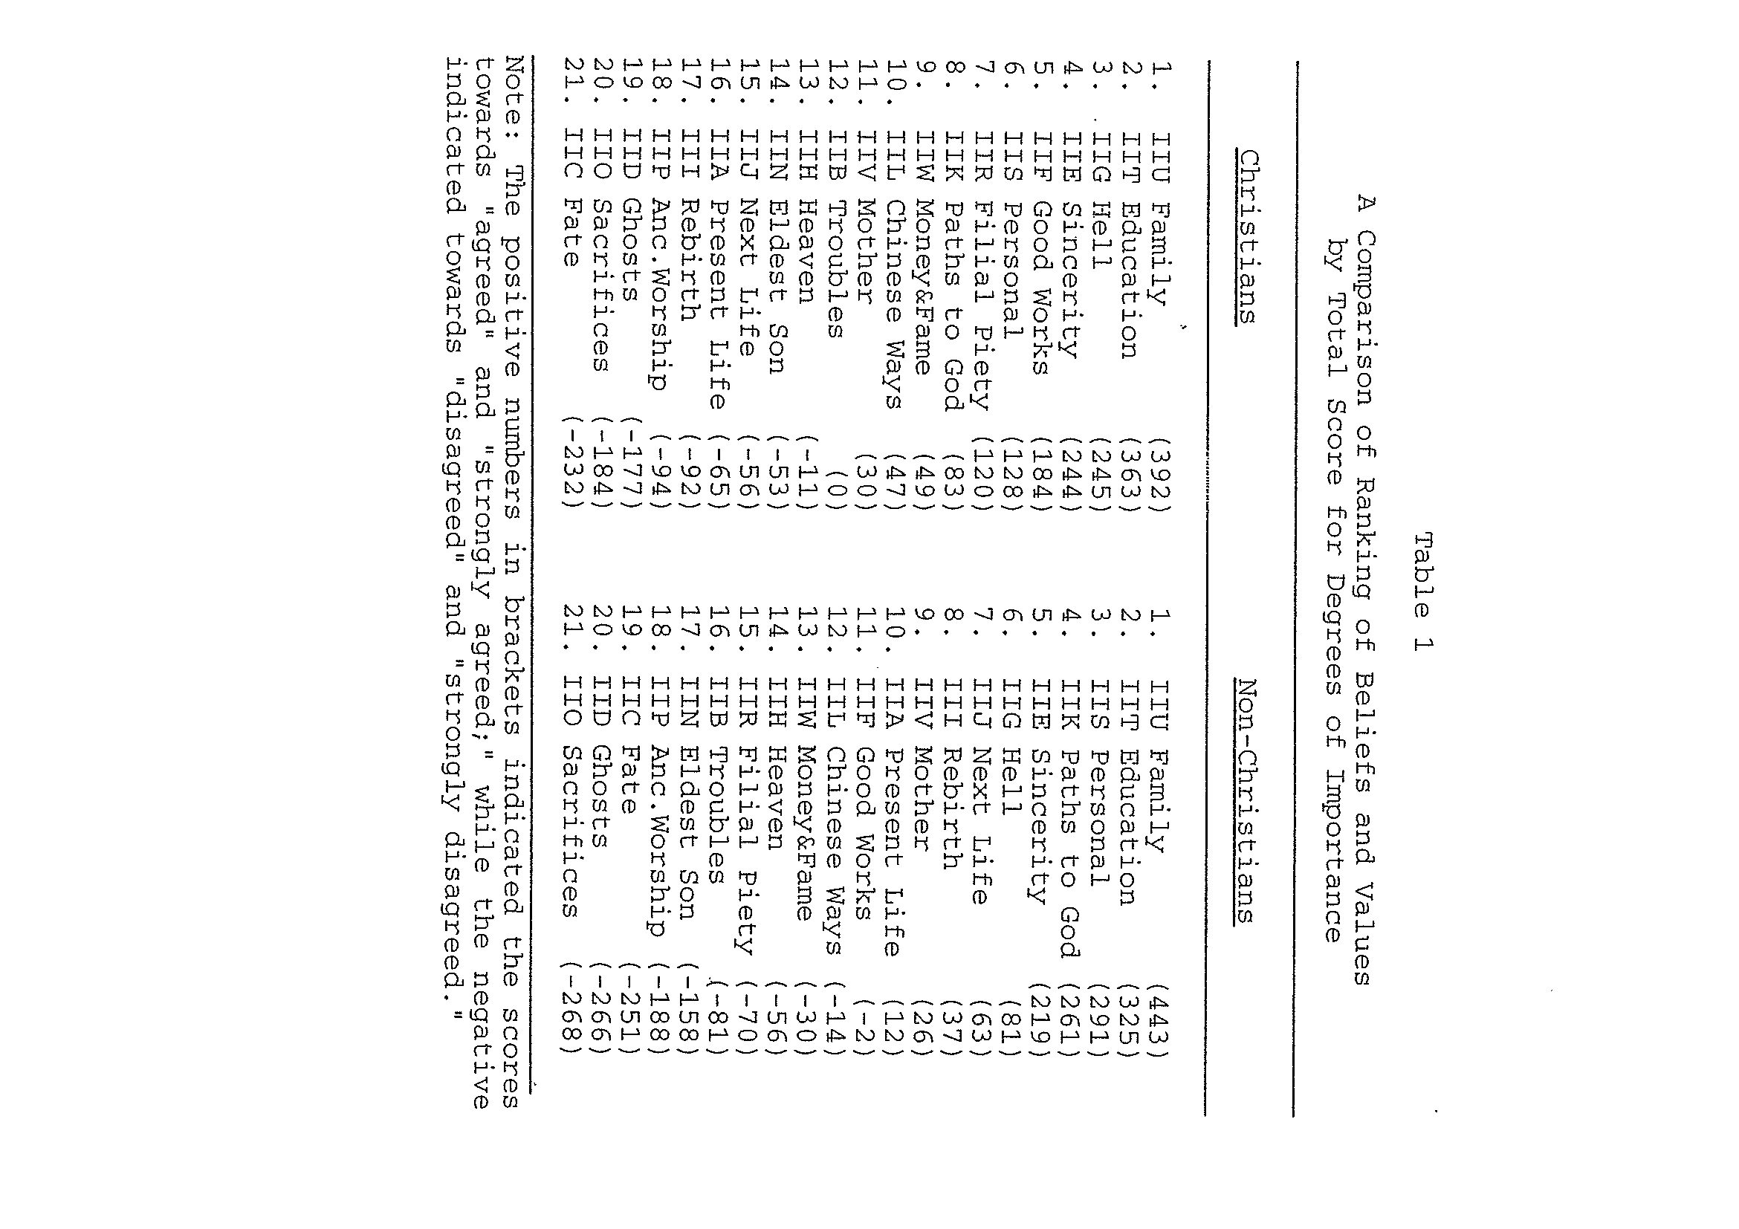

Slide 52
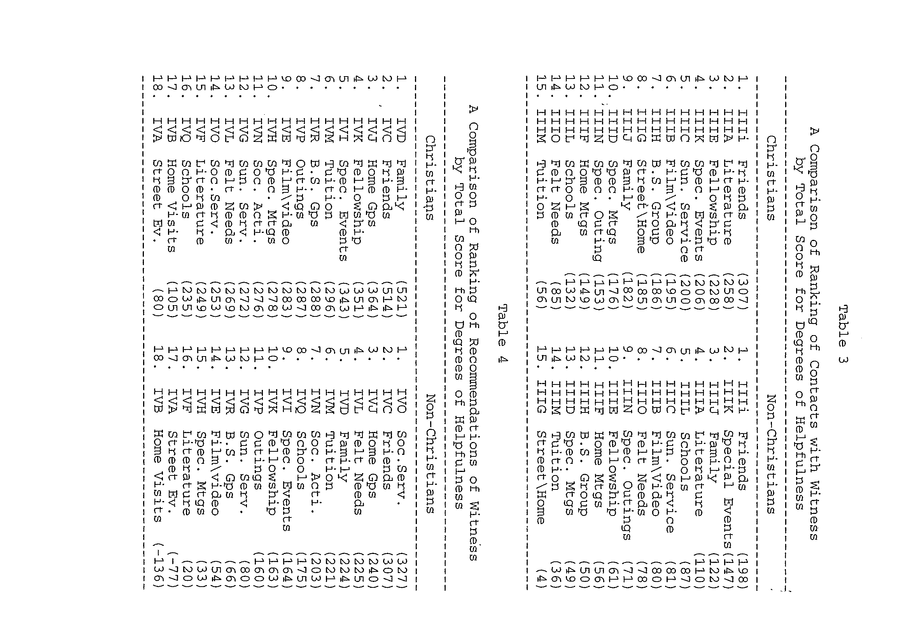

Slide 53
The Four Greatest Complaints
1. Sermons are Boring and irrelevant
2. Members are unfriendly to visitors
3. Too much emphasis on money
4. Poor childcare

Slide 54
CRITICAL BALANCE
1. FAITHFULNESS TO SCRIPTURES – original message of the Biblical text
2. CULTURE OF SELF & CHURCH – influencing the message in the Biblical text
3. CULTURE OF THE RECIPIENTS – how it speaks to their needs, the Message of the Cross and not a message of a culture

Slide 55
III. Go Where the fish are biting
Let your target determine your
Approach.

Slide 56
IV. Find the Fish that are Hungry
Those in Transition
Those in tension

Slide 57
Evangelism Strategy
The needs of unbelievers Determine our Program.
The Key: Felt Needs
The felt needs of the unchurched are primarily
emotionally and relationally.

Slide 58
The mind-set of unbelievers
Determine our Strategy.
The Culture of unbelievers
Determine our Style.

Slide 59
V. Use as many hooks as possible
The more hooks your use, the more you Catch.

Slide 60
VI. Fish for the Kind of fish
you can best catch
What kind of people
are already attending?
What kind of person am I?

Slide 61
VI. Fish for the Kind of fish
you can best catch
You can best reach people
That You relate to!’
You attract what you are not what
you want.

Slide 62
Options when your church
Doesn’t match the community:
Build on our strengths
Re-invent Congregation
Start new Congregation

Slide 63
DOORS TO WITNESSING
1. NEED FOR MORE THAN RATIONAL WITNESS
Bridge the gap by building relationships
A. Focus on People as People.
Four universal quests:
a. Longing to know and to be known
b. Longing to know who I am
c. Longing to know why I am here
d. Longing to know God

Slide 64
DOORS TO WITNESSING
NEED FOR MORE THAN RATIONAL WITNESS
B. Power of Testimonies
Faith – both personal and relational
a. John the Baptist testified of Jesus.
b. The Holy Spirit confirmed the testimony.
c. A testimony is unique, identifiable,
interesting, relevant, personal and
authoritative.
d. Share life faith stories.

Slide 65
DOORS TO WITNESSING
NEED FOR MORE THAN RATIONAL WITNESS
SPECIAL OPPORTUNITIES
a. Magnify “aloneness”, “hopelessness.
b. Magnify limits of natural revelation.
c. Appeal to common sense experience.
d. Expose power of pre-suppositions.
Discover, clarify and guide with care.

Slide 66
POSITIONING
FOUNDATIONAL PRINCIPLES
Body life and personal life (Acts 2:41-47)
Worship, Instruction, Fellowship, Evangelism
DIVINE SPIRIT WORKING (John 16:8-11)
HE is the divine Executive, the Lord of Harvest.

Slide 67
POSITIONING
3. MOBILIZED CHURCH
a. Philosophy of Ministry
b. Vision – sense of distinctive direction
c. Infrastructure – 4 Cs
Celebration – side by side for worship
Congregation – face to face for fellowship
Cells – heart to heart for edification
Core – soul to soul for oneness

Slide 68
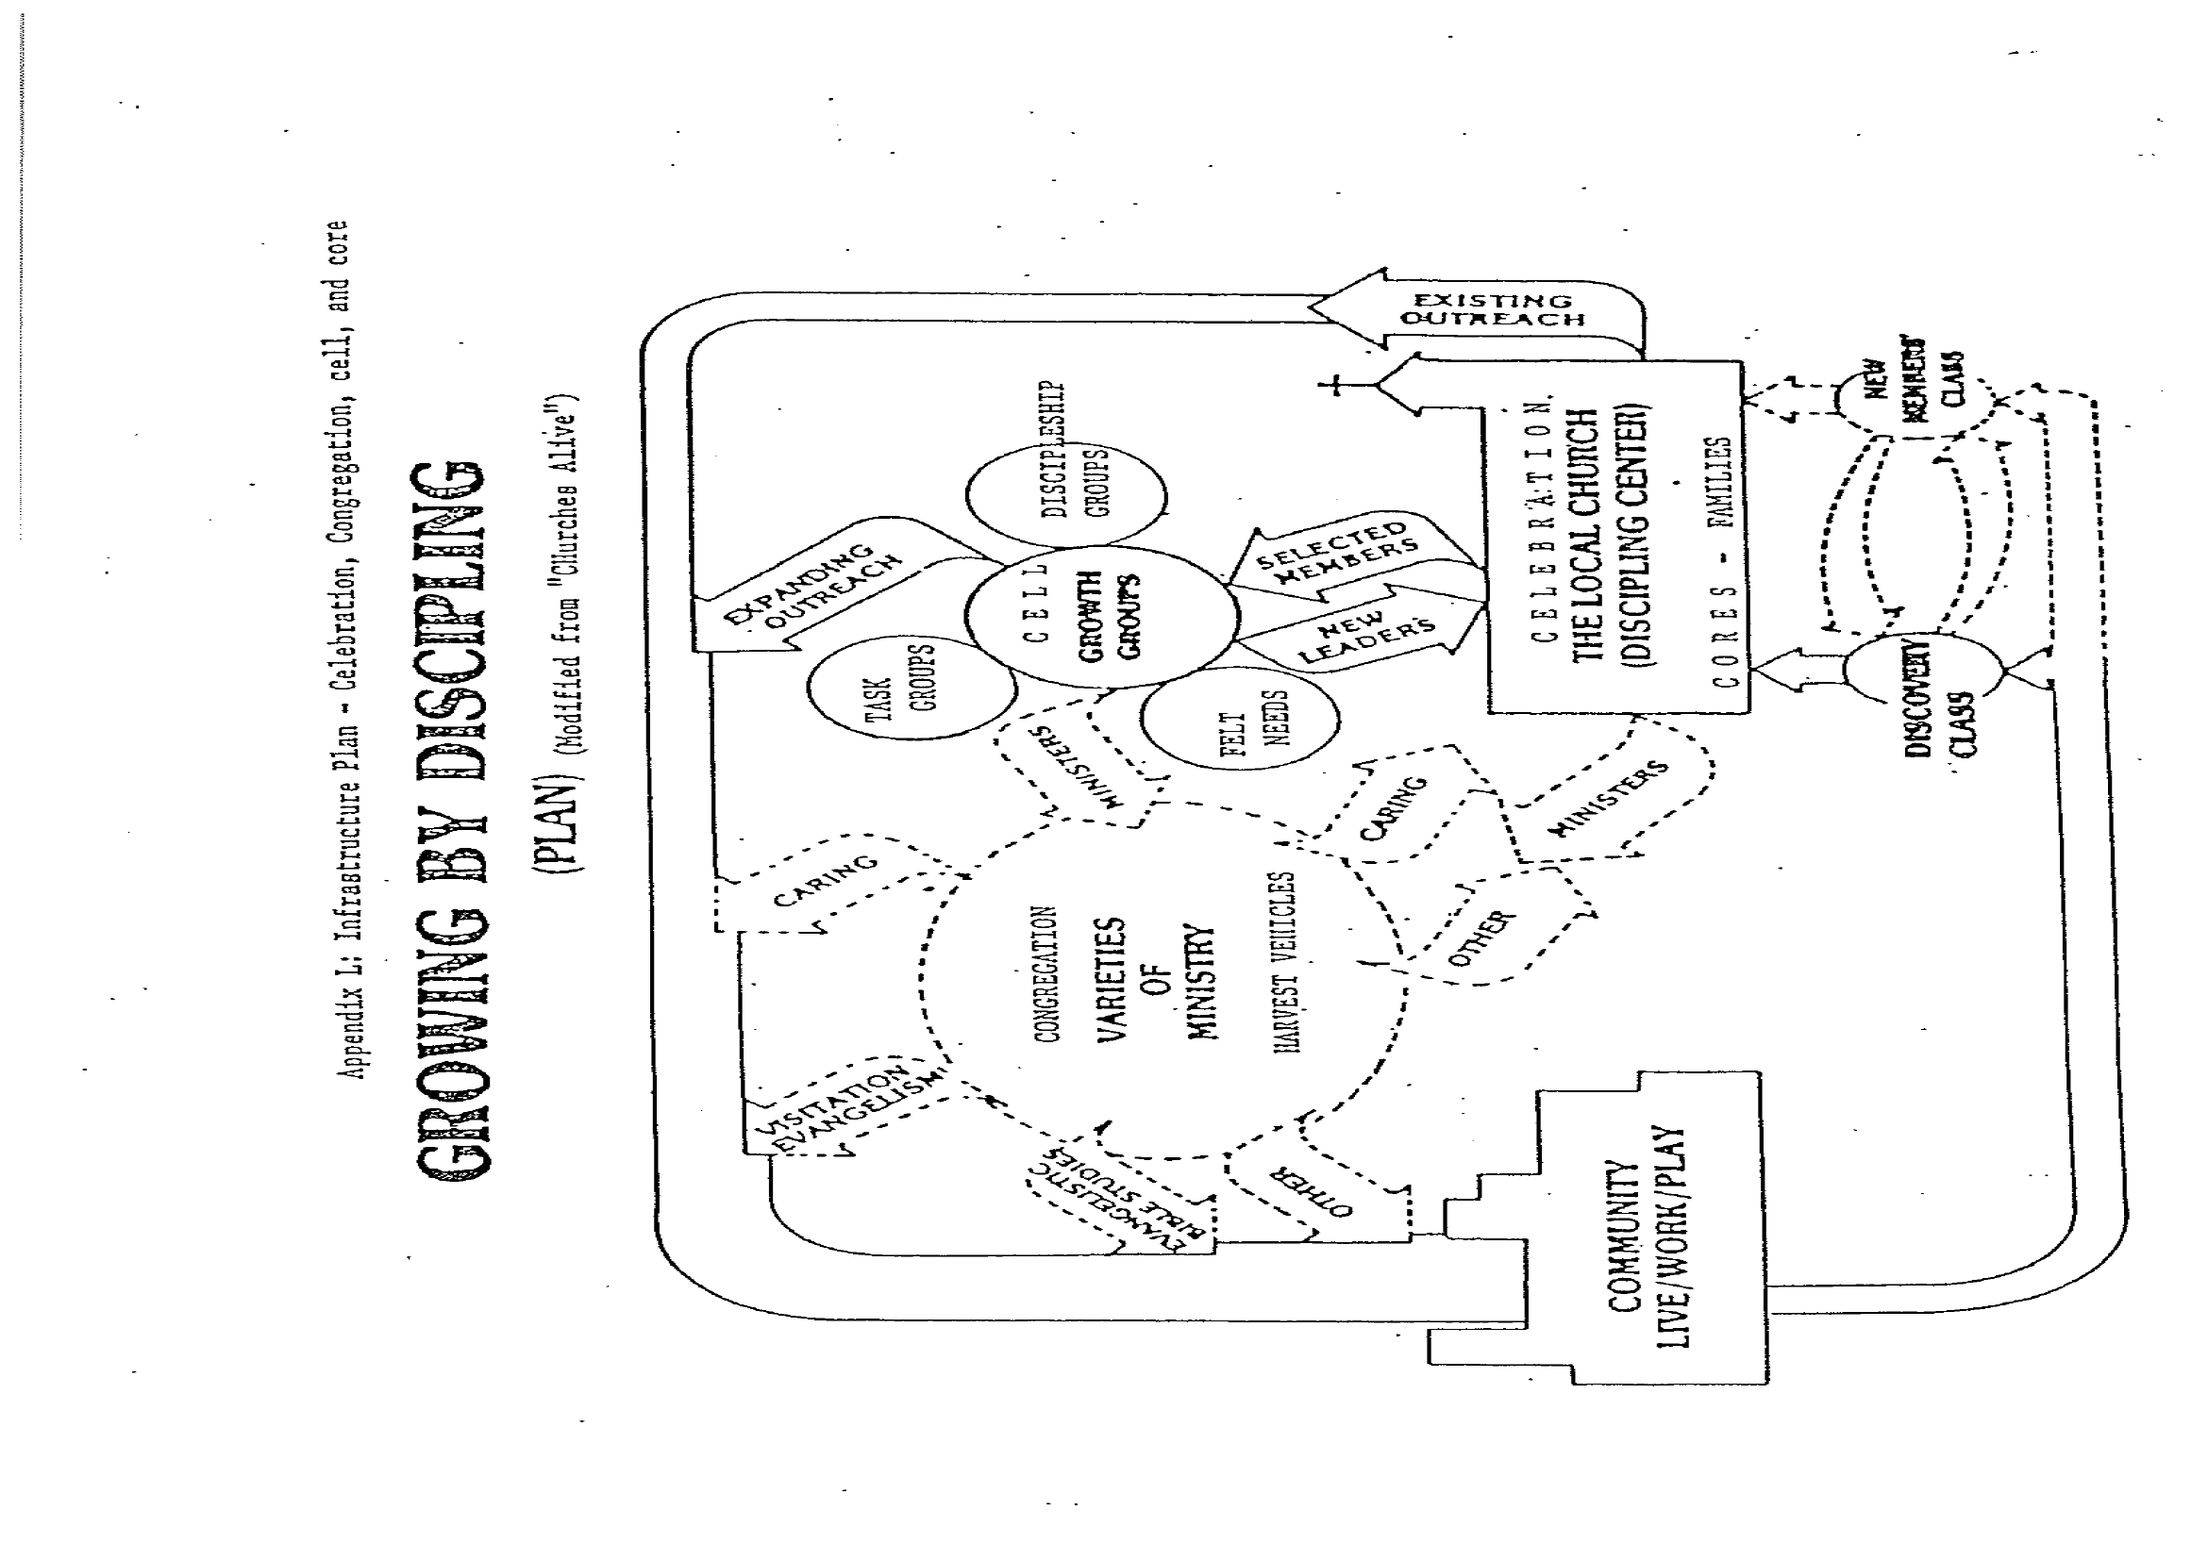

Slide 69
POSITIONING
4. STRATEGIC ORIENTATION
a. Process of journey
People in transition and in tension
(1) Stages of Growth towards decision
Level of responsiveness
(2) Seasons of Life
Development and Passages

Slide 70
POSITIONING
b. Process of Witness
(1) Relationship – belonging
(2) Service – good deeds
(3) Testimonies – good life stories
(4) Invitations to harvest vehicles
(5) Evangelist - conversational
(6) Prayer

Slide 71
Go Forth… into the Virtual World
Seek to build Christian community online because that’s where we can encounter members and potential members of our church:
More that 1-2 billion Internet users worldwide
Millions on MySpace
Millions of bloggers
Millions on Facebook
Twitters

Slide 72
Go Forth… into the Virtual World
In Asia, Europe and North America—an entire generation has experienced the Internet as a means for maintaining relationships with family and friends.
The Internet is a lifeline for users whose mobility is limited by disability, chronic illness or advanced age.
The Internet is where we can find and engage seekers.

Slide 73
Go Forth… into the Virtual World
Outreach to spiritual seekers
Create Virtual Community online
Foster online network and relationship
Provide opportunity for discussion, information, spiritual development, questions and prayers
Serve as teaching tool and opportunities for congregations, conferences and national ministries

Slide 74
WITNESSING LIFESTYLE
(Psa 126:5) They that sow in tears shall reap in joy.
(Psa 126:6) He that goeth forth and weepeth, bearing precious seed, shall doubtless come again with rejoicing, bringing his sheaves with him.
BE INTENTIONAL AND PURPOSEFUL!
(In season, out of season with a partner/s)

Slide 75
CHALLENGE
“Believe you that I am able to do this?”
(Matt. 9:28).
Faith is the entire person in the right relationship with God through the power of His Spirt in us.
Do I know my Risen Lord intimately?
Do I know the power of His indwelling Spirit?

Slide 76
CHALLENGE
“Believe you that I am able to do this?”
(Matt. 9:28).
Empty myself and be controlled by the Spirt.
Pray and trust the Lord to bring people into my life and give me the wisdom, love and patience to share His Gospel.
Pray and leave the results to Him.

Slide 77
ASSIGNMENTS
1. Please discuss TWO fears that you face in witnessing and how you would solve them.
2. Using either the Romans Road or Book of Sin illustration, please use it to witness to at least THREE loved ones or friends.

Slide 78
WINNING THE LOST
WHAT ONE LESSON HAVE I LEARNT?
WHAT WILL ONE PRAYER BE?

Slide 79
Email: gohsengfong@hotmail.com
WhatsApp: +65-98207783
Website: www.FaithAtWorkFellowship.org

