Slide 1
FIVE LEVELS OF LEADERSHIP
FROM
HOW SUCCESSFUL PEOPLE LEAD
BY JOHN MAXWELL

Slide 2
BENEFITS
1. IT CREATES A CLEAR PICTURE OF LEADERSHIP.
2. IT DEFINES LEADING AS A VERB, NOT A NOUN.
3. IT BREAKS DOWN LEADERSHIP INTO UNDERSTANDABLE STEPS.
4. IT PROVIDES A GAME PLAN FOR LEADERSHIP DEVELOPMENT.
5. IT ALIGNS LEADERSHIP PRACTICES, PRINCIPLES AND VALUES.

Slide 3
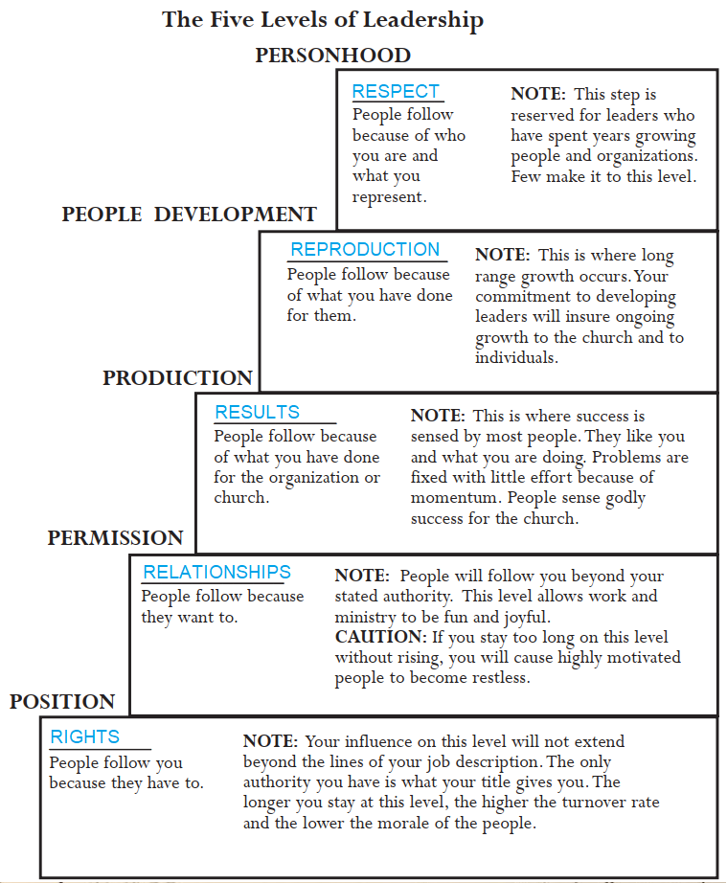

Slide 4
INSIGHTS
1. I CAN MOVE UP A LEVEL BUT I NEVER LEAVE THE PREVIOUS ONE BEHIND.
2. I AM NOT ON THE SAME LEVEL WITH EVERY PERSSON.
3. THE HIGHER I GO, THE EASIER IT IS TO LEAD OTHERS.
4. THE HIGHER I GO, THE MORE TIME AND COMMITMENT IS REQUIRED TO WIN A LEVEL.
5. MOVING UP OCCURS SLOWLY, BUT GOING DOWN CAN HAPPEN QUICKLY.

Slide 5
INSIGHTS
6. THE HIGHER I GO, THE GREATER THE RETURN.
7. MOVING FARTHER UP ALWAYS REQUIRES FURTHER GROWTH.
8. NOT CLIMBING THE LEVELS LIMITS ME AND MY PEOPLE.
9. WHEN I CHANGE POSITIONS OR ORGANIZATIONS, I SELDOM STAY AT THE SAME LEVEL.
10. I CANNOT CLIMB THE LEVELS ALONE.

Slide 6
LEVEL ONE – POSITION BIBLE EXAMPLE
1. POSITION – PEOPLE FOLLOW ME BECAUSE THEY HAVE TO.
2. REHOBOAM WAS POWER HUNGRY AND ACTED FOOLISHLY.
1Ki 12:7-8 And they spake unto him, saying, If thou wilt be a servant unto this people this day, and wilt serve them, and answer them, and speak good words to them, then they will be thy servants for ever. (8) But he forsook the counsel of the old men, which they had given him, and consulted with the young men that were grown up with him, and which stood before him:
3. LAW OF THE LID – LEADERSHIP ABILITY DETERMINES A PERSON’S LEVEL OF EFFECTIVENESS.

Slide 7
LEVEL ONE – POSITION UPSIDE
1. THE POSITION IS USUALLY GIVEN BECAUSE THERE IS LEADERSHIP POTENTIAL.
2. THE POSITION MEANS AUTHORITY IS RECOGNISED.
3. THE POSITION IS AN INVITATION TO GROW AS A LEADER.
CHARACTER, COMPASSION, COURAGE, COMPETENCY, CONVICTIONS, COMMITMENT AND CHARISMA (ABILITY TO DRAW OTHERS)

Slide 8
LEVEL ONE – POSITION UPSIDE
4. IT ALLOWS ME TO SHAPE AND DEFINE MY LEADERSHIP.
A. SELF KNOWLEDGE: WHO AM I? WHOSE AM I?
PERSONAL IDENTITY, EMOTIONAL SECURITY, TEMPERAMENT,
GIFTEDNESS, STRENGTHS AND WEAKNESSES.
B. VALUES: 1. ETHICAL (RIGHT THING FOR THE RIGHT REASON),
2. RELATIONAL (TRUST AND RESPECT CULTURE)
3. SUCCESS (ETERNAL SACRED TRUST GOALS)

Slide 9
LEVEL ONE – POSITION UPSIDE
4. IT ALLOWS ME TO SHAPE AND DEFINE MY LEADERSHIP.
C. SPIRITUAL DAILY DISCIPINES: RIGHT ATTITUDES, IMPORTANT PRIORITIES, HEALTH GUIDELINES, FAMILY CARE, HEALTHY THOUGHTS, PROPER COMMITMENT,
FINANCIAL HEALTH, FAITH DEEPENED, INVESTMENT IN SOLID RELATIONSHIPS AND ACCOUNTABILITY, PLANNED GIVING,
APPOINTMENT WITH GOD – LISTEN, REFLECT, PRAY AND OBEY.

Slide 10
LEVEL ONE – POSITION DOWNSIDE
1. HAVING A POSITION IS MISLEADING. LEADERSHIP IS INFLUENCE AND ACTION.
2. RELYING ON POSITION OFTEN DEVALUES PEOPLE. NO TRUST OR RESPECT.
3. THEY FEED ON POLITICS, DEFENDING AND EXPANDING OWN TURF.
4. THEY PLACE RIGHTS OVER RESPONSIBILTIES TO SERVE OTHERS.
5. THEY ARE OFTEN LONELY AS THEY FEEL INSECURITY AND THREATS.

Slide 11
LEVEL ONE – POSITION DOWNSIDE
6. THEY GET BRANDED AND STRANDED IN THAT POSITION.
7. TURNOVER IS HIGH, THE BEST PEOPLE LEAVING.
8. THEY RECEIVE PEOPLE’S LEAST,NOT THEIR BEST.
A. CLOCK WATCHERS – HARDLY WAIT TO STOP WORK.
B. “JUST ENOUGH” EMPLOYEES TO GET BY, TO GET PAID.
C. MENTALLY ABSENT, SLOPPY NEITHER CREATIVE NOR INNOVATIVE.

Slide 12
LEVEL ONE – POSITION BEST BEHAVIOURS
1. CORRECT MIND-SET
A. TITLES NOT ENOUGH WITH SENSE OF DISSATIFICATION.
B. PEOPLE ARE THE MOST VALUABLE ASSET, SO PEOPLE SKILLS NEEDED.
C. A LEADER DOES NOT NEED TO HAVE ALL THE ANSWERS.
D. A LEADER ALWAYS INCLUDES OTHERS IN COLLABORATION.

Slide 13
LEVEL ONE – POSITION BEST BEHAVIOUR
2. MOVE TOWARDS INFLUENCING PEOPLE.
I – INVEST IN PEOPLE, THEIR LIFE AND INTERESTS.
N – NATURAL WITH PEOPLE. BE AUTHENTIC AND SINCERE.
F – FAITH IN PEOPLE – DEMONSTRATE I BELIEVE IN THEM & WORK.
L – LISTENING TO THEM TO SHOW RESPECT.
U – UNDERSTANDING BY KNOWING THEIR ASPIRATIONS.

Slide 14
LEVEL ONE – POSITION BEST BEHAVIOUR
2. MOVE TOWARDS INFLUENCING PEOPLE.
E – ENCOURAGEMENT – THE OXYGEN OF THE SOUL.
N – NAVIGATE TO OFFER IDEAS THAT ADD VALUE.
C – COMPASSION FOR CARE AND CONCERN.
E – ENTHUSIASM, PASSION FOR THE PEOPLE AND CAUSE.

Slide 15
LEVEL ONE – POSITION BEST BEHAVIOUR
3. STOP RELYING ON POSITION TO PUSH PEOPLE.
TOP-DOWN – I AM OVER YOU.
SEPARATION – DO NOT GET PEOPLE CLOSE TO YOU.
IMAGE – FAKE IT TILL YOU MAKE IT.
STRENGTH – NEVER LET THEM SEE YOU SWEAT.
SELFISHNESS – YOU ARE HERE TO HELP ME.
POWER – I DETERMINE YOUR FUTURE.
INTIMIDATION – DO THIS OR ELSE!
RULES – THE MANUAL SAYS …

Slide 16
LEVEL ONE – POSITION BEST BEHAVIOUR
4. TRADE ENTITLEMENT FOR WORKING FORWARD TOGETHER TOWARDS VISION.
COLLABORATION – LET US WORK TOGETHER.
INITIATION – I WILL COME TO YOU.
INCLUSION – WHAT DO YOU THINK?
CO-OPERATION – TOGETHER, WE CAN MAKE IT.

Slide 17
LEVEL ONE – POSITION BEST BEHAVIOUR
4. TRADE ENTITLEMENT FOR WORKING FORWARD TOGETHER TOWARDS VISION.
SERVICE – I AM HERE TO HELP YOU.
DEVELOPMENT – I WANT TO ADD VALUE TO YOU.
ENCOURAGEMENT – I BELIEVE YOU CAN DO THIS.
INNOVATION – LET US THINK OUTSIDE THE BOX.

Slide 18
REFLECTIONS
WHAT IS ONE BLESSING/ LESSON THAT YOU HAVE LEARNT?
WHAT IS ONE PRAYER ITEM TO BE SHARED?

