Slide 1
FIVE LEVELS OF LEADERSHIP
“HOW SUCCESSFUL PEOPLE LEAD”
“MILLION LEADERS MANDATE” BOOKS 1 TO 6
BY JOHN MAXWELL

Slide 2
BENEFITS
1. IT CREATES A CLEAR PICTURE OF LEADERSHIP.
2. IT DEFINES LEADING AS A VERB, NOT A NOUN.
3. IT BREAKS DOWN LEADERSHIP INTO UNDERSTANDABLE STEPS.
4. IT PROVIDES A GAME PLAN FOR LEADERSHIP DEVELOPMENT.
5. IT ALIGNS LEADERSHIP PRACTICES, PRINCIPLES AND VALUES.

Slide 3
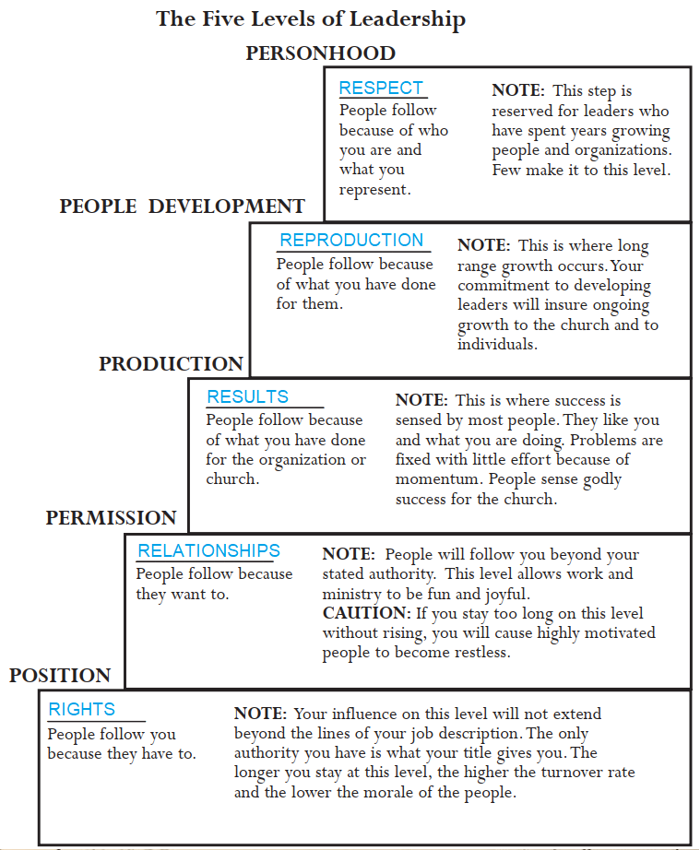

Slide 4
INSIGHTS
1. I CAN MOVE UP A LEVEL BUT I NEVER LEAVE THE PREVIOUS ONE BEHIND.
2. I AM NOT ON THE SAME LEVEL WITH EVERY PERSSON.
3. THE HIGHER I GO, THE EASIER IT IS TO LEAD OTHERS.
4. THE HIGHER I GO, THE MORE TIME AND COMMITMENT IS REQUIRED TO WIN A LEVEL.
5. MOVING UP OCCURS SLOWLY, BUT GOING DOWN CAN HAPPEN QUICKLY.

Slide 5
INSIGHTS
6. THE HIGHER I GO, THE GREATER THE RETURN.
7. MOVING FARTHER UP ALWAYS REQUIRES FURTHER GROWTH.
8. NOT CLIMBING THE LEVELS LIMITS ME AND MY PEOPLE.
9. WHEN I CHANGE POSITIONS OR ORGANIZATIONS, I SELDOM STAY AT THE SAME LEVEL.
10. I CANNOT CLIMB THE LEVELS ALONE.

Slide 6
LEVEL ONE - POSITION
IT IS A GREAT PLACE TO VISIT,
BUT YOU WOULD NOT WANT TO LIVE THERE.

Slide 7
LEVEL ONE – POSITION BIBLE EXAMPLE
1. POSITION – PEOPLE FOLLOW ME BECAUSE THEY HAVE TO.
2. REHOBOAM WAS POWER HUNGRY AND ACTED FOOLISHLY.
1Ki 12:7-8 And they spake unto him, saying, If thou wilt be a servant unto this people this day, and wilt serve them, and answer them, and speak good words to them, then they will be thy servants for ever. (8) But he forsook the counsel of the old men, which they had given him, and consulted with the young men that were grown up with him, and which stood before him:
3. LAW OF THE LID – LEADERSHIP ABILITY DETERMINES A PERSON’S LEVEL OF EFFECTIVENESS.

Slide 8
LEVEL ONE – POSITION UPSIDE
1. THE POSITION IS USUALLY GIVEN BECAUSE THERE IS LEADERSHIP POTENTIAL.
2. THE POSITION MEANS AUTHORITY IS RECOGNISED.
3. THE POSITION IS AN INVITATION TO GROW AS A LEADER.
CHARACTER, COMPASSION, COURAGE, COMPETENCY, CONVICTIONS, COMMITMENT AND CHARISMA (ABILITY TO DRAW OTHERS)

Slide 9
LEVEL ONE – POSITION UPSIDE
4. IT ALLOWS ME TO SHAPE AND DEFINE MY LEADERSHIP.
A. SELF KNOWLEDGE: WHO AM I? WHOSE AM I?
PERSONAL IDENTITY, EMOTIONAL SECURITY, TEMPERAMENT,
GIFTEDNESS, STRENGTHS AND WEAKNESSES.
B. VALUES: 1. ETHICAL (RIGHT THING FOR THE RIGHT REASON),
2. RELATIONAL (TRUST AND RESPECT CULTURE)
3. SUCCESS (ETERNAL SACRED TRUST GOALS)

Slide 10
LEVEL ONE – POSITION UPSIDE
4. IT ALLOWS ME TO SHAPE AND DEFINE MY LEADERSHIP.
C. SPIRITUAL DAILY DISCIPINES: RIGHT ATTITUDES, IMPORTANT PRIORITIES, HEALTH GUIDELINES, FAMILY CARE, HEALTHY THOUGHTS, PROPER COMMITMENT,
FINANCIAL HEALTH, FAITH DEEPENED, INVESTMENT IN SOLID RELATIONSHIPS AND ACCOUNTABILITY, PLANNED GIVING,
APPOINTMENT WITH GOD – LISTEN, REFLECT, PRAY AND OBEY.

Slide 11
LEVEL ONE – POSITION DOWNSIDE
HAVING A POSITION IS MISLEADING. LEADERSHIP IS INFLUENCE AND ACTION.
2. RELYING ON POSITION OFTEN DEVALUES PEOPLE. NO TRUST OR RESPECT.
3. THEY FEED ON POLITICS, DEFENDING AND EXPANDING OWN TURF.
4. THEY PLACE RIGHTS OVER RESPONSIBILTIES TO SERVE OTHERS.
5. THEY ARE OFTEN LONELY AS THEY FEEL INSECURITY AND THREATS.

Slide 12
LEVEL ONE – POSITION DOWNSIDE
6. THEY GET BRANDED AND STRANDED IN THAT POSITION.
7. TURNOVER IS HIGH, THE BEST PEOPLE LEAVING.
8. THEY RECEIVE PEOPLE’S LEAST,NOT THEIR BEST.
A. CLOCK WATCHERS – HARDLY WAIT TO STOP WORK.
B. “JUST ENOUGH” EMPLOYEES TO GET BY, TO GET PAID.
C. MENTALLY ABSENT, SLOPPY NEITHER CREATIVE NOR INNOVATIVE.

Slide 13
LEVEL ONE – POSITION BEST BEHAVIOURS
1. CORRECT MIND-SET
A. TITLES NOT ENOUGH WITH SENSE OF DISSATIFICATION.
B. PEOPLE ARE THE MOST VALUABLE ASSET, SO PEOPLE SKILLS NEEDED.
C. A LEADER DOES NOT NEED TO HAVE ALL THE ANSWERS.
D. A LEADER ALWAYS INCLUDES OTHERS IN COLLABORATION.

Slide 14
LEVEL ONE – POSITION BEST BEHAVIOUR
2. MOVE TOWARDS INFLUENCING PEOPLE.
I – INVEST IN PEOPLE, THEIR LIFE AND INTERESTS.
N – NATURAL WITH PEOPLE. BE AUTHENTIC AND SINCERE.
F – FAITH IN PEOPLE – DEMONSTRATE I BELIEVE IN THE WORK.
L – LISTENING TO THEM TO SHOW RESPECT.
U – UNDERSTANDING BY KNOWING THEIR ASPIRATIONS.

Slide 15
LEVEL ONE – POSITION BEST BEHAVIOUR
2. MOVE TOWARDS INFLUENCING PEOPLE.
E – ENCOURAGEMENT – THE OXYGEN OF THE SOUL.
N – NAVIGATE TO OFFER IDEAS THAT ADD VALUE.
C – COMPASSION FOR CARE AND CONCERN.
E – ENTHUSIASM, PASSION FOR THE PEOPLE AND CAUSE.

Slide 16
LEVEL ONE – POSITION BEST BEHAVIOUR
3. STOP RELYING ON POSITION TO PUSH PEOPLE.
TOP-DOWN – I AM OVER YOU.
SEPARATION – DO NOT GET PEOPLE CLOSE TO YOU.
IMAGE – FAKE IT TILL YOU MAKE IT.
STRENGTH – NEVER LET THEM SEE YOU SWEAT.
SELFISHNESS – YOU ARE HERE TO HELP ME.
POWER – I DETERMINE YOUR FUTURE.
INTIMIDATION – DO THIS OR ELSE!
RULES – THE MANUAL SAYS …

Slide 17
LEVEL ONE – POSITION BEST BEHAVIOUR
4. TRADE ENTITLEMENT FOR WORKING FORWARD TOGETHER TOWARDS VISION.
COLLABORATION – LET US WORK TOGETHER.
INITIATION – I WILL COME TO YOU.
INCLUSION – WHAT DO YOU THINK?
CO-OPERATION – TOGETHER, WE CAN MAKE IT.

Slide 18
LEVEL ONE – POSITION BEST BEHAVIOUR
4. TRADE ENTITLEMENT FOR WORKING FORWARD TOGETHER TOWARDS VISION.
SERVICE – I AM HERE TO HELP YOU.
DEVELOPMENT – I WANT TO ADD VALUE TO YOU.
ENCOURAGEMENT – I BELIEVE YOU CAN DO THIS.
INNOVATION – LET US THINK OUTSIDE THE BOX.

Slide 19
LEVEL 2 - PERMISSION
CHRISTIANITY IS RELATIONSHIPS.
YOU CANNOT LEAD PEOPLE UNTIL YOU LIKE THEM.
DOES HE LIKE ME?
WILL HE HELP ME?
CAN I TRUST HIM?

Slide 20
LEVEL 2 – PERMISSION UPSIDE
1. IT MAKES WORK MORE ENJOYABLE.
PEOPLE ARE WON OVER WITH INTERACTION.
FOCUS IS FROM “ME” TO “WE” TO SERVE.
2. IT INCREASES THE ENERGY LEVEL.
GOOD RELATIONSHIPS CREATE ENERGY.
ALL WOULD WANT TO GIVE THEIR BEST.

Slide 21
LEVEL 2 – PERMISSION UPSIDE
3. IT OPENS UP CHANNELS OF COMMUNICATION.
SPIRIT OF COMMUNITY AND TRANSPARENCY
EARS – I HEAR WHAT YOU ARE SAYING.
EYES – I SEE WHAT YOU ARE SEEING.
HEART – I FEEL WHAT YOU ARE FEELING.
UNDIVIDED ATTENTION – I VALUE WHO YOU ARE.

Slide 22
LEVEL 2 – PERMISSION UPSIDE
4. IT FOCUSES ON VALUE OF EACH PERSON.
UNIQUENESS AND DIFFERENCES
WHAT DOES HE…
TALK ABOUT?
CRY ABOUT?
DREAM ABOUT?
LAUGH ABOUT?
PLAN ABOUT?

Slide 23
LEVEL 2 – PERMISSION UPSIDE
5. IT NURTURES TRUST.
TRUST IS THE FOUNDATION.
THE MORE TRUST, THE BETTER RELATIONSHIP.
THE BETTER RELATIONSHIP, THE BETTER LEADING.
IN TIMES OF DIFFICULTY, A SHELTER.
IN TIMES OF OPPORTUNITY, A LAUNCHING PAD.

Slide 24
LEVEL 2 – PERMISSION DOWNSIDE
1. IT APPEARS TOO SOFT FOR SOME LEADERS.
ESPECIALLY FOR THOSE WHO WANT ACTION.
IT TAKES BOTH PERMISSION AND PRODUCTION.
IT CAN BE FRUSTRATING FOR ACHIEVERS – TOO SLOW.
THEY BECOME RESTLESS, TAKE OVER OR LEAVE.

Slide 25
LEVEL 2 – PERMISSION DOWNSIDE
3. SUCH LEADERS CAN BE TAKEN ADVANTAGE OF.
TAKERS – TO BETTER THEMSELVES
DEVELOPERS – THEMSELVES AND LEADERS
ACQUAINTERS – BENEFITING BUT NOT CONTRIBUTING
FRIENDS – ENJOY RELATIONSHIPS

Slide 26
LEVEL 2 – PERMISSION DOWNSIDE
4. IT REQUIRES OPENNESS TO BE EFFECTIVE.
VULNERABLE TO ADMIT MISTAKES, FAULTS.
IT IS DIFFICULT FOR THOSE WHO ARE UNLIKEABLE.
DISCOVER WHAT IS LIKEABLE ABOUT YOURSELF.
MAKE A CHOICE TO CARE ABOUT OTHERS,
LOOK FOR SOMETHING LIKEABLE IN OTHERS.
APPRECIATE THAT AND CARE FOR OTHERS.

Slide 27
LEVEL 2 – PERMISSION DOWNSIDE
6. IT FORCES THE DEALING OF WHOLE PERSON.
MESSY, DYSFUNCTIONAL, DISILLUSIONED.
MAY LOSE THE POTENTIAL OF OTHERS.
NEEDED CARE:
C – CONNECT AND LISTEN.
A – ACCEPT WHERE THEY ARE COMING FROM.
R – RESPOND WITH DISCERNMENT.
E – ENDURE WITH PATIENCE AND FAITH IN GOD.

Slide 28
LEVEL 2 – PERMISSION - BIBLE EXAMPLE
NEHEMIAH KNEW HIS GOD AND WHERE GOD WAS GOING AND HE LED PEOPLE TO FULFILL GOD’S PURPOSE.
1. NEHEMIAH KNEW HIS GOD.
Neh 1:5 And said, I beseech thee, O LORD God of Heaven, the great and terrible God, that keeps covenant and mercy for them that love Him and observe His commandments:
GOD – ELOHIM, ALMIGHTY, FAITHFUL &TRUE. EL-SHADDAI.
LORD – YAHWEH, ETERNAL ONE, I AM THAT I AM. HESED.
Lord – ADONAI, THE MASTER, LORD OF ALL.

Slide 29
LEVEL 2 – PERMISSION - BIBLE EXAMPLE
NEHEMIAH KNEW HIS GOD
A. GOD IS THE SOURCE (ACTS 17:28) DISCIPLINE OF SIMPLICITY (2 COR.11:3)
B. GOD IS IN CONTROL (DAN. 4:35) DISCIPLINE OF SILENCE (PS. 46:1,10)
C. GOD IS THE JUDGE (1 PET. 2:23) DISCIPLINE OF SOLITUDE (PS. 139:23.24)
D. GOD IS THE MASTER (ECCL. 12:13) DISCIPLINE OF SURRENDER (PROV. 3:5,6)

Slide 30
LEVEL 2 – PERMISSION - BIBLE EXAMPLE
IDENTIFYING WITH NEEDS IN PRAYER.
Neh 1:6 Let Thine ear now be attentive, and Thine eyes open, that Thou may hear the prayer of Thy servant, which I pray before Thee now, day and night, for the children of Israel Thy servants, and confess the sins of the children of Israel, which we have sinned against thee: both I and my father's house have sinned.
A. LIKE OUR SAVIOUR, TOUCHED WITH FEELINGS OF OUR INFIRMITIES, YET WITHOUT SIN (HEB. 4:15,16).
B. LEAD YOURSELF AND OTHERS AS HOUSE OF PRAYER WITH PRAYER PLANS: JOURNALS, PARTNERS, RETREATS, FASTING, CHAIN.

Slide 31
LEVEL 2 – PERMISSION - BIBLE EXAMPLE
LEADING WITH PEOPLE IN GOD’S PURPOSE.
Neh 2:20 Then answered I them, and said unto them, The God of Heaven, He will prosper us; therefore we His servants will arise and build: but ye have no portion, nor right, nor memorial, in Jerusalem.
A. IT IS GOD’S PURPOSE AND HE WILL PROSPER US. (MATT. 16:18). DO NOT GIVE UP. DO NOT GIVE IN.
B. WE WILL ARISE AND BUILD. RISK AND SACRIFICE. PRAY, PLAN, PRESENT AND EXECUTE TOGETHER.

Slide 32
LEVEL 2 – PERMISSION BEST BEHAVIORS
CONNECT WITH MYSELF FIRST.
A. SELF-AWARENESS OF PERSONALITY & GIFTS.
B. SELF-IMAGE IN GOD’S WORTH.
C. SELF-HONESTY TO FACE REALITY.
D. SELF-IMPROVEMENT IN LIFE LONG LEARNING.
E. SELF-RESPONSIBILITY FOR ATTITUDES & ACTIONS.

Slide 33
LEVEL 2 – PERMISSION BEST BEHAVIORS
DEVELOP PEOPLE-ORIENTED SKILLS. PEOPLE PERSON
A. ANALOGIES OF:
HOST – TAKE INITIATIVE TO COMFORT.
DOCTOR – PROBE TO SEE NEED.
COUNSELLOR – LISTEN AND INTERPRET.
TOUR GUIDE – GET THEM TO DESTINATION.

Slide 34
LEVEL 2 – PERMISSION BEST BEHAVIORS
2. DEVELOP PEOPLE-ORIENTED SKILLS. PEOPLE PERSON
B. NEEDS
Security, give confidence (Heb. 10:25)
Feel special, honour them (Rom. 12:10)
Better future, give hope (Lam. 3:21-23)
To be understood, listen (Rom. 12:15)
Direction, navigate, chart (1 Peter 5:1,2)

Slide 35
LEVEL 2 – PERMISSION BEST BEHAVIORS
2. DEVELOP PEOPLE-ORIENTED SKILLS. PEOPLE PERSON
B. NEEDS
Needy, speak to needs (Phil. 2:4)
Emotionally low, encourage (Col. 3:12,13)
To succeed, help to win (Eccl. 4:9,10)
Relationship, provide community (1 Cor.12:26)
Models, be an example (1 Cor. 11:1)

Slide 36
LEVEL 2 – PERMISSION BEST BEHAVIORS
STRIKE A BALANCE BETWEEN CARE & FEEDBACK. HELP INDIVIDUAL, IMPROVE TEAM AND VISION.
A. CARING VALUES THE PERSON. FEEDBACK VALUES HIS POTENTIAL.
B. CARING ESTABLISHES THE RELATIONSHIP.
FEEDBAK EXPANDS AND DEEPENS IT
C. CARING DEFINES THE RELATIONSHIP.
FEEDBACK DIRECTS IT TO A PURPOSE.

Slide 37
LEVEL 2 – PERMISSION BEST BEHAVIORS
STRIKE A BALANCE BETWEEN CARE & FEEDBACK.
D. CHECK LIST FOR CARE-FEEDBACK.
HAVE I INVESTED ENOUGH IN RELATIONSHIP?
DO I VALUE HIM AS AN INDIVIDUAL PERSON?
AM I SURE THAT THIS IS HIS ISSUE, INTEREST?
AM I WILLING TO INVEST TO HELP?
AM I SETTING SPECIFIC EXPECTATIONS?

Slide 38
LEVEL 2 – PERMISSION BEST BEHAVIORS
STRIKE A BALANCE BETWEEN CARE & FEEDBACK.
E. FEEDBACK
DO IT:
QUICKLY WHILE IT IS SMALL.
CALMLY AND NOT IN ANGER.
PRIVATELY, NOT TO EMBARRASS.
THOUGHTFULLY, NOT TO THREATEN.

Slide 39
LEVEL 2 – PERMISSION
REFLECTIONS:
WHAT ONE LESSON HAVE I LEARNT?
WHAT WILL BE ONE PRAYER I HAVE?

