Slide 1
THE BLESSED MAN
PSALM ONE

Slide 2
REJOICE IN THE LORD (Ron Hamilton)
God never moves without purpose or plan
When trying His servant and moulding a man.
Give thanks to the Lord though your testing seems long. In darkness He giveth a song.
O rejoice in the Lord, He makes no mistake,
He knoweth the end of each path I take.
For when I am tried and purified,
I shall come forth as gold.

Slide 3
I could not see through the shadows ahead.
So I looked at the Cross of my Saviour instead.
I bowed to the will of the Master that day.
Then peace came and tears fled away.
O rejoice in the Lord, He makes no mistake,
He knoweth the end of each path I take.
For when I am tried and purified,
I shall come forth as gold.

Slide 4
Now I can see testing comes from above.
God strengthens His children and purges in love.
My Father knows best and I trust in His care.
Through purging more fruit I will bear.
O rejoice in the Lord, He makes no mistake,
He knoweth the end of each path I take.
For when I am tried and purified,
I shall come forth as gold.

Slide 5
(Psa 1:1) Blessed is the man that walketh not in the counsel of the ungodly, nor standeth in the way of sinners, nor sitteth in the seat of the scornful.
(Psa 1:2) But his delight is in the Law of the LORD; and in His Law doth he meditate day and night.

Slide 6
(Psa 1:3) And he shall be like a tree planted by the rivers of water, that bringeth forth his fruit in his season; his leaf also shall not wither; and whatsoever he doeth shall prosper.
(Psa 1:4) The ungodly are not so: but are like the chaff which the wind driveth away.

Slide 7
(Psa 1:5) Therefore the ungodly shall not stand in the judgment, nor sinners in the congregation of the righteous.
(Psa 1:6) For the LORD knoweth the way of the righteous: but the way of the ungodly shall perish.

Slide 8
PSALMS
Psalm (Greek psalmos) translates the Hebrew (mizmor), “song, instrument music”.
The Psalms are meant to be sung – and accompanied by musical instruments.
There are community as well as individual psalms.
They gave the examples of wide experiences of saints, through times of worship and praise as well as days of despair, lamentations and supplications.

Slide 9
STRUCTURE
TWO PRIMARY ELEMENTS:
Thought Parallelism
Imagery

Slide 10
STRUCTURE
1a. Synonymous: The thought expressed in the first line is restated in the same or similar form in the second line.
“The heavens declare the glory of God; and the firmament sheweth his handywork” (Ps. 19:1).

Slide 11
STRUCTURE
“LORD, how are they increased that trouble me!
many are they that rise up against me” (Ps. 3:1).

Slide 12
STRUCTURE
1b. Antithetic: A contrast of thought is presented in the second line.
“For the LORD knoweth the way of the righteous:
but the way of the ungodly shall perish” (Ps. 1:6).

Slide 13
STRUCTURE
“For evildoers shall be cut off:
but those that wait upon the LORD, they shall inherit the earth” (Ps. 37:9).

Slide 14
STRUCTURE
1c. Synthetic: The second line takes up and develops the thought begun in the first line.
“My soul shall make her boast in the LORD:
the humble shall hear thereof, and be glad” (Ps. 34:2)).

Slide 15
STRUCTURE
1d. Emblematic: The second member reproduces the thought of the first by using a metaphor or simile.
“The ungodly are not so: but are like the chaff which the wind driveth away” (Ps. 1:4).

Slide 16
STRUCTURE
1e. Climactic: The second line represents the first but omits the last term.
“Give unto the LORD, O ye mighty,
give unto the LORD glory and strength” (Ps. 29:1).

Slide 17
STRUCTURE
2. Imagery
Simile is a comparison which is made explicit by the presence of the word "like" or "as." "As the deer pants for streams of water, So my soul pants for you, O God." (Psalm 42:1)

Slide 18
STRUCTURE
2. Imagery
Metaphor is a comparison that is implicit, that is, a comparison without the mention of "like" or "as.”
"The LORD is my shepherd, I shall not want.“
(Psalm 23:1)

Slide 19
INTRODUCTION
Psalm One is introductory and prefactory.
Jerome: The Preface of the Holy Ghost
Hengstenberg: A Short Compendium of the main subjects of the Psalms – the righteous and the ungodly

Slide 20
I. THE BLESSEDNESS OF THE MAN (verse 1a)
II. HIS CHARACTER, DESCRIBED NEGATIVELY, IN SHARP CONTRAST WITH THE UNGODLY (verse 1b)
III. HIS CHARACTER, DESCRIBED POSITIVELY, WITH ONE DISTINGUISHING MARK (verses 2,3)
IV. CHARACTER OF THE UNGODLY MAN (verses 4-6)

Slide 21
BLESSEDNESS
THE BLESSEDNESS
1. Blessedness (plural) – fullness of blessings
2. “Oh, how completely happy is the man, even of the poor, forgotten and obscure!”
3. He finds joy within.
4. A Psalm of congratulations.

Slide 22
BLESSEDNESS
SOME BLESSINGS
1. Of Peace (Roman 5:1)
2. Of Purpose (Eccl. 12:13)
3. Of Wisdom (Psalm 119:165)
4. Of usefulness (Luke 12:37, watch and serve)
5. Of eternity (1 John 2:16,17, abides forever)

Slide 23
BLESSEDNESS
BY WHOM?
1. Intrinsically blessed (John 13:17)
2. In judgment of men (Acts 2:43; 5:13, magnified)
3. Jesus declares him to be so (Matt. 5:1-11).
4. At Last Judgment, King confirms (Mt. 25:34).
When God blesses, it will be forever (1 Chron. 17:27; Num. 22:6).

Slide 24
CHARACTER - NEGATIVELY
IMPLICATIONS – “WALK”, “STAND”, “SIT”
They form a climatic process – a gradation
They represents three stages of deterioration: thinking, behaving, belonging
a. “Walk” – occasional conformity
b. “Stand” – fixed association
c. “Sit” - established residence
The verbs convey the idea of fixed mental attitude – a characteristic, distinctive.
Warning against wrong company (Prov. 13:20;
1 Cor. 15:33).

Slide 25
CHARACTER - NEGATIVELY
THE UNGODLY
1. “Counsel of the Ungodly”
a. “Counsel” – ruling principle
b. “Ungodly” – no fear of God and restless
c. No participating in projects (cf. Ps. 119:24)
2. “Way of Sinners”
a. “Way” – line of conduct
b. “Sinners” – “to miss the mark” – rebellion
c. No indulging in open sin (cf. Matt. 7:13)

Slide 26
CHARACTER - NEGATIVELY
THE UNGODLY
3. “Seat of the Scornful”
a. “Seat” – fellowship
b. “Scornful” – “to talk loosely” – against God and His Word.
Despise knowledge, counsel and correction (Prov. 1:22; 9:7-8; 24:9).
c. He has no fellowship with scorners.
d. Inner holiness and concern
(Jer. 9:1; 2 Peter 2:7; Luke 19:41)

Slide 27
ETERNITY – HARVEST OF TIME
(Gal 6:7) Be not deceived; God is not mocked: for whatsoever a man soweth, that shall he also reap.
Sow a thought … reap an act.
Sow an act … reap a habit.
Sow a habit … reap a character.
Sow a character … reap a destiny.
(by Samuel Smiles)

Slide 28
CHARACTER - POSITIVELY
HIS DELIGHT
1. “But” – strong adversative
a. He does not enter into a vacuum.
b. An emphasized contrast (Ps. 49:14,15; 73:26)
(Gen 50:20) But as for you, ye thought evil against me; but God meant it unto good, to bring to pass, as it is this day, to save much people alive.

Slide 29
CHARACTER - POSITIVELY
HIS DELIGHT
2. “Delight”- Joy and rejoicing (Jer. 15:16)
a. Not under law as a curse (Gal. 3:13).
b. The Word as rule of life (Ps. 119:32).
c. Word dwells richly (Col. 3:16).
d. Not just the good but God’ Law.
(Psa 138:2) I will worship … and praise Thy name for Thy lovingkindness and for Thy truth: for Thou hast magnified Thy word above all Thy name.
(Psa 119:32) I will run the way of Thy commandments, when Thou shalt enlarge my heart.

Slide 30
CHARACTER - POSITIVELY
HIS DELIGHT
3. “Law of the LORD” – total revelation
a. God-breathed – authoritative (2 Tim 3:16)
b. Love Law as guide and guard (Jn 8:32).
c. LORD – I AM that I AM! His Word is eternal (Ps. 119:160) and forever settled in Heaven (Ps. 119:89).
(Joh 8:32) And ye shall know the truth, and the truth shall make you free.

Slide 31
CHARACTER - POSITIVELY
HIS DELIGHT
3. “Law of the LORD” – total revelation
d. The Word gives peace (Ps. 119:165),
faith (Rom. 10:17), joy (Ps. 63:5),
understanding, wisdom (Ps. 119:98,99)
life (Prov. 16:22) and success (Jos. 1:8).
(Rom 10:17) So then faith cometh by hearing, and hearing by the Word of God.

Slide 32
CHARACTER - POSITIVELY
HIS DELIGHT
4. “Meditate day and night”
a. “Meditate” – groaning, intensifying.
b. Verb refers to a habit of life. Chew cud.
c. Not entertaining but practical (Jn 13:17).
d. “Night and day” – continuous process.
(Jos 1:8) This book of the law shall not depart out of thy mouth; but thou shalt meditate therein day and night, that thou mayest observe to do according to all that is written therein: for then thou shalt make thy way prosperous, and then thou shalt have good success.

Slide 33
CHARACTER - POSITIVELY
HIS DELIGHT
“Meditate day and night”
(2Ti 3:16,17) All scripture is given by inspiration of God, and is profitable for doctrine, for reproof, for correction, for instruction in righteousness: That the man of God may be perfect, thoroughly furnished unto all good works.
a. Doctrine – defining right
b. Reproof – rebuking wrong
c. Correction – restoring right
d. Instruction – nurturing right
Results:
Perfect
Furnished

Slide 34
CHARACTER - POSITIVELY
HIS SUCCESS – strong, secure and stable
1. “As a tree” – evergreen and fruitful
a. Simile used in Jer. 17:7-8, Ps. 92:12-14
b. Life tree in contrast to chaff.
c. Blessedness because of what he is.
(Psa 92:12-14) The righteous shall flourish like the palm tree: he shall grow like a cedar in Lebanon. Those that be planted in the House of the LORD shall flourish in the courts of our God. They shall still bring forth fruit in old age; they shall be fat and flourishing;

Slide 35
CHARACTER - POSITIVELY
HIS SUCCESS
2. “Planted” or “Transplanted”
a. Planted by God (Matt. 15:13)
b. Cultivated and secured – trees of righteousness (Isa. 61:3).
c. Intended for fruitfulness (Eph. 2:10).
d. Disconnecting times for growth and more fruitfulness (John 15:5)

Slide 36
CHARACTER - POSITIVELY
HIS SUCCESS
3. “By the rivers of water”
a. Streams of irrigation (cf. Prov. 21:1)
b. Wells of water (John 4:14; 7:37-39)
c. Rooted in Christ (Col. 2:7)
(Joh 4:14) But whosoever drinketh of the water that I shall give him shall never thirst; but the water that I shall give him shall be in him a well of water springing up into everlasting life.

Slide 37
CHARACTER - POSITIVELY
HIS SUCCESS
4. “His fruit he gives in his season”
a. Fruit - product of tree (2 Peter 1:8)
i. Of Holy Spirit (Gal. 5:22,23)
ii. Of righteousness (Heb. 12:11)
iii. Of holiness (Rom. 6:22)
iv. Of souls saved (Prov. 11:30; 1 Thess. 2:19)
(Pro 11:30) The fruit of the righteous is a tree of life; and he that winneth souls is wise.

Slide 38
CHARACTER - POSITIVELY
HIS SUCCESS
4. “His fruit he gives in his season”
b. Season – time of growth progress
i. Fruitful according to time
ii. Season and patience needed
iii. May tarry but it will come (Jam. 5:7).
iv. Lessons learned in affliction, trials
(Gal 6:9) And let us not be weary in well doing: for in due season we shall reap, if we faint not.

Slide 39
CHARACTER - POSITIVELY
HIS SUCCESS
5. “His leaf also shall not wither”
a. Beauty and protective qualities
b. Vigor and security
c. Enduring quality
i. Freshness of heart and experience
ii. Life progression in love, hope, faith

Slide 40
CHARACTER - POSITIVELY
HIS SUCCESS
6. “Whatever he does, he shall prosper”
a. God in the process (Gen. 39:3, with Joseph)
b. Outward riches (Abraham, Prov. 10:22)
c. Benefits of adversity (Heb. 12:11)
d. Soul prosperity (1 Peter 1:7)
(1Pe 1:7) That the trial of your faith, being much more precious than of gold that perisheth, though it be tried with fire, might be found unto praise and honour and glory at the appearing of Jesus Christ:

Slide 41
CHARACTER - POSITIVELY
HIS SUCCESS
7. Prosperity of Trials
a. To enter deeper into faith and obedience
(Heb. 5:8,9; 12:2; Psa. 119:67.71)
b. To forge bond of divine-human suffering
(1 Peter 4:13; Phil. 1:28.29; Col. 1:23,24)
c. To identify with and comfort others
(Heb. 4:15,16; 7:26,27; 2 Cor. 1:3,4)

Slide 42
CHARACTER - POSITIVELY
HIS SUCCESS
7. Prosperity of Trials
d. To make us useful in saving others
(Gen. 50:20; Rom. 11:14; 2 Cor. 4:9)
e. Ultimately, to become like God –
into His Image (Rom. 8:29) – in touch
with His nature (Gen. 22:16,17)
My Goal is God Himself – at any cost, by any road.!

Slide 43
CHARACTER OF THE UNGODLY
THE DIVINE VIEW OF THE UNGODLY
1. “Not so are the ungodly”
Emphatic – a clearly stated contrast
Contrast throughout the Psalter
2. “Like the chaff”— threshed material
a. Isa. 17:13 provides background
b. Intrinsic worthlessness
c. The imagery of process
d. Quality as chaff, destiny as chaff
3. “The wind” – the various trials

Slide 44
CHARACTER OF THE UNGODLY
THE CONCLUSION
1. “Therefore” – reasoned conclusion
2. “Shall not stand” – permanent situation
a. “Shall not rise up, stand accepted
b. His inability to stand his ground (Ps 5:5)

Slide 45
CHARACTER OF THE UNGODLY
THE CONCLUSION
“In the judgment” (cf Dan 5:27)
a. A particular judgment is meant (Rev 20:11-15)
b. Swift and resistless judgment
4. “For the Lord knows” – reason
a. Experiential knowledge (Job 23:10)
b. The verb in other contexts (Gen 18:19, 2 Tim 2:19)
c. The ungodly, He knows not (Mat 7:22-23)
5. “Shall perish” – shall come to nothing (Ps 112:10)

Slide 46
1. HARD GROUND
HEAR, UNDERSTAND NOT,
UNRESPONSIVE
INPENETRABLE BECAUSE OF TRAFFIC
SERMON HARDENED
EVIL HABITS
DAILY LIVING
SATAN

Slide 47
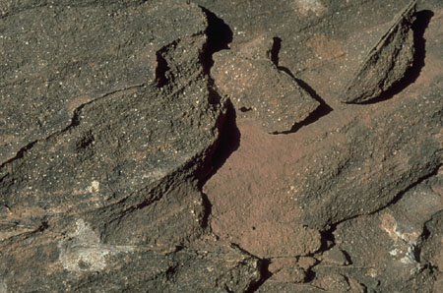
SUN
1. TRIBULATION 2. PERSECUTION 3. TEMPTATION
2. ROCKY GROUND
IMPULSIVENESS
MUCH FEELINGS
WEALTHY, HAPPY
CHARACTER – SHALLOW
CONVICTION & COURAGE
HEAR, REJOICE, BUT NO OBEDIENCE, NON- PRODUCTIVE

Slide 48
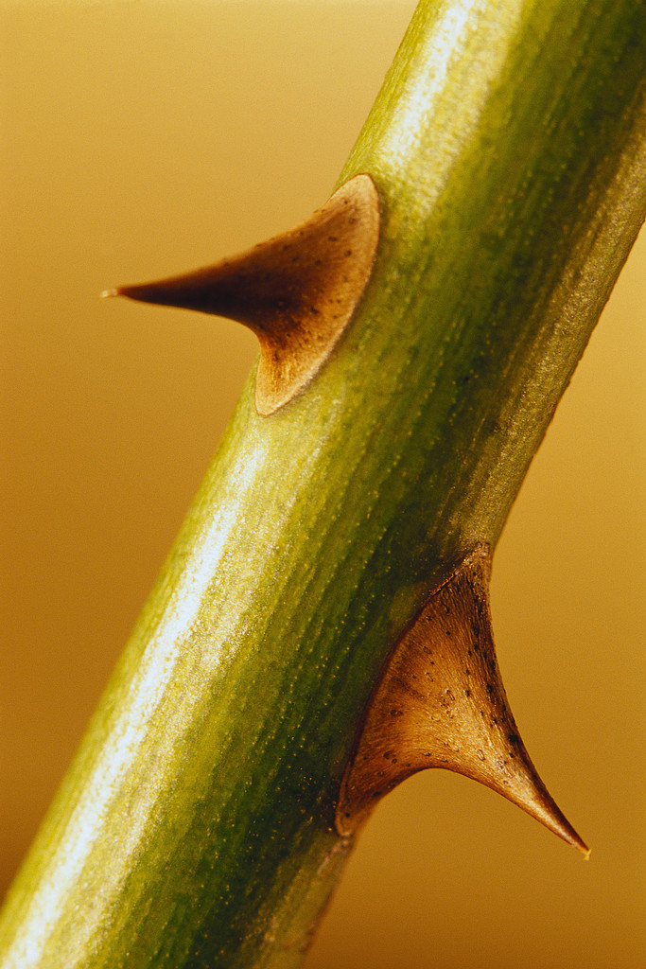
3. THORNY GROUND
THORNS
CARES
RICHES
PLEASURES
DESIRES
HEAR, BUT RESPOND TO WORLD, DESTRUCTIVE, UNFRUITFUL

Slide 49
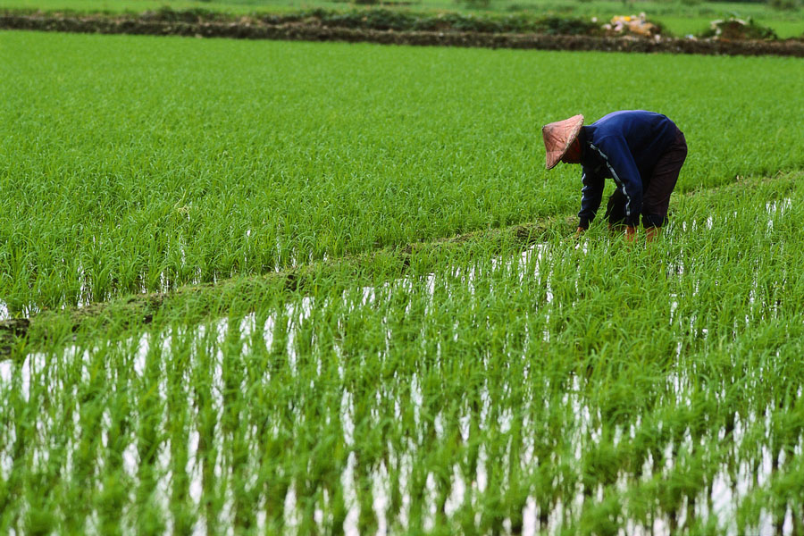
4. GOOD GROUND
HEAR, UNDERSTAND, OBEY, PRODUCTIVE

Slide 50
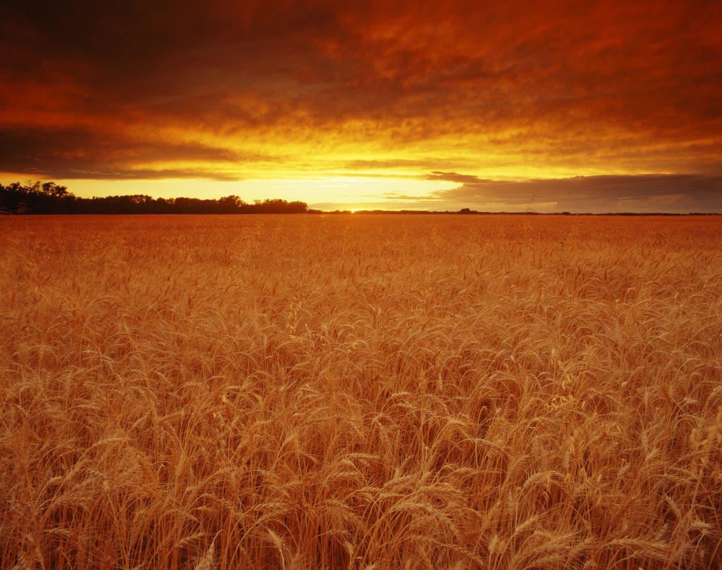
4. GOOD GROUND
HEAR, UNDERSTAND, OBEY, PRODUCTIVE
WISDOM
PRUNING
OBEDIENCE
INFLUENCE
EXCHANGED LIFE
DREAM

Slide 51
A PRAYER
Dear God,
Breaking through change is never easy, and yet growth demands it.
Therefore I fearfully step out of my world of defeatism and cautiously open myself to a world of winners.

Slide 52
A PRAYER
It will take time, Lord.
Therefore, please enable me to be patient in letting You and others help me become perfect and complete, lacking in nothing.

Slide 53
A PRAYER
Truthfully, Father, I am still intimidated and lack strength.
Therefore I ask that You will do something for me that I cannot do for myself. And as my life changes and a “better me” becomes a reality, I’ll give You all the praise.
For Jesus’ sake, Amen!

Slide 54
REFLECTIONS
1. The progression of sin begins with how we think, then how we behave and ends up with to whom we belong. We need to check on the starting point and consider the source of our counsel. Is the advice godly or ungodly? Can we trust our own conscience?

Slide 55
REFLECTIONS
2. Our heart is never meant to be a vacuum. We will have our delight. Personal pleasure could be selfishness. Pleasure with other people will fall short. God’s Presence and Promises should be our eternal delight. How much do we hunger for God and His Word?

Slide 56
REFLECTIONS
3. (Deu 30:19) I call heaven and earth to record this day against you, that I have set before you life and death, blessing and cursing: therefore choose life, that both thou and thy seed may live:
(1) (Psa 1:1) Blessed is the man that walks not in the counsel of the ungodly, nor stands in the way of sinners, nor sits in the seat of the scornful.
(2) OR “Cursed is the man that walks in the counsel of the ungodly, and stands in the way of sinners, and sits in the seat of the scornful.”

Slide 57
QUESTION ONE
Please read Mark chapter one and observe and write down the following:
1. Truths about God to meditate
2. Something to praise God for
3. A promise to believe
4. An example to follow
5. An example to avoid
6. A needed change of attitude
7. A verse to memorize
8. A prayer using the lessons learnt

Slide 58
QUESTION TWO
1. Please identify:
A. Three persons of positive influence in your life.
B. For each person, write down three good counsel or support in your life.
2. Please identify:
A. Three persons that you need to pray for and help.
B. For each, write down two advice or actions you will give.

Slide 59
Email: gohsengfong@hotmail.com
WhatsApp: +65-98207783
Website: www.faithatworkfellowship.org

