Slide 1
CONFLICT – Outside and Inside
NEHEMIAH 4, 5

Slide 2
(Nehemiah 4:1-4)
But it came to pass, that when Sanballat heard that we built the wall, he was wroth, and took great indignation, and mocked the Jews.
And he spake before his brethren and the army of Samaria, and said, What do these feeble Jews? will they fortify themselves? will they sacrifice? will they make an end in a day? will they revive the stones out of the heaps of the rubbish which are burned?
Now Tobiah the Ammonite was by him, and he said, Even that which they build, if a fox go up, he shall even break down their stone wall.
Hear, O our God; for we are despised: and turn their reproach upon their own head, and give them for a prey in the land of captivity:

Slide 3
(Nehemiah 4:5-8)
And cover not their iniquity, and let not their sin be blotted out from before thee: for they have provoked thee to anger before the builders.
So built we the wall; and all the wall was joined together unto the half thereof: for the people had a mind to work.
But it came to pass, that when Sanballat, and Tobiah, and the Arabians, and the Ammonites, and the Ashdodites, heard that the walls of Jerusalem were made up, and that the breaches began to be stopped, then they were very wroth,
And conspired all of them together to come and to fight against Jerusalem, and to hinder it.

Slide 4
(Nehemiah 4:9-12)
Nevertheless we made our prayer unto our God, and set a watch against them day and night, because of them.
And Judah said, The strength of the bearers of burdens is decayed, and there is much rubbish; so that we are not able to build the wall.
And our adversaries said, They shall not know, neither see, till we come in the midst among them, and slay them, and cause the work to cease.
And it came to pass, that when the Jews which dwelt by them came, they said unto us ten times, From all places whence ye shall return unto us they will be upon you.

Slide 5
TERM
Conflicts are disagreements, struggles or battles over opposing issues, methods, values, principles and goals with different attitudes and emotions.
“Conflictus” the Latin word, means an act of striking together or clashing with.” (Merriam-Webster).
In Greek, it is often “agon” from which we get the English “agony”. It means the actual struggle or strife – “what great conflict” (Col. 2:1).
The Chinese word is made up of two different symbols to indicate danger as well as opportunity. Conflicts then present the opportunity to change, grow and reflect God’s power in relationship.

Slide 6
(1). OUTSIDE FORCES
EMOTIONAL INSECURITY AND CONFLICTS ARE INTERTWINED.
THEY AFFECT EACH OTHER.

Slide 7
A. Emotional Attacks (Neh. 4:1-23)
First tactic: Ridicule
Put down, attacking sense of self-worth
Motive: substitute for reasoning because of fear
Contagious with someone leading. Cowards could not do it alone (enemies from all directions).
(Nehemiah 4:1-3) What do these feeble Jews? will they fortify themselves? will they sacrifice? will they make an end in a day? will they revive the stones out of the heaps of the rubbish which are burned? Now Tobiah the Ammonite was by him, and he said, Even that which they build, if a fox go up, he shall even break down their stone wall.

Slide 8
2. Second tactic: Resistance – organized (vs. 6-8)
Negative people gravitated together, conspiracy.
Stirring up trouble. Security & protection needed.
(Neh 4:7,8) But it came to pass, that when Sanballat, and Tobiah, and the Arabians, and the Ammonites, and the Ashdodites, heard that the walls of Jerusalem were made up, and that the breaches began to be stopped, then they were very wroth,
And conspired all of them together to come and to fight against Jerusalem, and to hinder it.

Slide 9
3. Third tactic: Rumour (vs. 11,12)
Feeding on people’s fear – “we are going to get you.”
No power to stop work but able to create fear.
Sustenance and strength needed.
Rumours were spread by those closest to the enemy.
They were exaggerated the more they were repeated (10 times over). Negative gets exaggerated.
Leaders should not swallow rumors (6:6, Gashmu).
(Nehemiah 4:12) And it came to pass, that when the Jews which dwelt by them came, they said unto us ten times, From all places whence ye shall return unto us they will be upon you.

Slide 10
B. The Effects
(Neh 4:10) And Judah said, The strength of the bearers of burdens is decayed, and there is much rubbish; so that we are not able to build the wall.
Effect: Discouragement – at half-way point (4:6). Purpose: to hinder and stop work
Strength giving out, fatigue
So much rubble – frustrated
We are not able – impossible – failure.
Enemies attacking – fear, paralysed actions

Slide 11
C. The Right Response
Rely on God - pray (vs. 4,5).
Face problem but focus on God.
He knows and will give confidence and strength (Acts 4:29-31).
(Nehemiah 4:4) Hear, O our God; for we are despised: and turn their reproach upon their own head, and give them for a prey in the land of captivity:
(Isa 41:10) Fear thou not; for I am with thee: be not dismayed; for I am thy God: I will strengthen thee; yea, I will help thee; yea, I will uphold thee with the right hand of my righteousness.

Slide 12
C. The Right Response (continue)
3. When ridiculed, do not take it out on people but talk it out with God.
Let God know – let off steam before Him.
Do not suppress feelings.
Confess the feelings.
Rely on God.
(Psa 13:2) How long shall I take counsel in my soul, having sorrow in my heart daily? how long shall mine enemy be exalted over me?
(Psalms 18:2) The LORD is my rock, and my fortress, and my deliverer; my God, my strength, in whom I will trust; my buckler, and the horn of my salvation, and my high tower.

Slide 13
4. Respect the opposition and sinful nature (Neh. 4:9).
Stronger the opposition, the stronger the response – posting of guards day and night
“We prayed” – following the leader – bonding corporate prayer.
Watch and Pray (Matt. 26:41; 1 Peter 5:8).
(Nehemiah 4:9) Nevertheless we made our prayer unto our God, and set a watch against them day and night, because of them.
(Col 4:2) Continue in prayer, and watch in the same with thanksgiving;

Slide 14
5. Reinforce the weak points (vs. 13).
Good leaders know where they are vulnerable and they reinforce that area (vs. 16f)
By families (vs. 13)
Rallying points with trumpets – keeping communication open (vs. 16)
We must build and battle at the same time.
(Nehemiah 4:13) Therefore set I in the lower places behind the wall, and on the higher places, I even set the people after their families with their swords, their spears, and their bows.

Slide 15
6. Reassure the people (vs. 14).
“Remember the LORD!” Great and Terrible Yahweh
If we fear the LORD, we are not going to fear people.
What we are doing is pleasing to the LORD – great assurance.
God is with us, in us and for us and will bring their actions to nothing
(Rom 8:31) What shall we then say to these things? If God be for us, who can be against us?
(Psalms 76:10) Surely the wrath of man shall praise Thee: the remainder of wrath shalt Thou restrain.

Slide 16
Refuse to quit. Do not give up!
a. Winners never quit. Quitters never win.
b. Ultimate test of leadership:
determination and persistence.
c. What does it take to stop me?
(Nehemiah 4:21) So we laboured in the work: and half of them held the spears from the rising of the morning till the stars appeared.
(1 Corinthians 15:58) Therefore, my beloved brethren, be ye stedfast, unmoveable, always abounding in the work of the Lord, forasmuch as ye know that your labour is not in vain in the Lord.

Slide 17
d. Reflections (by E. Dobson)
Let God’s Word determine which battle to be fought and when. Major on the important convictions.
Present a united front to the public.
Designate a spokesperson of good judgment.
Use an agreed written statement.
Coach the members what to say and to do.
Refer to the spokesperson for confirmation.
Stop those rumours by supplying truths regularly.
Encourage people to pray for wisdom and comfort.
Whenever in doubt, check with civil or church laws.

Slide 18
Fair conflicts allows people who are charged with inappropriate behaviour:
to know who their accusers are
to learn what their concerns are
to respond to those who accuse face to face
Questions to potential carriers of evil reports:
What is your reason for telling me?
Where did you get that information?
Have you gone to those directly involved?
Have you personally checked out the facts?
Can I quote you when I check out the facts?

Slide 19
(2). CONFLICT ARISING INSIDE
SABOTAGE
HOUSE DIVIDED
(Mark 3:25) And if a house be divided against itself, that house cannot stand.

Slide 20
(Neh 5:1) And there was a great cry of the people and of their wives against their brethren the Jews.
(Neh 5:2) For there were that said, We, our sons, and our daughters, are many: therefore we take up corn for them, that we may eat, and live.
(Neh 5:3) Some also there were that said, We have mortgaged our lands, vineyards, and houses, that we might buy corn, because of the dearth.
(Neh 5:4) There were also that said, We have borrowed money for the king's tribute, and that upon our lands and vineyards.

Slide 21
(Neh 5:5) Yet now our flesh is as the flesh of our brethren, our children as their children: and, lo, we bring into bondage our sons and our daughters to be servants, and some of our daughters are brought unto bondage already: neither is it in our power to redeem them; for other men have our lands and vineyards.
(Neh 5:6) And I was very angry when I heard their cry and these words.
(Neh 5:7) Then I consulted with myself, and I rebuked the nobles, and the rulers, and said unto them, Ye exact usury, every one of his brother. And I set a great assembly against them.

Slide 22
(Neh 5:8) And I said unto them, We after our ability have redeemed our brethren the Jews, which were sold unto the heathen; and will ye even sell your brethren? or shall they be sold unto us? Then held they their peace, and found nothing to answer.
(Neh 5:9) Also I said, It is not good that ye do: ought ye not to walk in the fear of our God because of the reproach of the heathen our enemies?
(Neh 5:10) I likewise, and my brethren, and my servants, might exact of them money and corn: I pray you, let us leave off this usury.

Slide 23
(Neh 5:11) Restore, I pray you, to them, even this day, their lands, their vineyards, their oliveyards, and their houses, also the hundredth part of the money, and of the corn, the wine, and the oil, that ye exact of them.
(Neh 5:12) Then said they, We will restore them, and will require nothing of them; so will we do as thou sayest. Then I called the priests, and took an oath of them, that they should do according to this promise.
(Neh 5:13) Also I shook my lap, and said, So God shake out every man from his house, and from his labour, that performeth not this promise, even thus be he shaken out, and emptied. And all the congregation said, Amen, and praised the LORD. And the people did according to this promise.

Slide 24
A. Causes (vs. 1;5) – real problem is selfishness (cry against Jewish brothers, profiteering).
Food shortage – famine and high prices (vs. 2)
Over-mortgaged – financial bondage (vs. 3)
High Taxes and borrowing (vs. 4), exploiting
Children into slavery (vs. 5), collateral
God’s Word said otherwise: Exod. 22:25; Deut. 23:19-20; Lev. 25:35-37 – no charging of interest n no enslaving
Root cause of internal conflict is always selfishness.
(Jas 4:1) From whence come wars and fightings among you? come they not hence, even of your lusts that war in your members?

Slide 25
B. Cure (vs. 6-13).
Reaction: Get angry (vs. 6) – very angry (Because of Injustice)
(Eph 4:26) Be ye angry, and sin not: let not the sun go down upon your wrath:
(Mar 11:15) And they come to Jerusalem: and Jesus went into the temple, and began to cast out them that sold and bought in the temple, and overthrew the tables of the moneychangers, and the seats of them that sold doves;

Slide 26
“Releasing Anger” Prayer
Lord Jesus, thank you for loving me.
Thank You for caring for me.
Since You know everything,
You know the strong sense of
(hurt/injustice/fear/frustration)
I have felt about (name or situation).
Thank You for understanding my anger.
Right now, I release all of my anger to You.
Please forgive me and I trust my future to You.
In Jesus’ Name, I pray. Amen.

Slide 27
Reflection: Think before I speak (vs. 7a) – he pondered in his mind.
(Jas 1:19,20) Wherefore, my beloved brethren, let every man be swift to hear, slow to speak, slow to wrath:
For the wrath of man works not the righteousness of God.

Slide 28
3. Rebuke: Confront privately the offending party – nobles and officials. Tough calls. Unpopular, Costly
(Isa 50:7) For the Lord GOD will help me; therefore shall I not be confounded: therefore have I set my face like a flint, and I know that I shall not be ashamed.
(Luk 9:51) And it came to pass, when the time was come that He should be received up, He stedfastly set His face to go to Jerusalem,

Slide 29
Resolution: Publicly deal with public divisions (vs. 7c) – set before a great assembly.
(Neh 5:11) Restore, I pray you, to them, even this day, their lands, their vineyards, their olive-yards, and their houses, also the hundredth part of the money, and of the corn, the wine, and the oil, that ye exact of them.
(Neh 5:12) Then said they, We will restore them, and will require nothing of them; so will we do as thou sayest. Then I called the priests, and took an oath of them, that they should do according to this promise.

Slide 30
Resolution: Publicly deal with public divisions (vs. 7c). Deal to the degree they are known (continue)
Appeal to their conscience – not right.
Bad testimony – to outsiders too
Make restitution (vs. 10).
Public contract by an oath (vs. 12)
Visual lesson – shaking of aprons (vs. 13)

Slide 31
5. Reinforcement – Set an example of unselfishness (vs. 14-19).
Leaders ask others to do what they are already doing.
No lording and taxing the people as Governor
Hospitable to own people and others
(1Th 2:10) Ye are witnesses, and God also, how holily and justly and unblameably we behaved ourselves among you that believe:

Slide 32
(Neh 5:17) Moreover there were at my table an hundred and fifty of the Jews and rulers, beside those that came unto us from among the heathen that are about us.
(Neh 5:18) Now that which was prepared for me daily was one ox and six choice sheep; also fowls were prepared for me, and once in ten days store of all sorts of wine: yet for all this required not I the bread of the governor, because the bondage was heavy upon this people.

Slide 33
(3). ASKING TO DO SOMETHING WRONG
(Daniel 1:3-5)
And the king spake unto Ashpenaz the master of his eunuchs, that he should bring certain of the children of Israel, and of the king's seed, and of the princes;
Children in whom was no blemish, but well favoured, and skilful in all wisdom, and cunning in knowledge, and understanding science, and such as had ability in them to stand in the king's palace, and whom they might teach the learning and the tongue of the Chaldeans.
And the king appointed them a daily provision of the king's meat, and of the wine which he drank: so nourishing them three years, that at the end thereof they might stand before the king.

Slide 34
(Daniel 1:8-11)
But Daniel purposed in his heart that he would not defile himself with the portion of the king's meat, nor with the wine which he drank: therefore he requested of the prince of the eunuchs that he might not defile himself.
Now God had brought Daniel into favour and tender love with the prince of the eunuchs.
And the prince of the eunuchs said unto Daniel, I fear my lord the king, who hath appointed your meat and your drink: for why should he see your faces worse liking than the children which are of your sort? then shall ye make me endanger my head to the king.
Then said Daniel to Melzar, whom the prince of the eunuchs had set over Daniel, Hananiah, Mishael, and Azariah,

Slide 35
(Daniel 1:12-17) Prove thy servants, I beseech thee, ten days; and let them give us pulse to eat, and water to drink. Then let our countenances be looked upon before thee, and the countenance of the children that eat of the portion of the king's meat: and as thou seest, deal with thy servants.
So he consented to them in this matter, and proved them ten days. And at the end of ten days their countenances appeared fairer and fatter in flesh than all the children which did eat the portion of the king's meat.
Thus Melzar took away the portion of their meat, and the wine that they should drink; and gave them pulse.
(Daniel 1:17 KJV) As for these four children, God gave them knowledge and skill in all learning and wisdom: and Daniel had understanding in all visions and dreams.

Slide 36
1. Check my attitude.
An independent attitude is the basis of disloyalty.
A condemning one is the basis of self-righteousness.
An ungrateful heart is the basis of pride.
A lazy spirit is the basis of dishonesty and poverty.
A bitter attitude is the basis of selfishness.
An impure spirit is the basis of self-indulgence.
2. Clear my conscience.
Correct and apologise for the offending attitudes.
Fulfil the unfinished duties.
Learn to defer, limiting freedom to avoid offending taste.

Slide 37
3. Discern the basic desires.
Ask what and why the goals are.
Ask him to point out any shortcoming.
Discern God’s goals to be accomplished.
4. Design creative alternatives.
Remove any resistant spirit in order to be creative.
Use situation to grow my frame of reference.
Gain insights and ideas from book of Proverbs.
Design an alternative which can reach his goal.
(Psalms 76:10) Surely the wrath of man shall praise Thee: the remainder of wrath shalt Thou restrain.

Slide 38
Appeal to the authority.
Have an humble attitude of a learner and servant.
Explain convictions without spirit of condemnation.
Present the creative alternative to reach his goal.
Leave the final decision up to him.
Give God time to change his mind.
Expect him to respond with extra pressure on me.
Expect God to work on him in His time.
Know that God will bring forth benefits.
(Romans 8:28) And we know that all things work together for good to them that love God, to them who are the called according to His purpose.

Slide 39
Suffer for not doing what is wrong.
(1 Peter 4:19) Wherefore let them that suffer according to the will of God commit the keeping of their souls to Him in well doing, as unto a faithful Creator.
Disciples were to be willing to be rejected by family (Mt. 10:32-39).
Disciples were to preach though forbidden by officials (Acts 4:19).
Daniel was willing to die rather than worship the king (Dan. 6:16-16).
Others were stoned, tortured, imprisoned and killed (Hebrews 11:35-40).

Slide 40
(4). ATTITUDE - HUMBLING
1. (1 Cor. 16:14; 1 Peter 4:8; Rom. 5:5). Do I love God and people enough?
2. Peaceful heart (John 14:27), Jesus’ promised peace with Jesus as Source.
(1Co 16:14) Let all your things be done with love.

Slide 41
3. Self-control (Gal. 5:22,23, Gal. 6:1 – take heed). God is in control (Dan. 4:35).
(Dan 4:35) And all the inhabitants of the earth are reputed as nothing: and He doeth according to His will in the army of heaven, and among the inhabitants of the earth: and none can stay His hand, or say unto Him, What doest Thou?

Slide 42
4. Wisdom (James 1:5; 3:17). Pure, gentle, peaceable and full of mercy.
5. Discernment (Eccl. 8:5). Time and Judgment with personal involvement (John 7:24)
(Joh 7:24) Judge not according to the appearance, but judge righteous judgment.

Slide 43
6. Words to speak (Psalm 141:3; Luke 12:11,12; Prov. 15:1). Soft answer turns away anger.
7. Second mile (Matt. 5:41;44), even to enemies. Love, bless, do good and pray for them.
(Psa 141:3) Set a watch, O LORD, before my mouth; keep the door of my lips.

Slide 44
8. The goal is not “WINNING”
BUT RECONCILIATION TO GOD
(2Co 5:18) And all things are of God, who hath reconciled us to Himself by Jesus Christ, and hath given to us the ministry of reconciliation;
(2Co 5:19) To wit, that God was in Christ, reconciling the world unto Himself, not imputing their trespasses unto them; and hath committed unto us the word of reconciliation.

Slide 45
PRAYER OF SALVATION
God, I need a real relationship with You. I admit many times, I have chosen to go my own way instead of Your way.
Please forgive me for my sins. Jesus, thank You for dying on the Cross to pay the penalty for my sins.
Please come into my life to be my Lord and Saviour.
Change me from the inside and make me the person You created me to be. In Jesus’ Name, I pray. Amen

Slide 46
9. Reflections – Managing
Who are involved in the conflict? Any manager?
What are the goals of all – long or short term?
List the reasons for actions or inactions?
Where will it happen at another place or time?
When does this managing done with time line?
How is it to be done? Policy and procedures?
Clearly define the problem together.
Explore alternative solutions by collaboration, negotiation or dichotomy (one or the others), by deferring getting needs met to the future.

Slide 47
(Acts 6:1) And in those days, when the number of the disciples was multiplied, there arose a murmuring of the Grecians against the Hebrews, because their widows were neglected in the daily ministration.
(Acts 6:2) Then the twelve called the multitude of the disciples unto them, and said, It is not reason that we should leave the word of God, and serve tables.
(Acts 6:3) Wherefore, brethren, look ye out among you seven men of honest report, full of the Holy Ghost and wisdom, whom we may appoint over this business.
(Acts 6:4) But we will give ourselves continually to prayer, and to the ministry of the word.

Slide 48
(Acts 6:5) And the saying pleased the whole multitude: and they chose Stephen, a man full of faith and of the Holy Ghost, and Philip, and Prochorus, and Nicanor, and Timon, and Parmenas, and Nicolas a proselyte of Antioch:
(Acts 6:6) Whom they set before the apostles: and when they had prayed, they laid their hands on them.
(Acts 6:7) And the Word of God increased; and the number of the disciples multiplied in Jerusalem greatly; and a great company of the priests were obedient to the faith.

Slide 49
WORK TOWARDS CREATIVE SOLUTIONS (Acts 6:1-7)
What goals did the Grecian Jews have in this conflict?
Were they expecting the twelve disciples to be involved in the food distribution?
What goals did the disciples have in this conflict?
What was proposed?
Who were the ones selected to do the distribution?
How did the disciples demonstrate trust (v. 5)?
(clue: The chosen men were all Grecian Jews.)
What was the result of the decision (v. 7)?
How did the proposal satisfy both sets of goals and prevented split?
When you are in conflict, what goals do you have?
Will you keep in mind the other party’s goals and create solutions?

Slide 50
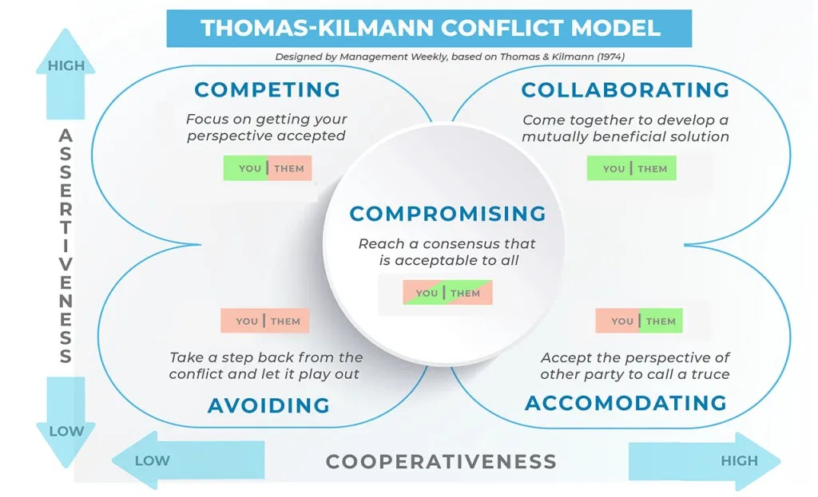

Slide 51
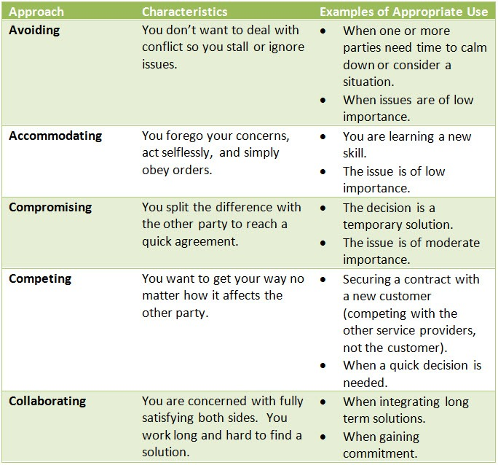

Slide 52
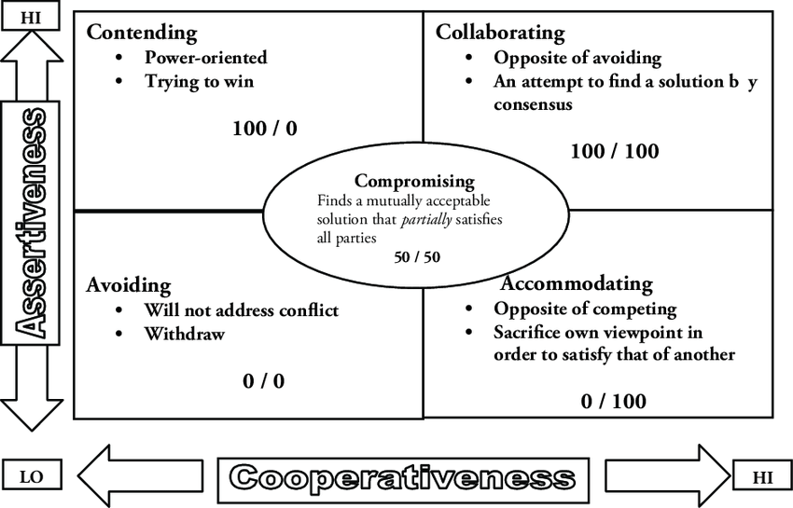

Slide 53
Competing is assertive and uncooperative—an individual pursues his own concerns at the other person’s expense.
This is a power-oriented mode in which you use whatever power seems appropriate to win your own position—your ability to argue, your rank, or economic sanctions.
Competing means “standing up for your rights,” defending a position which you believe is correct, or simply trying to win

Slide 54
Accommodating is unassertive and cooperative—the complete opposite of competing.
When accommodating, the individual neglects his own concerns to satisfy the concerns of the other person; there is an element of self-sacrifice in this mode.
Accommodating might take the form of selfless generosity or charity, obeying another person’s order when you would prefer not to, or yielding to another’s point of view.

Slide 55
Avoiding is unassertive and uncooperative—the person neither pursues his own concerns nor those of the other individual.
a. Thus he does not deal with the conflict.
b. Avoiding might be seen at times as a diplomatic move involving bypassing or ignoring the issue.
c. It could also involve putting off the issue until the time is favorable, or simply stepping back from an uncomfortable or hazardous situation.

Slide 56
Collaborating is both assertive and cooperative—the complete opposite of avoiding. Collaborating involves an attempt to work with others to find some solution that fully satisfies their concerns.
a. It means digging into an issue to pinpoint the underlying needs and wants of the two individuals. b. Collaborating between two persons might take the form of exploring a disagreement to learn from each other’s insights or trying to find a creative solution to an interpersonal problem.

Slide 57
Compromising is moderate in both assertiveness and cooperativeness. The objective is to find some expedient, mutually acceptable solution that partially satisfies both parties.
It falls intermediate between competing and accommodating. Compromising gives up more than competing but less than accommodating.
Likewise, it addresses an issue more directly than avoiding, but does not explore it in as much depth as collaborating.
In some situations, compromising might mean splitting the difference between the two positions, exchanging concessions, or seeking a quick middle-ground solution.

Slide 58
Each of us is capable of using all five conflict-handling modes. None of us can be characterized as having a single style of dealing with conflict.
But certain people use some modes better than others and, therefore, tend to rely on those modes more heavily than others—whether because of temperament or practice.
Your conflict behavior in the workplace is therefore a result of both your personal predispositions and the requirements of the situation in which you find yourself.
(Romans 12:18) If it be possible, as much as lieth in you, live peaceably with all men.

Slide 59
ASSIGNMENT – Live at peace, despite differences
(Rom. 14:1-6; 12-13; 19-23)
Does every dispute have only one true solution?
What spiritual issues did Paul identify that were better left to each individual’s conscience (between self & God)?
Do you think the people of that day considered those areas serious or unimportant?
What reasons did Paul provided for not judging concerning disputable matters?
What four actions did Paul instruct to take or to refrain from taking, in relation to the other party?
Do you have “a disputable matter” that you can live at peace with others without resolution (Rom. 12:18)?
What should be the principle to follow when dealing with dispute (Phil. 2:3,4)?

Slide 60
Email: gohsengfong@hotmail.com
WhatsApp: +65-98207783
Website: www.FaithAtWorkFellowship.org

