Slide 1
CONFLICT MANAGEMENT LESSON 1 – VISION AND MINISTRY
(Nehemiah 2:20) Then answered I them, and said unto them, The God of heaven, He will prosper us; therefore we His servants will arise and build: but ye have no portion, nor right, nor memorial, in Jerusalem.

Slide 2
TERMS
1. Conflicts are disagreements, struggles or battles over opposing issues, methods, values, principles and goals with different attitudes and emotions.
a. “Conflictus” the Latin word, means an act of striking together or clashing with.” (Merriam-Webster).
b. In Greek, it is often “agon” from which we get the English “agony”. It means the actual struggle or strife – “what great conflict” (Col. 2:1).
c. The Chinese word is made up of two different symbols to indicate danger as well as opportunity. Conflicts then present the opportunity to change, grow and reflect God’s power in relationship.

Slide 3
2. Management has the minimum objective to control the differences in a way that permits people to function, to get along and to do the best to oversee, direct and control differences.
3. The objective of resolution is to conclude the conflict through some process of reducing things into simpler form, or to lessen the conflict. Not all conflicts can be resolved but can be managed (Rom. 12:18).
4. In reconciliation, the objective is not only to resolve but also to restore and to nurture the relationship and to walk together toward the same goal (Amos 3:3). Reconciliation may be inappropriate such as in the case of adultery or cult entrapment.

Slide 4
5. Identifiable Conflicts (by Speed Leas)
a. Change in Leadership styles – introvert or extrovert
b. Staff conflict due to different expectations
c. Doctrinal and vision disagreements among leaders
d. Differing priorities about financial expenditures and budgeting
e. Marriage conflict and divorce
f. Disagreements over use of church facilities
g. Sexual abuses and love triangles of members
h. Attempts to fire the Pastor or other leaders
i. Loss or gain in membership – issues of control, care, comfort
j. Clashes over music and style of worship

Slide 5
6. Volunteers Burnt out (by T. Rainer)
No return on Investment – nothing matters.
No Life change – just spiritual activities.
No Desire – burnt out with too many activities
No Breaks – too much work and few workers
No attachment to vision and future – ownership needed.
No appreciation and respect – feeling of being used.
No community and relationship building and caring
No urgency related to the ministry to make a difference

Slide 6
CHALLENGE OF VISION AND MINISTRY
(Proverbs 29:18) Where there is no vision, the people perish: but he that keeps the law, happy is he.
(Nehemiah 2:20) Then answered I them, and said unto them, The God of Heaven, He will prosper us; therefore we His servants will arise and build: but ye have no portion, nor right, nor memorial, in Jerusalem.

Slide 7
THE LEADER – NEHEMIAH
(Everything rises or falls on leadership.)
A. Three phases – cupbearer, builder and governor (promotion and redemptive lift)
There was credibility, dependability and availability.
Watch out for promotion erosion (Ps. 75:6)
B. Three areas to be examined:
His Heart - man of FAITH – He was faithful, available, initiating, teachable and hungry.
His Prayers
His Temptations – position (be more), power (do more) and privilege (have more).

Slide 8
C. Dark Side of Leadership (by Gary McIntosch & S. Rima)
Compulsive Leader (Moses)
Status conscious, looking for re-assurance and approval from authority
Ties to control activities and keep order as a workaholic.
At times, excessively moralistic, conscientious and judgmental.
At heart, an angry and rebellious spirit with repressed anger and resentment (Num. 20:7-12)
Narcissistic Leader (Solomon)
a. Driven to succeed by a need for admiration and recognition
An over-inflated sense of importance with grandiose ambition and fantasies
At heart, self-absorption and uncertainty due to deep sense of insecurity
No enjoyment of success and may be dissatisfied with life.
(Ecclesiastes 1:2) Vanity of vanities, saith the Preacher, vanity of vanities; all is vanity.

Slide 9
Paranoid Leader (King Saul)
Suspicious, hostile, fearful and jealous (1 Sam. 18:7,8)
Hypersensitive to those who are successful and consider these as rivals.
Attachment of subjective meaning to motives and create rigid rules for control.
At heart, are strong feelings of insecurity and a lack of confidence.
Co-dependent Leader (Samson)
Peacemaker that cover up problems rather than face them, in effort to balance the group system. Reactive rather than active (Judg. 15:1-8)
Very benevolent with high tolerance for deviant behaviour
Willingness to take on more work so that he does not have to say no.
At heart, a repressed and frustrated person, who has trouble giving full and honest expressions to emotions or problems.

Slide 10
Passive-Aggressive Leader (Jonah)
Stubborn, forgetful, intentionally inefficient and impulsive
Tendency to complain, resist demands, procrastinate as a means of controlling the people and environment around
Exertion of control through use of short outbursts of sadness or anger
At heart, anger and bitterness as well as fear of success, since it will lead to higher expectations
(Jonah 4:3) Therefore now, O LORD, take, I beseech thee, my life from me; for it is better for me to die than to live.
Insights:
The dark side can never be eliminated but it can be overcome with a progressive exercise of a greater degree of self-management and self-discipline with boundaries and continued vigilance and mutual group accountability (2 Tim. 2:22).
To minimise its negative effects, we need to meditate and envision constantly on who God is and who we are in Christ Jesus.

Slide 11
D. The leader must know his GOD (Neh. 1:5 – the LORD God of Heaven, the great and awesome God – The Vision of God.
1. God’s Names:
a. Yahweh – the Eternal, ever-present One, who has revealed Himself (Exod. 3:14; 6:6; Ps. 46:1 – relational & covenantal God)
Compound names: Yahweh-nissi (Banner, Exod. 17:15), Yahweh-jireh (Provider, Gen 2:14), Yahweh-rohi (Shepherd, Ps. 23:1).
b. Elohim – the Almighty One, faithful and true (Gen.1:1) – creator, governor and provider
Compound names: El-Shaddai (Nurturer, Gen. 17:1), El-Olam (Gen. 21-33 – Everlasting God), El-Elyon (Ps. 78:35, Most High, Sovereign)
c. Adonai – the Lord of lords, Eternal Master of all (Psalm 90:1,2)
The God BIG enough to create and sustain in BIG enough to help.

Slide 12
2. Foundational Truths – Spiritual & Emotional Strength
a. God is the Source of life (Acts 17:28 – in Him, we live, move and have our being). HE is all we need.
b. God is the Controller (Isa.46:9-11). Nothing is out of control.
c. God is the Judge (2 Peter 2:23). HE has the last word.
d. God is the Master (Eccl. 12:13 – fear God and keep His commandments).
Focus on God to meet all our needs.
Anything less than God is not sufficient or satisfying.
(Daniel 4:35) And all the inhabitants of the earth are reputed as nothing: and He doeth according to His will in the army of Heaven, and among the inhabitants of the earth: and none can stay His hand, or say unto Him, What doest Thou?

Slide 13
3. Challenge – peaceful resting in the Oneness in God (Jn. 17:21)
Simplify to grow in intimacy and contentment in Him.
Discipline of Simplicity. GOD is our Source.
b. Be silent and be controlled by Him. Nothing is out of control. Discipline of Silence. GOD is Sovereign.
c. In solitude, be transformed to be like Him (cf. Gal. 5:22,23). Discipline of Solitude. GOD is our Judge. Rest in Him (Ps. 46:10).
Surrender to fulfil eternal purposes with Him (Prov. 3:5,6). Discipline of Surrender. GOD is our Adonai, Master.
(Proverbs 3:5) Trust in the LORD with all thine heart; and lean not unto thine own understanding. In all thy ways acknowledge Him, and He shall direct thy paths.

Slide 14
4. MY SELF-AWARENESS (1) My vision of Who I am and Whose I am.
I am a child of God, a new creation in Christ Jesus, of infinite worth and deeply loved (1 John 3:1; 2 Cor. 5:17; Luke 9:25; Jer. 31:3)
b. I am completely forgiven, fully pleasing and totally accepted in Him (Rom. 5:1; Col. 1:10, 28; Eph. 1:6).
c. I am absolutely complete in Him, one of a kind, nobody just like me … a designer original (Col. 3:10; Ps. 139:14).
(1 John 3:1) Behold, what manner of love the Father hath bestowed upon us, that we should be called the sons of God: therefore the world knows us not, because it knew Him not.
Find true and ultimate value and satisfaction in my identity in Christ Jesus, apart from my performance and achievement in the world.

Slide 15
5. OUR SELF-AWARENESS (2) – Vision of Who we are and Whose we are!
1. Of infinite worth and deeply loved – Sense of self-worth (value), security and serenity
2. Fully pleasing and totally accepted – Sense of satisfaction, stability and safety
Absolutely forgiven and complete in Christ – Sense of significance, sustenance and sufficiency
(Psalms 16:11) Thou wilt shew me the path of life: in Thy presence is fulness of joy; at Thy right hand there are pleasures for evermore.
Our greatest source of worth and pleasure is being known and loved by God and declared righteous, heirs and joint-heirs in Christ Jesus.

Slide 16
6. Prayer to be dependent upon the Lord to determine my worth and value
(Galatians 1:10) For do I now persuade men, or God? or do I seek to please men? for if I yet pleased men, I should not be the servant of Christ.
Dear Lord, Thank You for establishing my worth and value by dying for me and adopting me into Your family.
Because of Christ’s redemption, I am a new creation, a child of God, heir and joint-heir with Jesus, of infinite worth, deeply loved, completely forgiven, fully pleasing, totally accepted, absolutely complete and filled with His fullness, a designer original, one of a kind, really somebody and nobody just like me.
I will not live for the approval of people because I have Your approval and You are all I need. I do not have to prove anything, nor have anything to lose nor hide. I know who I am in Christ and whose I am. You are most worthy of my absolute love and trust.
Thank You, Lord. Amen.

Slide 17
E. PRAYER OF A LEADER (Neh. 1:4-11)
(Eze 22:30) And I sought for a man among them, that should make up the hedge, and stand in the gap before me for the land, that I should not destroy it: but I found none. (cf. Isa. 59:16, intercessor)
Leadership Thought: The effectiveness of my public leadership is determined by my private life. Prayer is the oxygen of my life.
1. WHEN SHOULD I PRAY?
Answer: Before I do anything else (1:3,4)
Leaders make prayer the first.
Losers make prayer the last.

Slide 18
2. When Nehemiah used prayer:
a. Occasion (1:4-11): After receiving bad news about the state of the people and the walls
Summary: Adored God, asked for hearing, confessed sins and asked for specific help (Revealing power)
Result: Included God in life, prepared Nehemiah’s heart and gave room for God to work (Jam. 4:6, grace needed)
b. Occasion (2:4): During conversation with King
Summary: “Help me, Lord.” (Source of all power)
Result: Expected results in God’s Hands (Prov. 21:1)

Slide 19
c. Occasion (4:4,5): After being taunted and ridiculed by Tobiah and Sanballat
Summary: “They are mocking You, Lord. You decide what to do with them.” (protecting power)
Result: Expressed anger to God, but did not take matters into his own hands (Mt. 5:10-12, blessed)
d. Occasion (4:9): After threats of attack by enemies
Summary: “We are in Your Hands. We will keep our weapons ready to fight if needed.” (power for service)
Result: Trusted God and took necessary precautions
(Acts 4:31; 1:8 – boldness and courage)

Slide 20
e. Occasion (6:9): Responding to threats
Summary: “O LORD, please strengthen me!” (strengthening power)
Result: Showed his reliance of God for emotional and mental strength (Mt. 26:41; Eph. 3:16)
f. Occasion (13:29): Reflecting on the actions of the enemies
Summary: Asked God to deal with enemies and their plans (grace all-sufficient)
Result: Took away desire to get revenge and entrusted justice to God (Rom. 12:19; 1 Peter 2:23)

Slide 21
g. Occasion (5:19; 13:14, 22, 31): Reflecting on his own service
Summary: “Remember me, God.” (Self-examination power)
Result: Clarified the motives for service (cf. Mark 12:30,31)
At least 23 instances of prayer – some lengthy and some spontaneous.
(1 Thessalonians 5:17) Pray without ceasing.
(James 5:16) Confess your faults one to another, and pray one for another, that ye may be healed. The effectual fervent prayer of a righteous man availeth much.

Slide 22
3. WHY SHOULD I PRAY?
a. It shows I am depending totally on God (cf. John 15:1-8; Matt. 5:3). Lord, what do you desire?
b. It lightens my load (Isa. 40:31).
(a) It makes wait patiently and trustingly for His will and timing
(b) It clears my vision, learning to see from God’s perspectives.
It rests my heart (Ps. 46:10) leaving my burden to Him.
c. It releases God’s power through faith (Jer. 33:3) – faith on fire.
Prayer can do what God can do.
(Luke 1:37) For with God nothing shall be impossible.

Slide 23
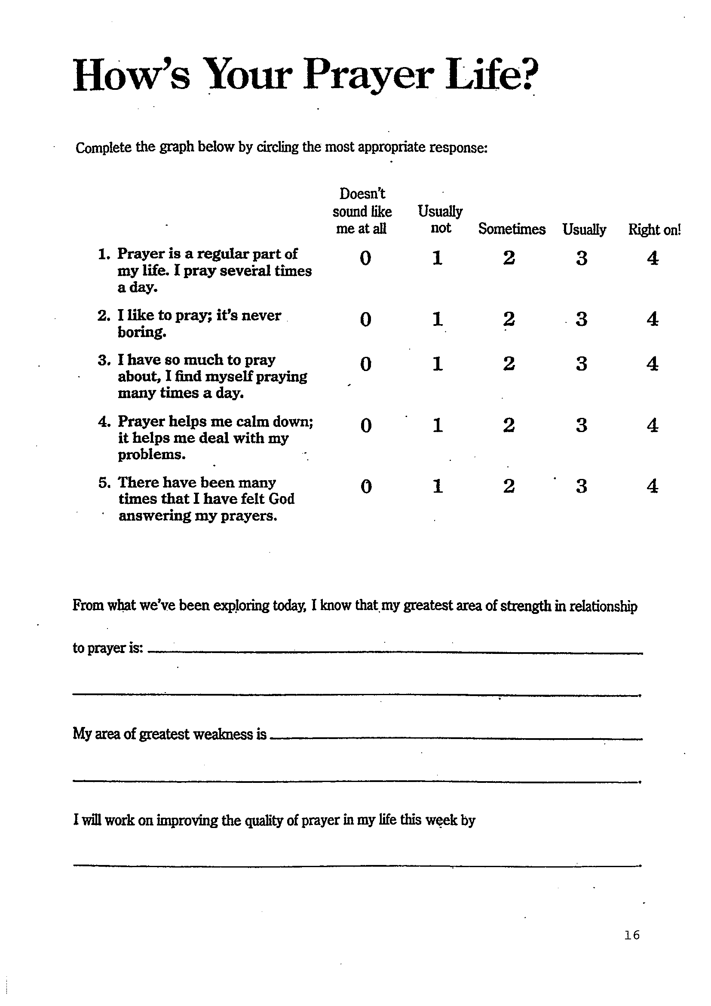

Slide 24
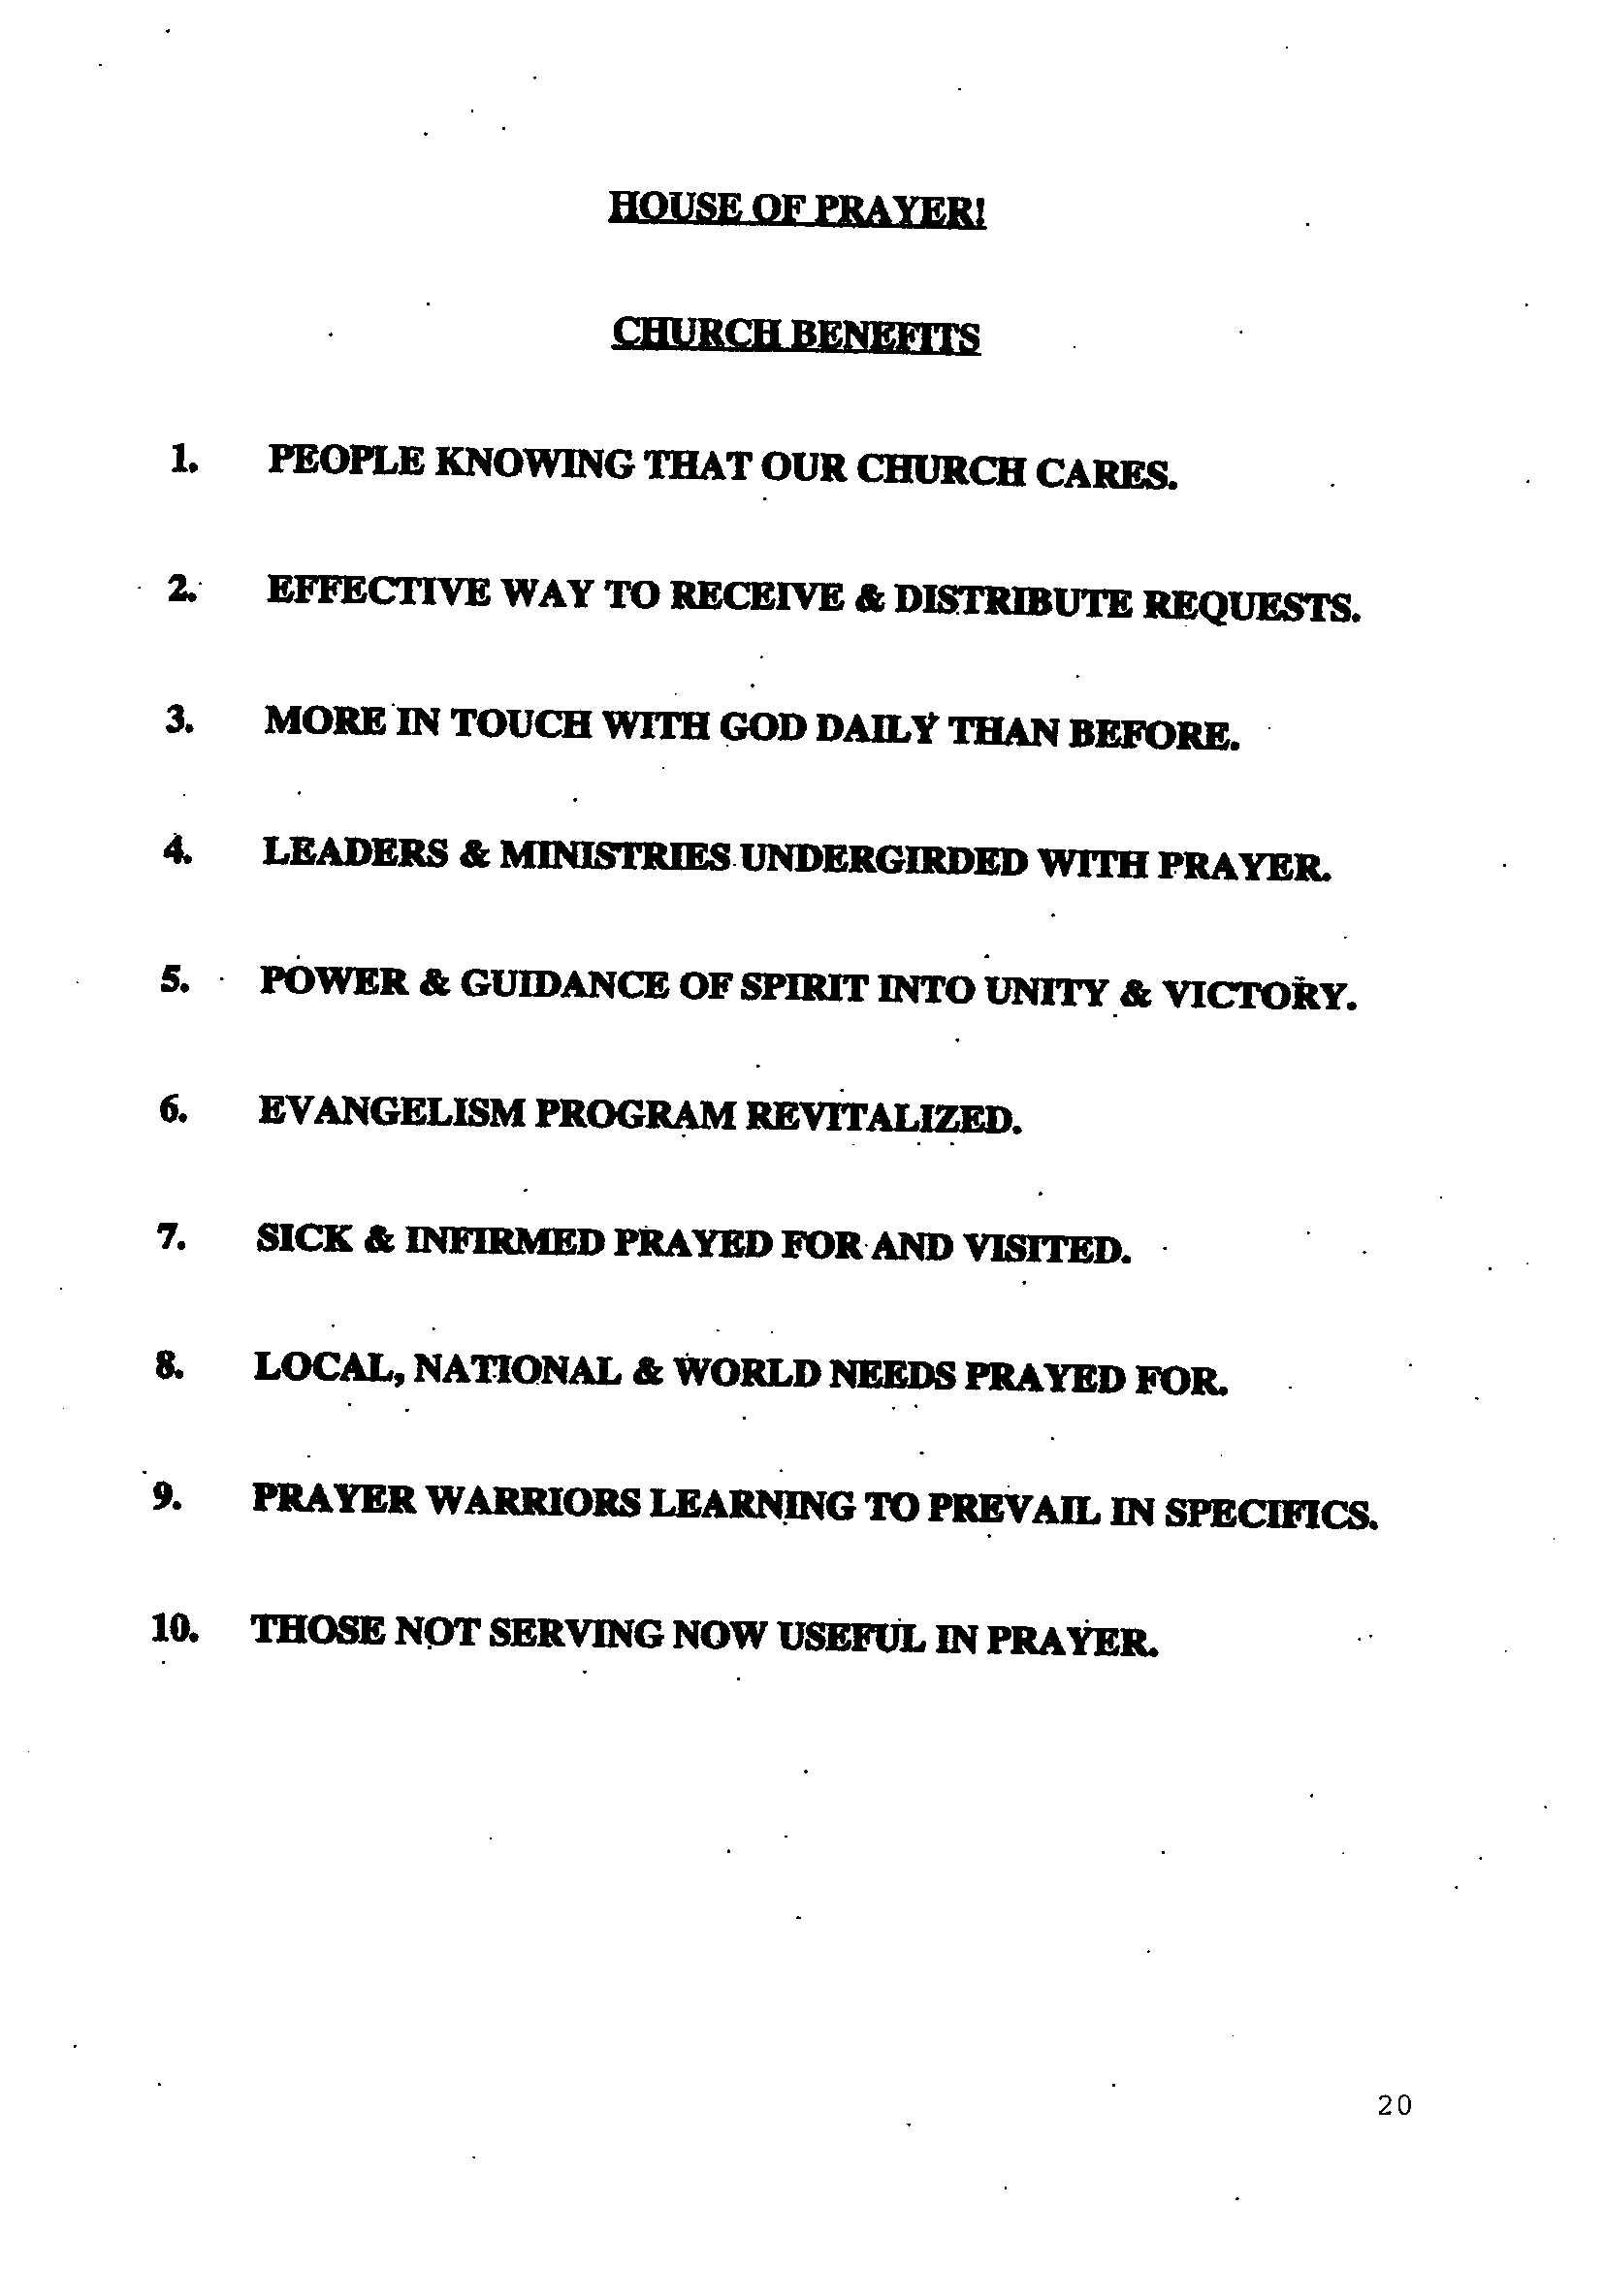

Slide 25
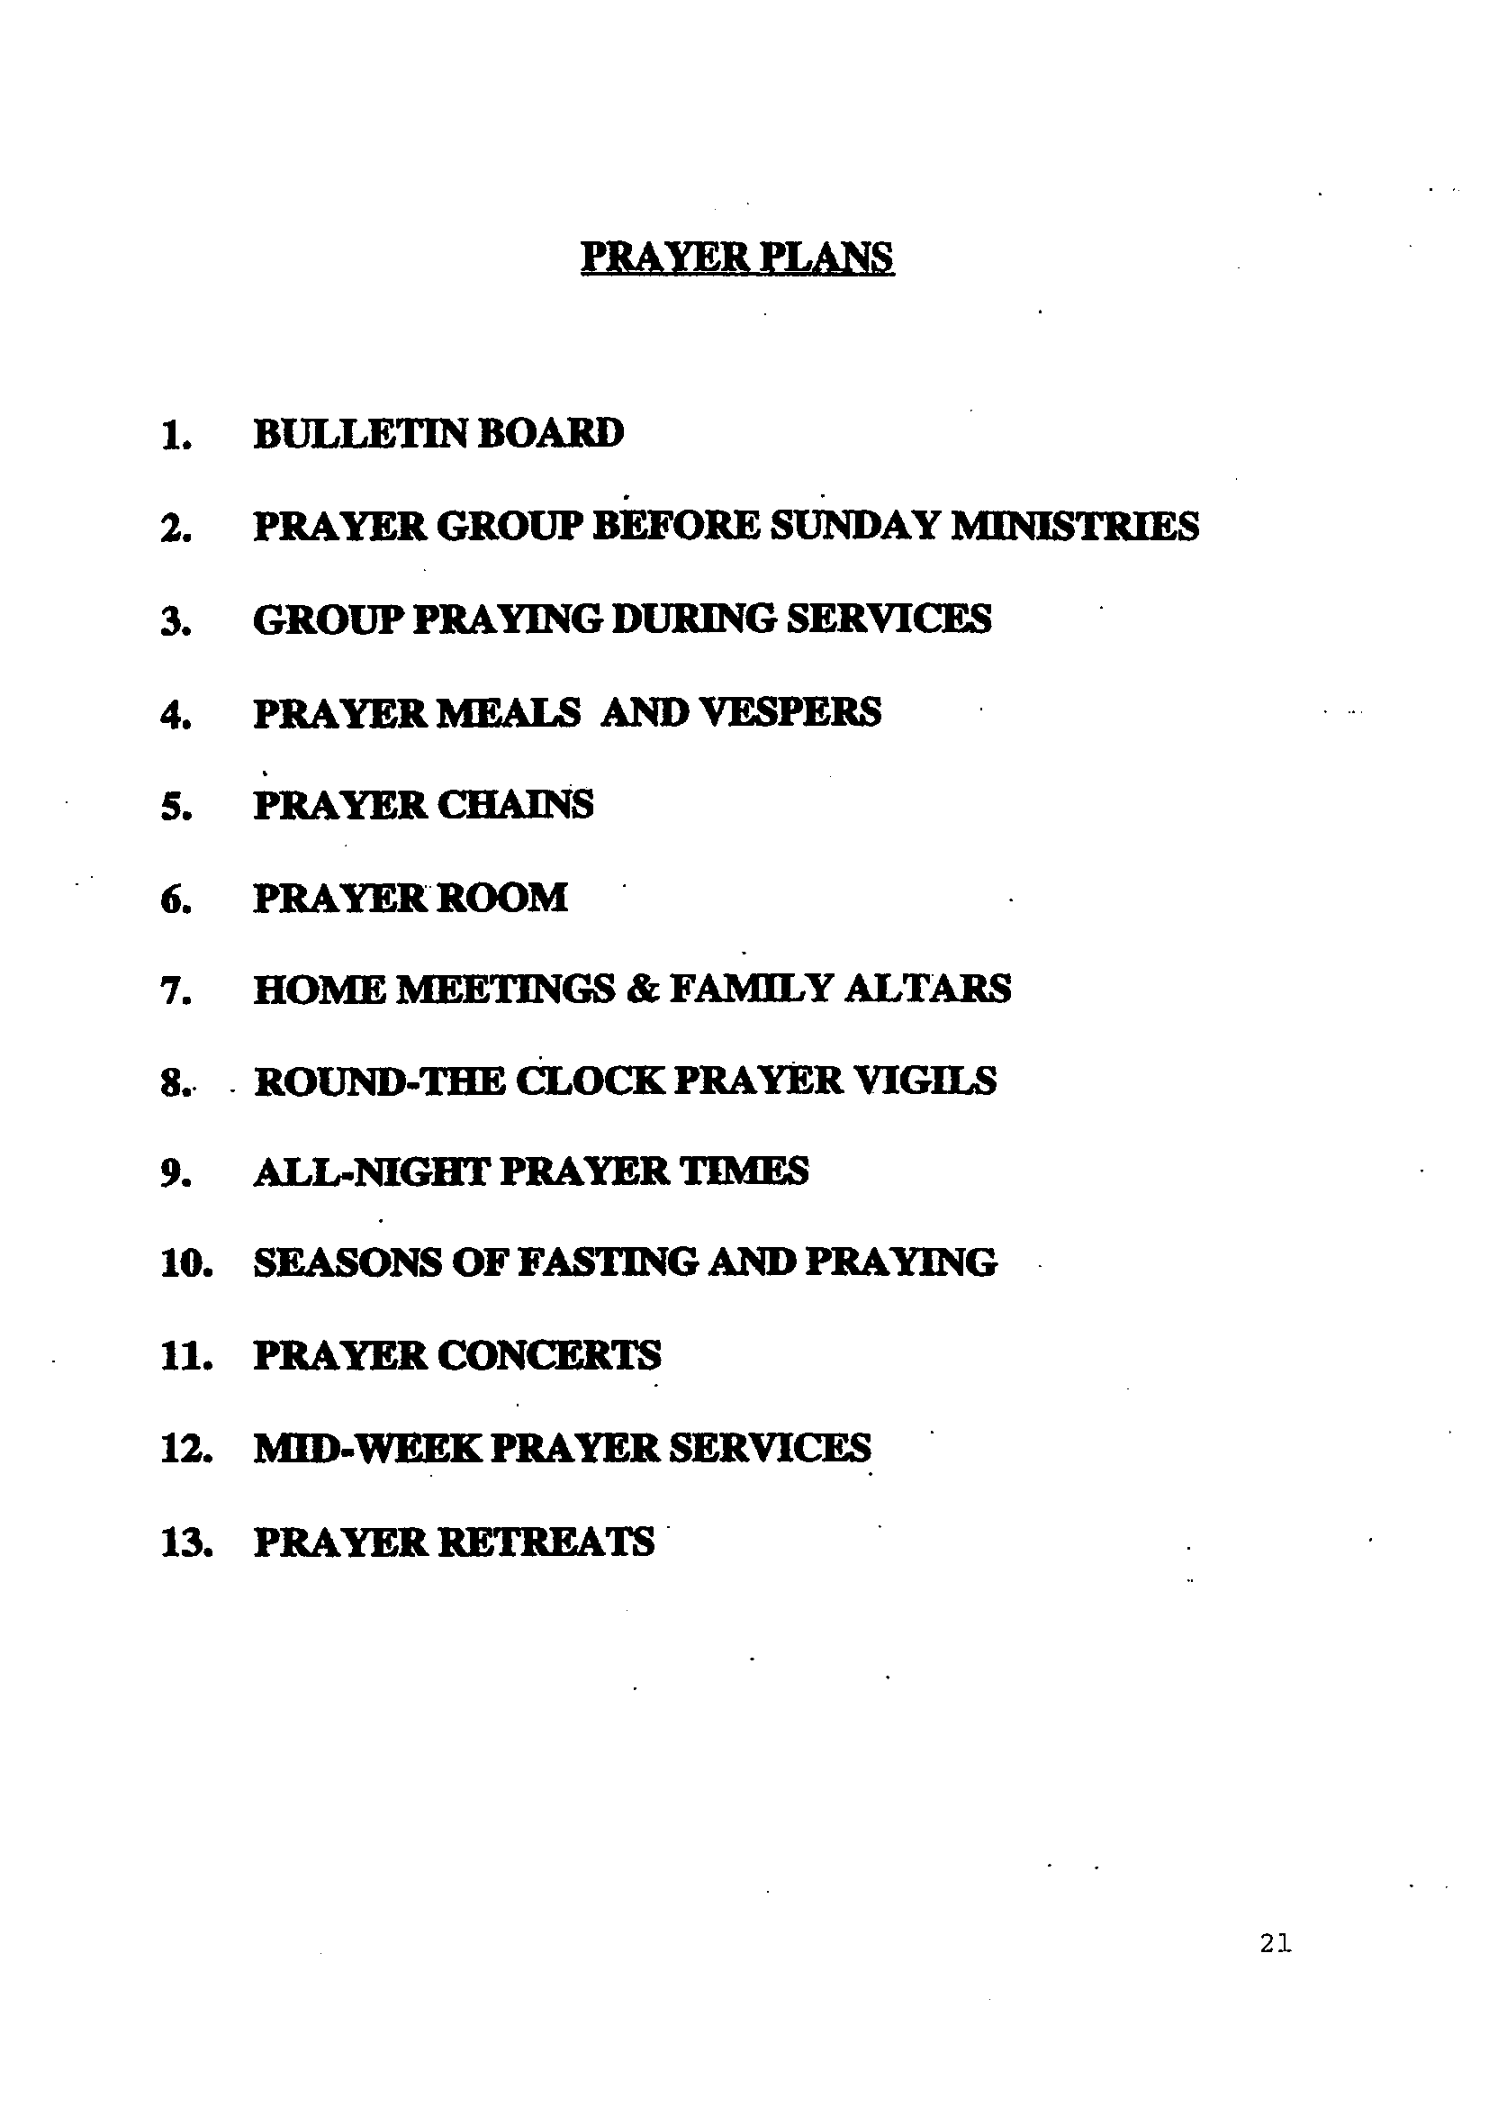

Slide 26
F. VISION OF MINISTRY: JEREMIAH KNEW WHERE HIS GOD WAS GOING.
1. Vision starts from within – we need to take a long look at our life.
a. Look within – examine inside – what do I know and feel? Dissatisfaction or fire in belly?
b. Look behind – what have I learned? Experiences add value to dreams.
c. Look around – what is happening to others? Meeting needs – what makes me cry and dream? What gives me energy?
d. Look above – What does God expect of me? What gives me the greatest reward, greatest return?

Slide 27
2. Two purposes for Nehemiah
a. Reconstruction of the Walls (Neh. 1-6)
Reconstruction of the People (Neh. 7-13)
Resulting in revival
Word giving insight, wisdom, singing and smiling (Chap 8, 12)
Corporate prayer and covenant (Chap 9)
Dedication (Chap. 11)
(Nehemiah 9:38) And because of all this we, and write it; and our princes, Levites, and priests, seal unto it make a sure covenant

Slide 28
3. Jesus’ Vision – that we be One with God (John 17:21-13)
a. His Personhood – in His image – like Jesus (Rom. 8:29; Gal. 5:22,23)
b. His Priorities
Cultural Commission (Gen. 1:26,27 – multiply and rule)
Great Commandments (Deut. 6:5; Lev.19:18; Mark 12:30,31 – Love God and people)
Great Commission (Matt. 28:18-20 – Make disciples – win, build, equip, multiply leaders)
His Glory (2 Cor. 3:18 – changed from glory to glory, filled with grace & truth, Jn 1:14)

Slide 29
4. Defining Your Church’s Purpose
a. It builds Morale
b. It reduces Frustration
c. It allows Focus
d. It attracts Co-operation
e. It assists Evaluation
Healthy Church Seminar

Slide 30
5. Five Instructions
a. “Love God with all your heart” – Worship
b. “Love your Neighbour as yourself” – Ministry
c. “Go….make Disciples” – Evangelism
d. “Baptizing them” – Fellowship
e. “Teaching them to do” – Equipping
Educate, structure, budget, calendar and evaluate on purposes.

Slide 31
6. The church exists to:
a. Celebrate God’s presence (Worship), growing stronger (Ps. 34:3).
b. Communicate God’s Word (Evangelism), growing larger (Acts 20:24).
c. Incorporate God’s family (Fellowship), growing warmer (Eph. 2:19).
d. Educate God’s people (Equipping), growing deeper (Eph. 4:12,13).
e. Demonstrate God’s love (Ministry), growing broader (Eph. 4:12a).
(Ephesians 4:12,13) For the perfecting of the saints, for the work of the ministry, for the edifying of the body of Christ:
Till we all come in the unity of the faith, and of the knowledge of the Son of God, unto a perfect man, unto the measure of the stature of the fulness of Christ:

Slide 32
7. Saddleback Church

Slide 33
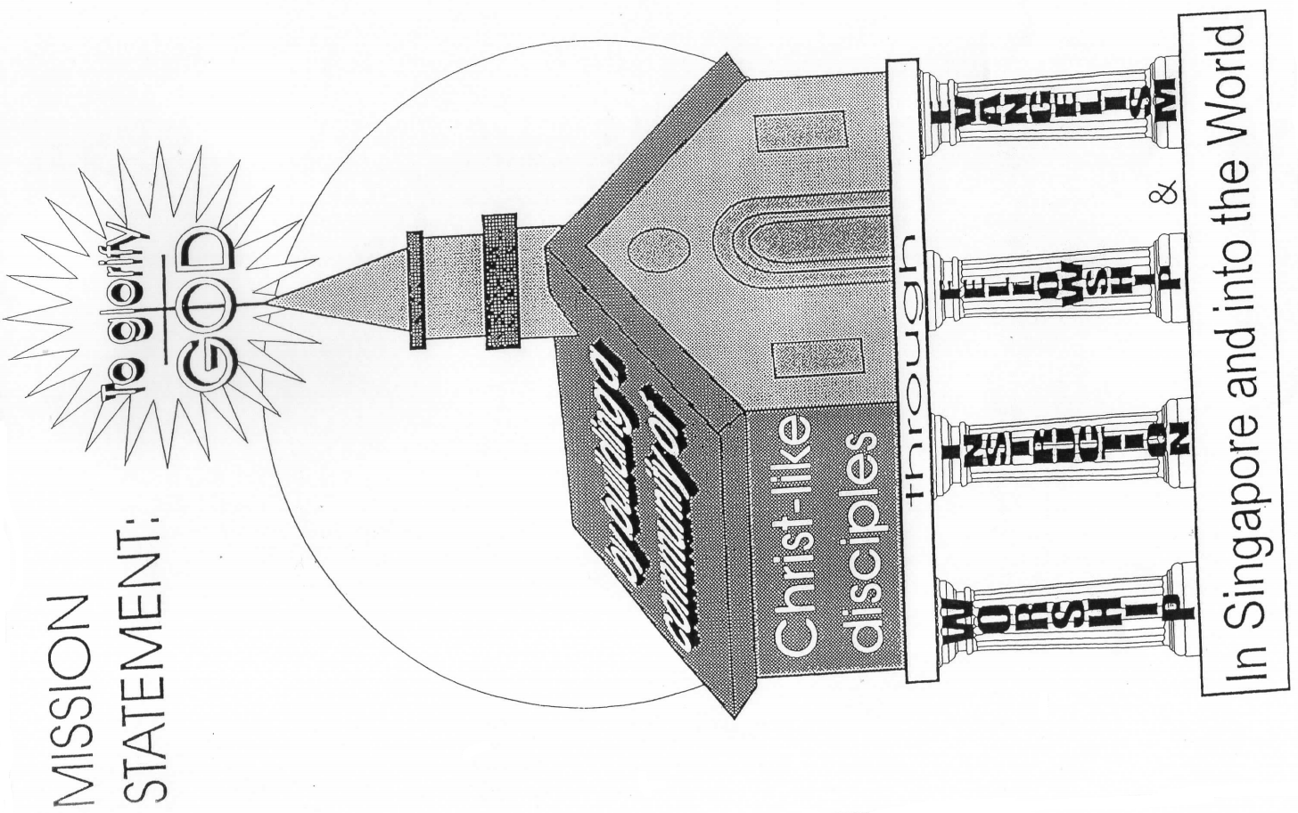

Slide 34
8. VISION: TO GLORIFY GOD BY MAKING CHRIST-LIKE DISCIPLES IN A COMMUNITY THAT CARES AND SHARES.
A. MOTIVE: TO GORIFY GOD (ISA. 42:8; 1 COR. 6:20; REV. 4:11).
B. MANDATE: TO MAKE DISCIPLES (MATT. 28:19-20).
C. MACHINERY: CHRIST-LIKE COMMUNITY (JOHN 13:35; EPH. 4:32).
D. MISSION: TO CARE AND SHARE (ACTS 2:41-47).

Slide 35
9. VISION: TO GLORIFY GOD BY MAKING CHRIST-LIKE DISCIPLES IN A COMMUNITY THAT CARES AND SHARES.
A. MYSELF: TO BE A GROWING CHRIST-LIKE DISCIPLE SO AS TO MAKE DISCIPLES OF LOVED ONES AND FRIENDS.
B. FAMILY: TO BE A BONDING COMMUNITY AS LIGHT AND SALT.
C. CHURCH: TO BUILD CHRIST-LIKE COMMUNITY THAT CARES AND SHARES.

Slide 39
H. THE PEOPLE
1. The outside – opposition (Neh. Chap 4,6)
2.. The inside – conflict (Chap 5), discouragement (4:12; 6:9) loafers (3:5), problems (chap 13)
Directories – Count and affirm people (Chap. 10-12)
The strategies – praying, planning, motivating and executing the project
(Nehemiah 6:15) So the wall was finished in the twenty and fifth day of the month Elul, in fifty and two days.

Slide 41
II. PRAY AND PLAN, PLAN AND PRAY (Neh. 2:1-9)
A. Why plan?
God does it (1 Cor. 14:33 – God is the author of peace)
(Jer 29:11) “For I know the thoughts that I think toward you, saith the LORD, thoughts of peace, and not of evil, to give you an expected end.”

Slide 42
2. God commands it (1 Cor. 14:40 – decently and in order)
(Pro 16:9) “A man's heart devises his way: but the LORD directs his steps.”
(Pro 4:26) “Ponder the path of thy feet, and let all thy ways be established.”
3. Planning shows good stewardship.
(Eph 5:15) “See then that ye walk circumspectly, not as fools, but as wise,”
(Eph 5:16) “Redeeming the time, because the days are evil.”
(Eph 5:17) “Wherefore be ye not unwise, but understanding what the will of the Lord is.”

Slide 43
B. Steps to be taken (by Rick Warren):
Think it through (4 months passed) (Neh. 2:1). Failing to plan is planning to fail.
We need to make time for “think” time. Nothing is more profitable and more demanding.
(Pro 13:16) Every prudent man deals with knowledge: but a fool lays open his folly.
(Pro 14:8) The wisdom of the prudent is to understand his way: but the folly of fools is deceit.
Questions to ask:
Where am I now?
Where am I going?
To be?
To do?
How do I get there?

Slide 44
2. Be prepared for opportunities (Neh. 2:1b-3).
(Neh 2:2) Wherefore the king said unto me, Why is thy countenance sad, seeing thou art not sick? this is nothing else but sorrow of heart. Then I was very sore afraid, (rejection of king)
We need to move ahead in spite of our fears.
Ready to answer (vs. 3) – prayed and assured king of his loyalty
The King’s response (vs. 4)
Nehemiah’s 3 requests (vs. 5,7,8) - Permission, Protection & Provision

Slide 45
3. Establish a goal. (Neh 2:5) And I said unto the king, If it please the king, and if thy servant have found favour in thy sight, that thou wouldest send me unto Judah, unto the city of my fathers' sepulchres, that I may build it. (specific goal)
a. Questions to ask:
What do I want to be?
What do I want to do?
What do I want to have?
b. Common errors in goal-setting
We set them too low.
We try to accomplish them too quickly.

Slide 46
Set a dead-line. (Neh 2:6) And the king said unto me, (the queen also sitting by him,) For how long shall thy journey be? and when wilt thou return? So it pleased the king to send me; and I set him a time.
Schedule it on the calendar: When to do task? How long? (12 years later, Neh. 5:14)
Presence of faith does not mean absence of plan and timing.
Goals are SMART goals:
Specific, Measureable, Achievable, Relevant and Time-bound.

Slide 47
Anticipate problems. (Neh 2:7) Moreover I said unto the king, If it please the king, let letters be given me to the governors beyond the river, that they may convey me over till I come into Judah;
Questions:
What would hold me back? (Idealism versus Realism)
What could go wrong?
Managers focus on solving today’s problems, while leaders focus on solving tomorrow‘s.
(Pro 22:3) A prudent man foresees the evil, and hides himself: but the simple pass on, and are punished. (cf. Prov. 27:12, prepares to meet them).

Slide 48
6. Calculate costs (for King’s pleasure, protection and provision).
(Luke 14:28) For which of you, intending to build a tower, sitteth not down first, and counteth the cost, whether he have sufficient to finish it? (cf. Prov. 24:3-4).
Leaders are willing to ask others for help (James 4:2).
The wisest risks are those taken after praying and planning.
(Pro 16:1) The preparations of the heart in man, and the answer of the tongue, is from the LORD.
(Proverbs 21:1) The king's heart is in the Hand of the LORD, as the rivers of water: He turns it whithersoever He wills.

Slide 49
Expect God’s gracious Hand (“the good Hand of the LORD upon me”, vs. 8b) – His sovereignty and control
Give God the credit and glory.
God gives exceeding abundantly above all we ask or think (vs. 9).
Leaders prepare for success rather than worry about failure as inevitable.
Plans from God are big enough for Him to move in and for others to be attracted.
(Ephesians 3:20) Now unto Him that is able to do exceeding abundantly above all that we ask or think, according to the power that works in us,

Slide 50
III. PRAY, PLAN AND EXECUTE
A. Expect opposition – resistance to change (Neh. 2:10).
(1Co 16:9) For a great door and effectual is opened unto me, and there are many adversaries.
1. There is no opportunity without opposition.
2. Forces of resistance
a. Barrier of the fearful unknown
b. Wall of traditional limitation
c. Obstacle course of personal excuses, eg. insecurity, comfort

Slide 51
B. Wait for the right timing (timing is everything) (waited 3 days, vs. 11).
1. What could he be doing?
Resting after long journey. (Do not make a major decision when tired or sick.)
Praying and planning (reviewing strategies).
Building curiosity – psychological build-up to readiness.
2. God has His own time-table.
(Isa 52:12) For ye shall not go out with haste, nor go by flight: for the LORD will go before you; and the God of Israel will be your rereward.
(Ecc 3:7) “ …a time to keep silence, and a time to speak;”
(Ecc 8:6) Because to every purpose there is time and judgment.

Slide 52
3. Some thoughts (from John Maxwell):
Wrong action at the wrong time leads to disaster.
Right action at the wrong time brings resistance.
Wrong action at the right time is a mistake.
Right action at the right time results in success.
(Ecclesiastes 3:1) To every thing there is a season, and a time to every purpose under the heaven:
(Galatians 4:4) But when the fulness of the time was come, God sent forth his Son, made of a woman, made under the law,

Slide 53
CYCLE OF SUCCESS
1. TEST – BETTER WAY? TAKE RISKS.
2. FAILURE – FAIL FORWARD WITHOUT LOSING ZEAL.
3. LEARN – WITH TEACHABLE SPIRIT FOR NEW THINGS.
4. IMPROVE – WITH EMPOWERED WISDOM & STRENGTH
5. RE-ENTER – REFRESH, REBUILD AND RELAUNCH.
TEST, FAIL, LEARN, IMPROVE AND RE-ENTER AGAIN.
(Ecclesiastes 3:6) A time to get, and a time to lose; a time to keep, and a time to cast away;

Slide 54
C. Get the facts first (Neh. 2:12-16).
Why at night?
Time to review without interruption
2. Protection of plans from pre-mature death
Good leaders do their own research.
(Pro 23:23) Buy the truth, and sell it not; also wisdom, and instruction, and understanding.
(Pro 14:15) The simple believeth every word: but the prudent man looks well to his going. (cf. Prov. 18:13).

Slide 55
D. Identify with your people (vs. 17a)
(Neh 2:17) Then said I unto them, Ye see the distress that we are in, … come, and let us build up the wall of Jerusalem, that we be no more a reproach.
Not blaming others nor be superior
Accepted blame, understood and identified with the people and situation (incarnational ministry)
The best ideas are not “mine” but “ours”.
Not just leading people but leading with people.

Slide 56
E. Dramatize the seriousness of the problem (vs. 17).
(Neh 2:17) Then said I unto them, Ye see the distress that we are in, how Jerusalem lieth waste, and the gates thereof are burned with fire: come, and let us build up the wall of Jerusalem, that we be no more a reproach.
Get people to face facts, with emotional word pictures.
He appealed to their self-esteem & discontent– in disgrace and reproach. We can do better.
He appealed to their concern for God’s glory.
The greatest motivation is not external, nor internal, but eternal – for His glory.

Slide 57
F. Ask for specific response (vs.17b) “… come and let us build up the wall”
1. Leaders see both the real (actual) and the ideal (possible), are realistic and optimistic.
Not afraid to ask for help, faith and sacrifice.
If people do buy into the leader but do not buy into vision – it is time for a new vision.
If people do buy into the leader and also buy into the vision, it is time to get behind the leader.

Slide 58
G. Encourage with personal testimony (vs. 18a).
1. His story – relationship built by his transparency & credibility
a. How God called him to lead – burden & vision, God’s idea
b. How circumstances confirmed his calling – God’s working in king
2. The people response gladly – vision had been transferred – shared burden. Lead with people. (after 90 years of wait)
3. People follow people, not just programs.
We have to touch the heart, before we ask for the hand. (1Co 11:1) Be ye followers of me, even as I also am of Christ.
People are ready to help when they sense God’s Hand upon our life.
The law of Buy-in – People buy into the leader, then the vision.

Slide 59
H. Answer the opposition quickly and confidently (vs. 20)
(Neh 2:20) Then answered I them, and said unto them, The God of Heaven, He will prosper us; therefore we His servants will arise and build: but ye have no portion, nor right, nor memorial, in Jerusalem.
1. Their first tactic – mocking and ridicule
a. Failed for last 90 years
b. Twice recent mocking (v 10, two persons; v 19, three persons)
c. Old accusation of rebellion against King (cf. Ezra 4:13)
(Proverbs 22:24) Make no friendship with an angry man; and with a furious man thou shalt not go:

Slide 60
2. Nehemiah refused to argue.
No intention to associate with them
Focus on God. He is in control. Believe and build.
The project was God’s idea. He can be trusted.
He exposed their selfish motives & reduced their influence.
Our life, not perfect, but we are attempting to grow and follow Christ. Live in the Audience of One.
Resolve today that toxic and abusive people will not take you down or even distract you from life and living His purpose.

Slide 61
IV. PRAY, PLAN, PRESENT AND EXECUTE (3:1-32)
Motivation without organization leads to frustration.
(1Co 14:40) Let all things be done decently and in order.
(Proverbs 11:14) Where no counsel is, the people fall: but in the multitude of counsellors there is safety.

Slide 62
A. Simplification: Keep it Simple. (KISS principle)
Nehemiah organized around natural groups: families (vs. 1, 2, 3, 5, 12 – 38 leaders named).
(Neh 4:13) I even set the people after their families with their swords, their spears …
The strongest organizations are the simplest.
(Beware of polarisation and safari syndrome.)

Slide 63
B. Participation:
Work with those who want to work.
Leaders love everyone, but move with movers.
Two kinds of people:
Workers – religious leaders, goldsmiths, perfume makers
Shirkers (vs. 5, the nobles of Tekoa, ignore them)
Three types of perspectives:
a. Those who do not know what is happening
b. Those who watch what is happening
c. Those who make things happen.

Slide 64
C. Delegation: (Manage by knowing people and their giftedness)
Assign specific people to the specific tasks.
Key Word: “section" = 13 times
1. He walked around the wall and divided it up clock-wise.
2. Break down major goals into smaller tasks.
3. Develop clear job description – what is expected and measurable.
4. Match the right person with the right task (SHAPE) & be accountable.
5. Remember that everyone’s responsibility is nobody’s.
SHAPE – Spiritual Gifts, Heart or passion, Ability or talent, Personality, Experiences

Slide 65
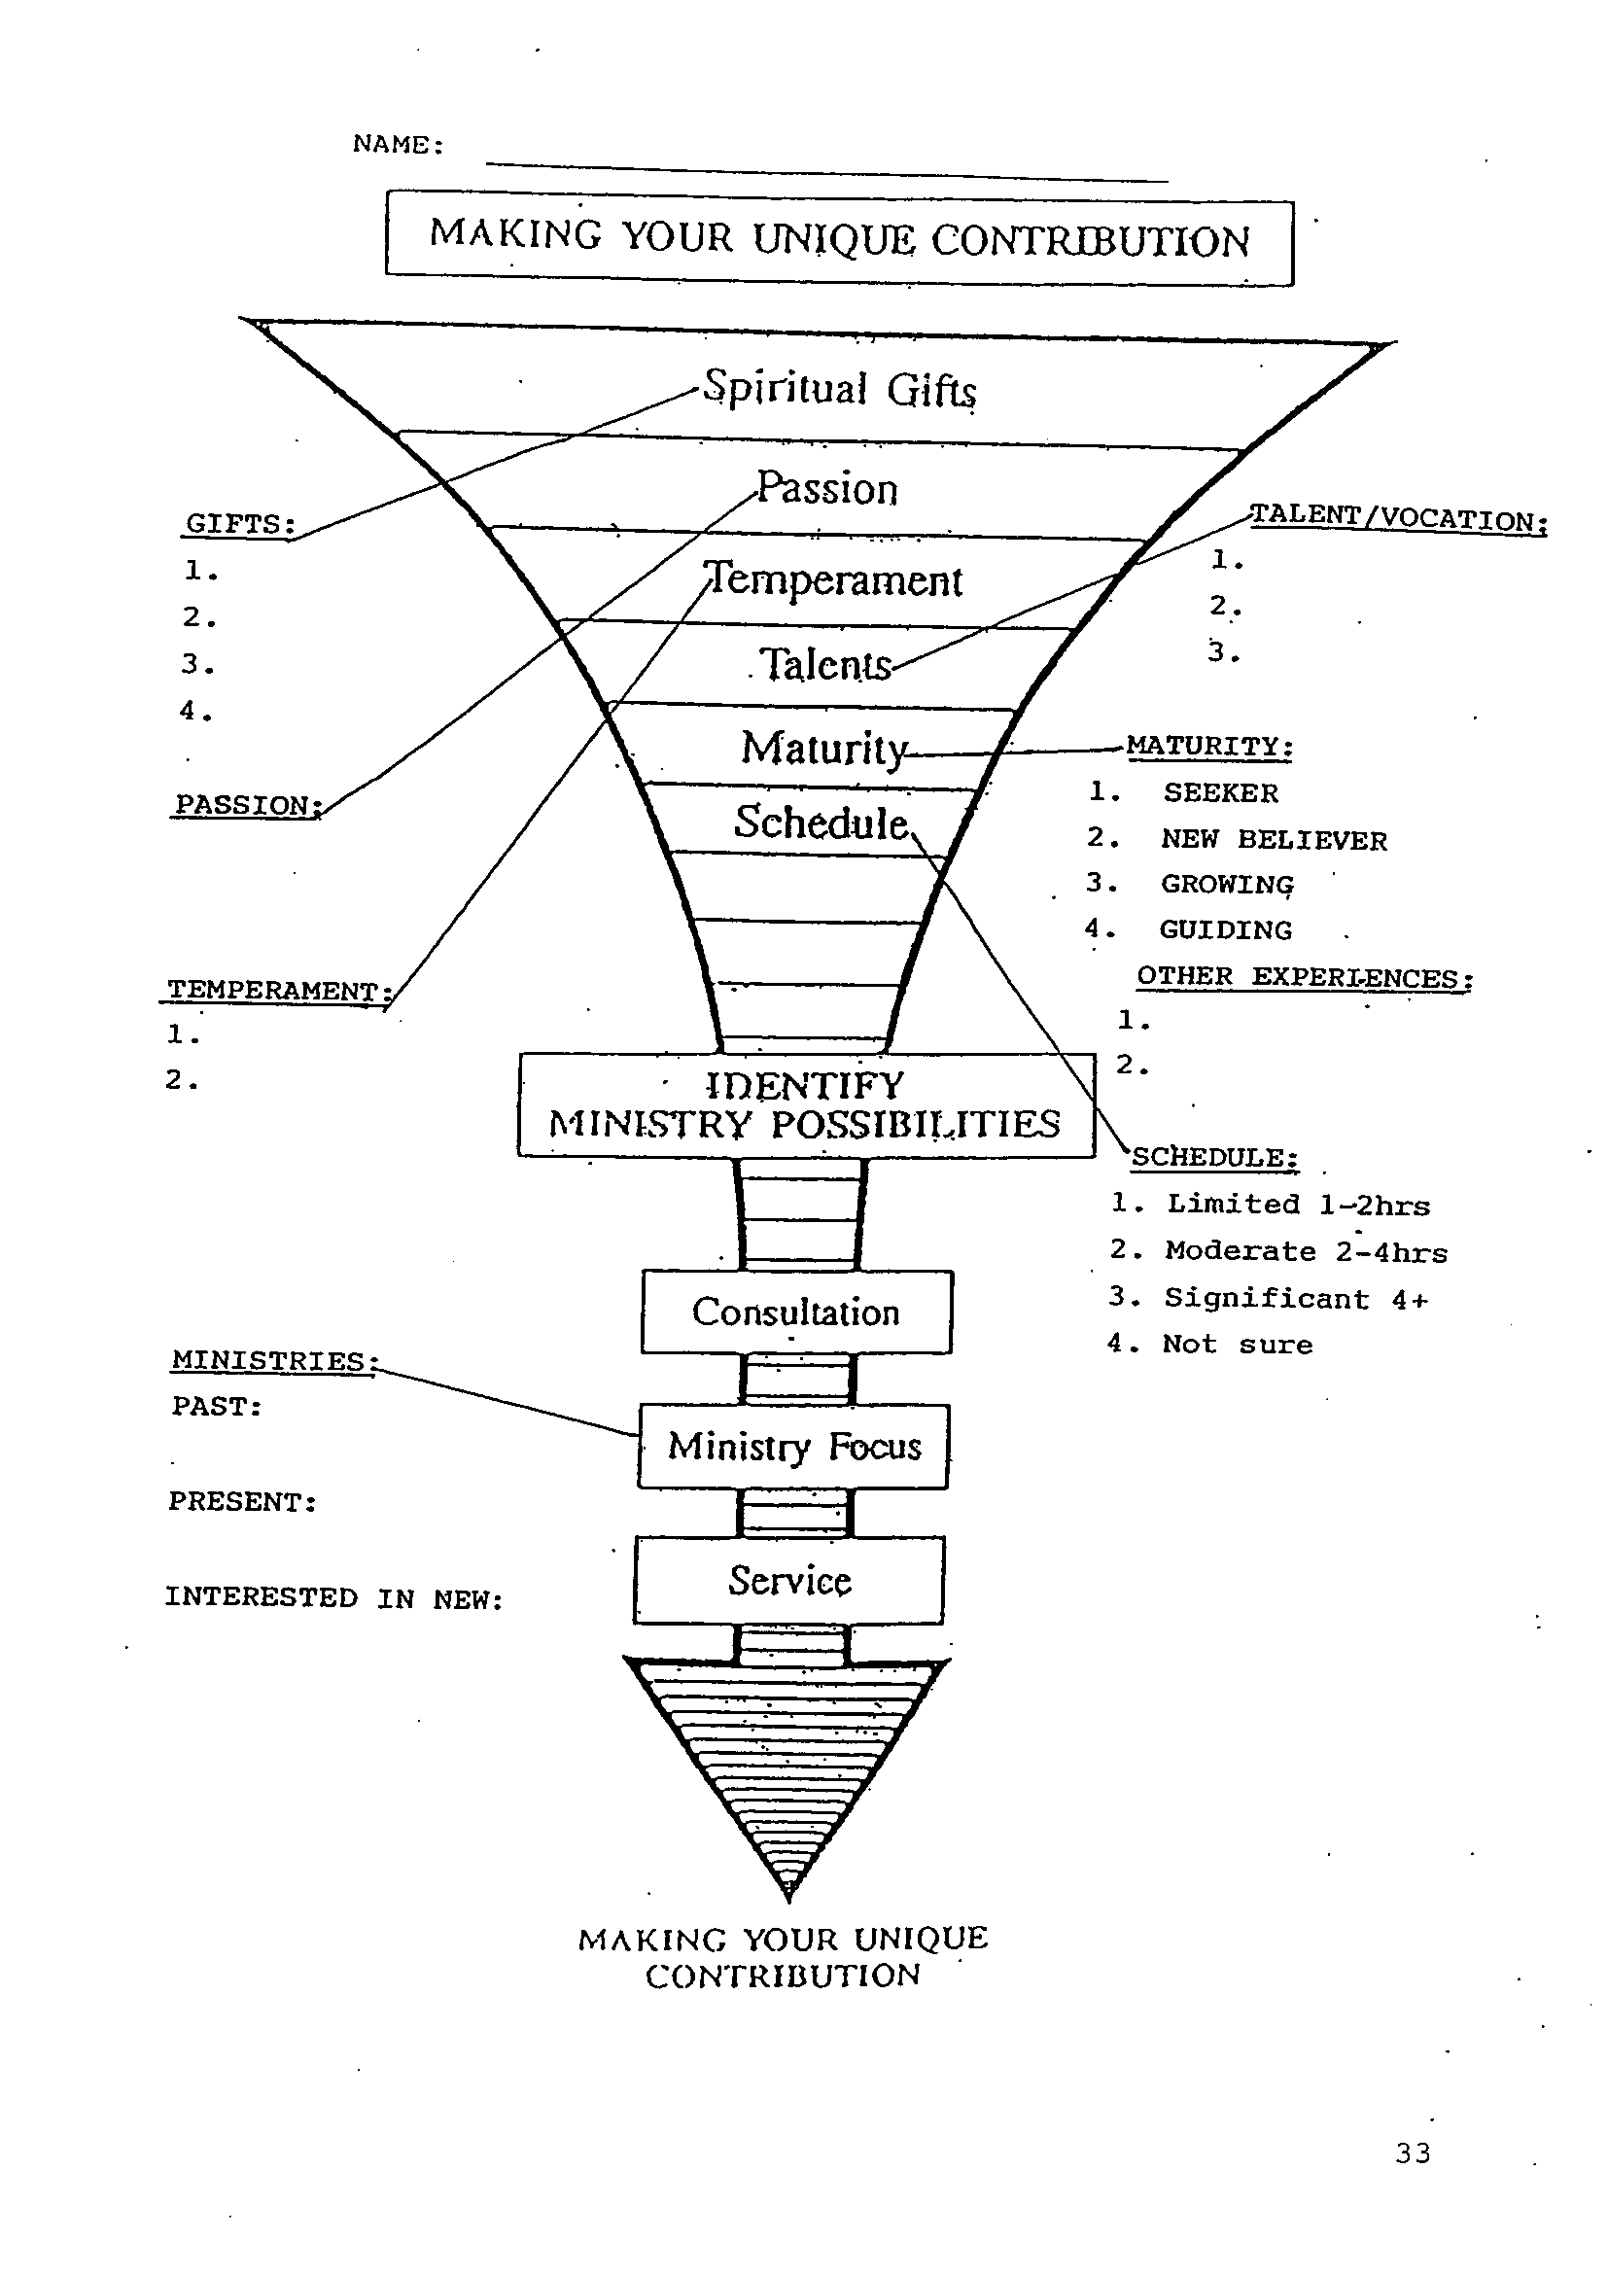

Slide 66
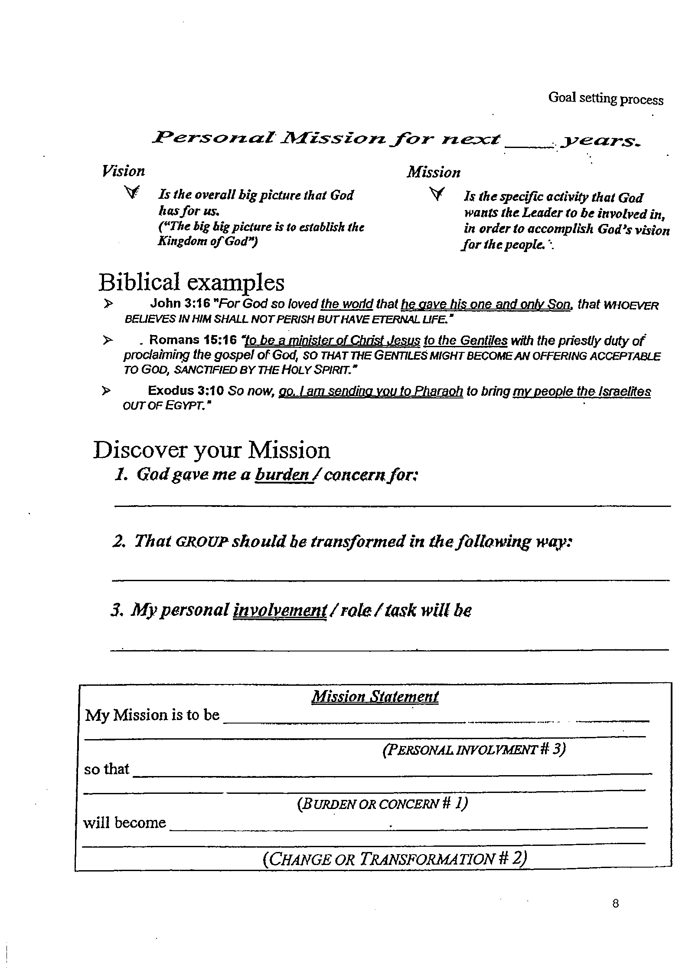

Slide 67
D. Motivation: Allow for ownership. High motivation
Key phrase: “by his own house” (vs. 10, 23, 28, 29, 30)
Fight for family – something they must do, great incentive
Something bigger than they were, making a difference
3. Save time.
We need to allow workers to develop their own ministries.
(Romans 12:4,6) For as we have many members in one body, and all members have not the same office … Having then gifts differing according to the grace that is given to us,

Slide 68
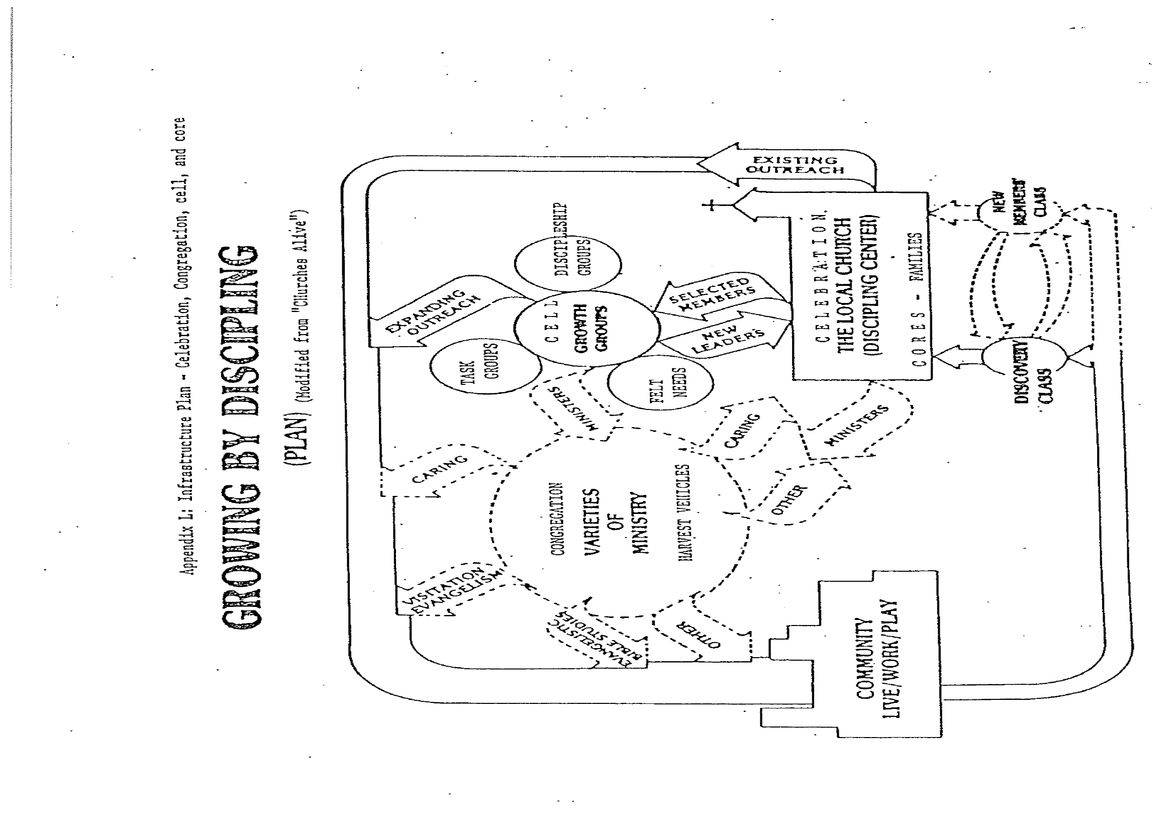

Slide 69
E. Co-operation: Encourage team work and synergy among them.
Key phrase: “Next to him/them” – 20 times (N.T. 58 “one another”)
We do so much more together – help and encourage with one heart.
We must provide a supportive climate of
trust and team-work. (eg. Geese in formation, 72% lift)
(Ecc 4:9,10) Two are better than one; because they have a good reward for their labour.
For if they fall, the one will lift up his fellow: but woe to him that is alone when he falleth; for he hath not another to help him up. (cf. New Testament: One another)

Slide 70
F. Administration: Supervising – management by walking around (cf. Jethro’s principle in Exodus 18, rulers of 1000, 100, 50,10)
Examples: vs. 5 – under their supervisors
vs. 17 – under Rehum
vs. 18 – under Bibbui
1. We need to establish clear lines of authority and accountability.
2. People do what we inspect, not what we expect.
Assess them – Instruct, Demonstrate, Experience done, Assess
(Rom 14:12) So then every one of us shall give account of himself to God

Slide 71
PROCESS - TEACH TO OBEY – EQUIPPING
1) PRAY – INDIVIDUAL & CORPORATE JOURNEY
2) ENCOURAGE – KNOW POTENTIAL & MOTIVATE.
3) SUPPORT – KNOW NEEDS AND PROVIDE HELP.
4) BE ACCOUNTABLE – TRANPARENCY
5) SERVE – POSITIVE HELP IN OTHER’S INTERESTS
GOAL: CHRISTIAN SERVANTS THAT HAVE FAITH:
FAITHFUL, AVAILABLE, INITIATING, TEACHABLE AND HUNGRY

Slide 72
SELF AND TEAM PLANNING (2 Chron. 1:10)
1) PLAN TO PLAN WEEKLY IN MIDST OF CHANGES.
2) FOCUS ON PRIMARY PURPOSES – WHY AND WHAT.
3) ASSESS INSIDE, OUTSIDE, CURRENT & FUTURE.
4) PRIORTISE THE IMPORTANT NOT THE URGENT. HIGH RETURN.
5) ASK RIGHT QUESTIONS – TARGET, RESOURCES,
ASSESMENT AND REFINING.
6) SET SPECIFIC GOALS – SPECIFIC, MEASURABLE, ATTAINABLE,
REALISTIC AND TIME BOUND (SMART GOALS)

Slide 73
SELF AND TEAM PLANNING (2 Chron. 1:10)
7) COMMUNICATE AND CLARIFY WITH GUIDELINES.
8) IDENTIFY POSSIBLE OBSTACLES AND RESPONSES.
9) HAVE OPEN SYSTEM TO ADAPT TO CHANGES.
10) MANAGE AND DIRECT RESOURCES.
11) MONITOR AND CORRRECT TO ADJUST.
12) STUDY CURRENT RESULTS TO EXPERIENCE SUCCESS.
(2 Chronicles 1:10) Give me now wisdom and knowledge, that I may go out and come in before this people: for who can judge this thy people, that is so great?

Slide 74
G. Appreciation: Give recognition (cf. Hebrew 11)
Honor Role of workers: Leader knows names and their successes
38 singled out. Success in proportion to degree of mobilisation
Honourable mention: Baruch (vs 20) – enthusiastically, above measure
Shallum’s daughters (vs. 12) – ladies mentioned
We must recognize and reward effort. Have appreciation days.
(Romans 2:10) But glory, honour, and peace, to every man that works good,
(Mat 25:21) His lord said unto him, Well done, thou good and faithful servant: thou hast been faithful over a few things, I will make thee ruler over many things: enter thou into the joy of thy lord.

Slide 75
ASSIGNMENT A – GOD’S AWARENESS BRINGS REALITY AND REST.
1. SELF-EXAMINATION – Please check which of these are you identifying with: (a) Compulsive leader, (b) Narcissistic leader, (c) Paranoid leader, (d) Co-dependent leader, (e) Passive-aggressive leader. Out of that, please name two attributes that you must be aware of. How do you self-manage and self-discipline those?
2. GOD-AWARENESS - To minimise its negative effects, we need to meditate and envision constantly on who God is and who we are in Christ Jesus. Spiritual identity and maturation are more important than mere spiritual activities. How will the constant awareness (a) of the vision of God and (b) of your identity in Christ Jesus help you to manage the dark side of your life?

Slide 76
ASSIGNMENT B – WORK TOWARDS CREATIVE SOLUTIONS (Acts 6:1-7)
What goals did the Grecian Jews have in this conflict?
Were they expecting the twelve disciples to be involved in the food distribution?
What goals did the disciples have in this conflict?
What was proposed?
Who were the ones selected to do the distribution?
How did the disciples demonstrate trust (v. 5)?
(clue: The chosen men were all Grecian Jews.)
What was the result of the decision (v. 7)?
How did the proposal satisfy both sets of goals and prevented split?
When you are in conflict, what goals do you have?
9. Will you keep in mind the other party’s goals and create solutions?

Slide 77
EVERYDAY COMMISSION
1. WHAT ONE LESSON HAVE I LEARNT?
WHAT WILL ONE PRAYER BE?

Slide 78
Email: gohsengfong@hotmail.com
WhatsApp: +65-98207783
Website: www.FaithAtWorkFellowship.org

