Slide 1
Goat Project
Group John -East Sikkim

Slide 2
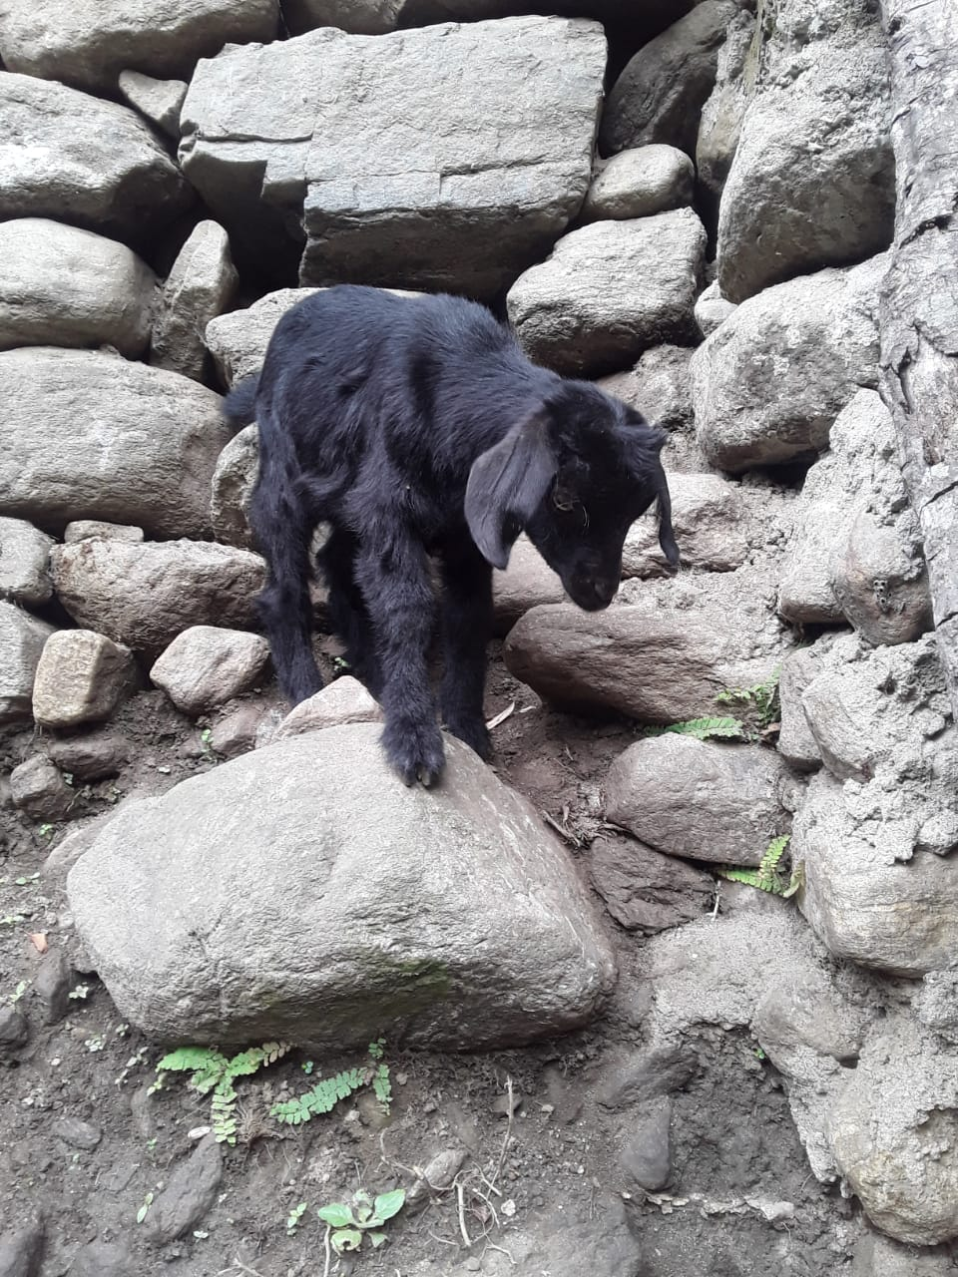
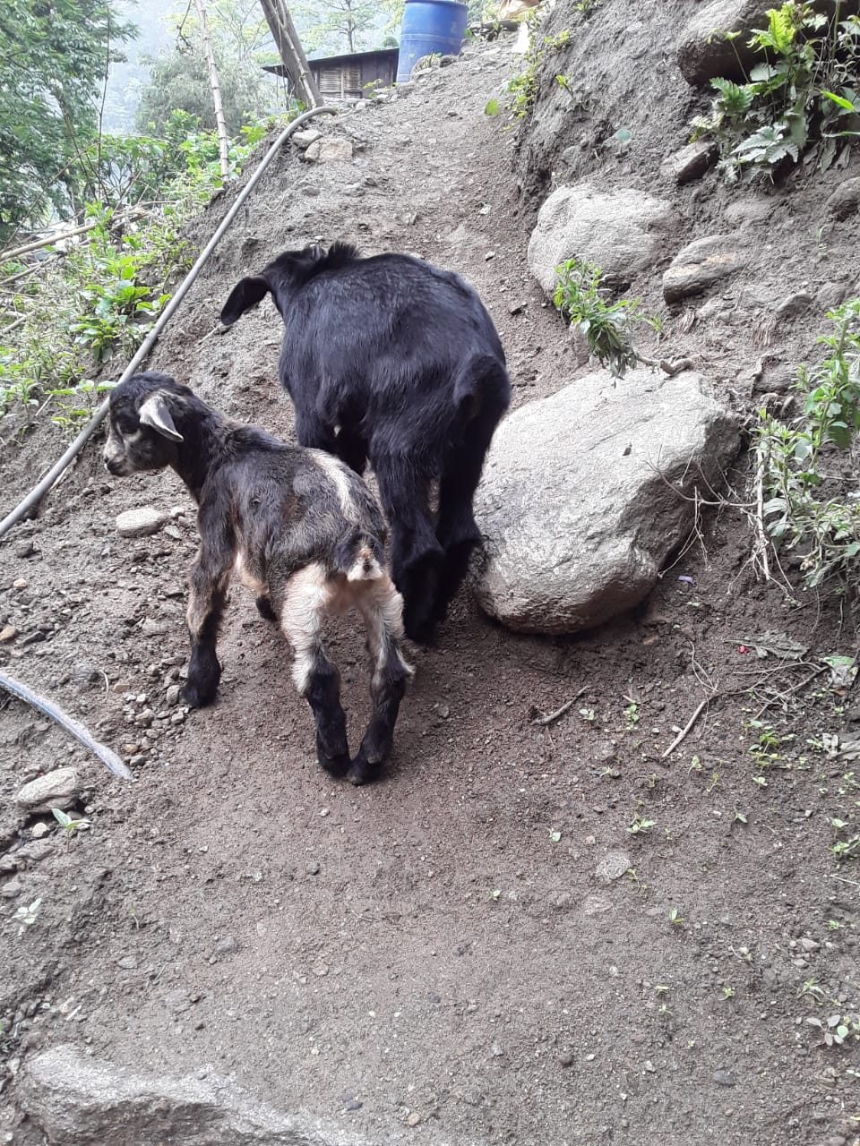
1. Ps. Asish Baraily (Two kids)

Slide 3
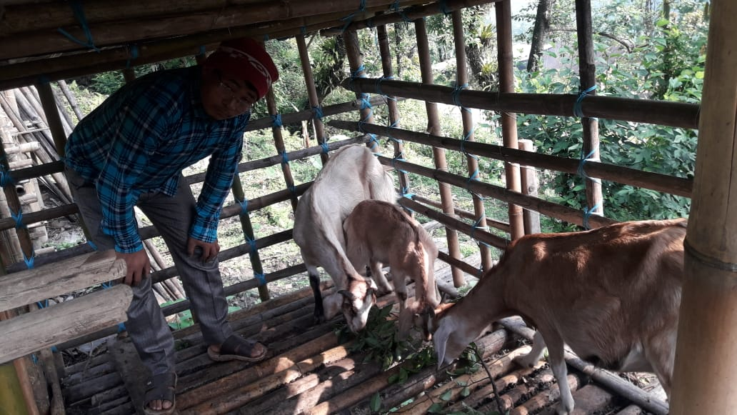
PS. Titus Subba ( 2 Kids )

Slide 4
3. Ps. Hanok (4 Kids from two goats)

Slide 5
Ps. Suraj Chettri ( 3kids)

Slide 6
Apam (1 kids)

Slide 7
Group Peter West Sikkim Ps. Jewan (1kids)

Slide 8
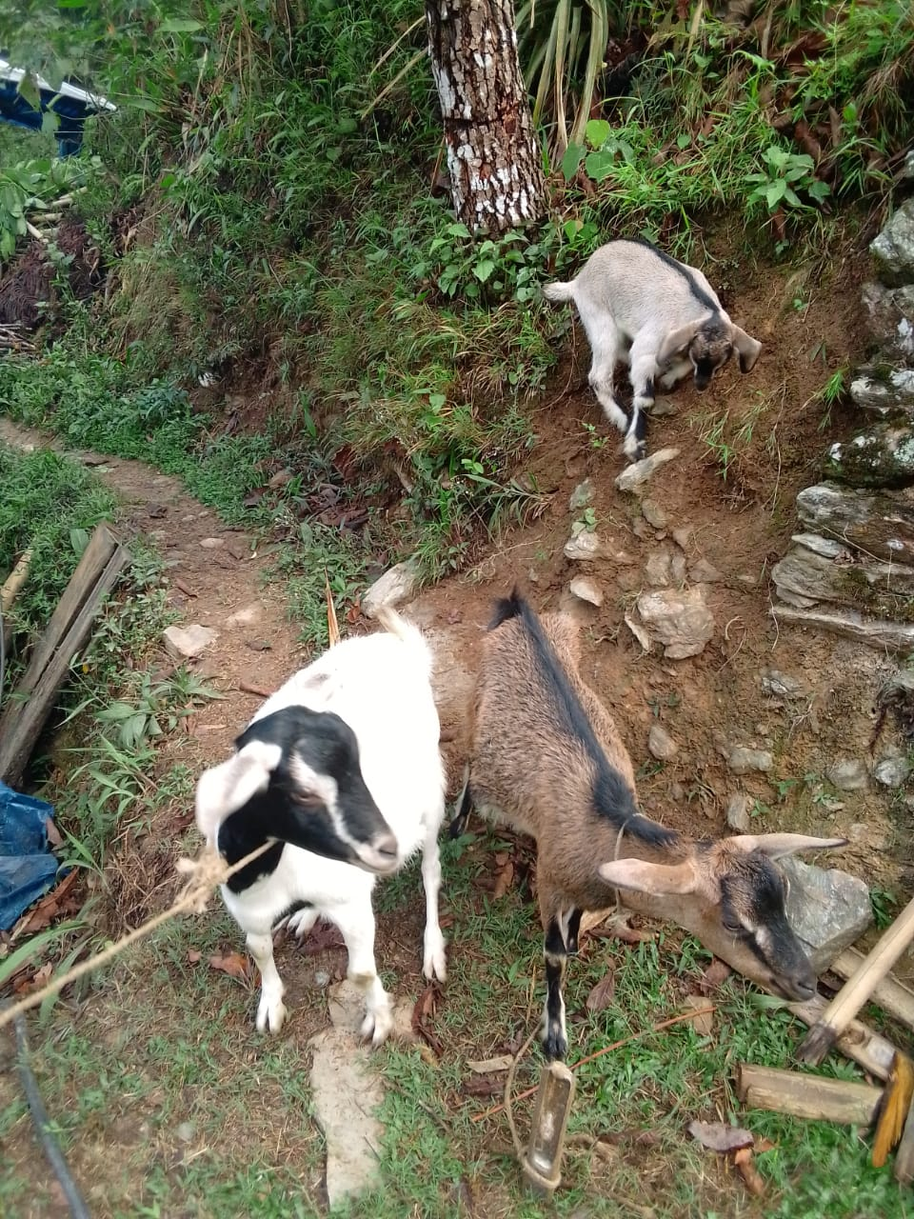
Nar Bahadur Tamang (1Kids)

Slide 9
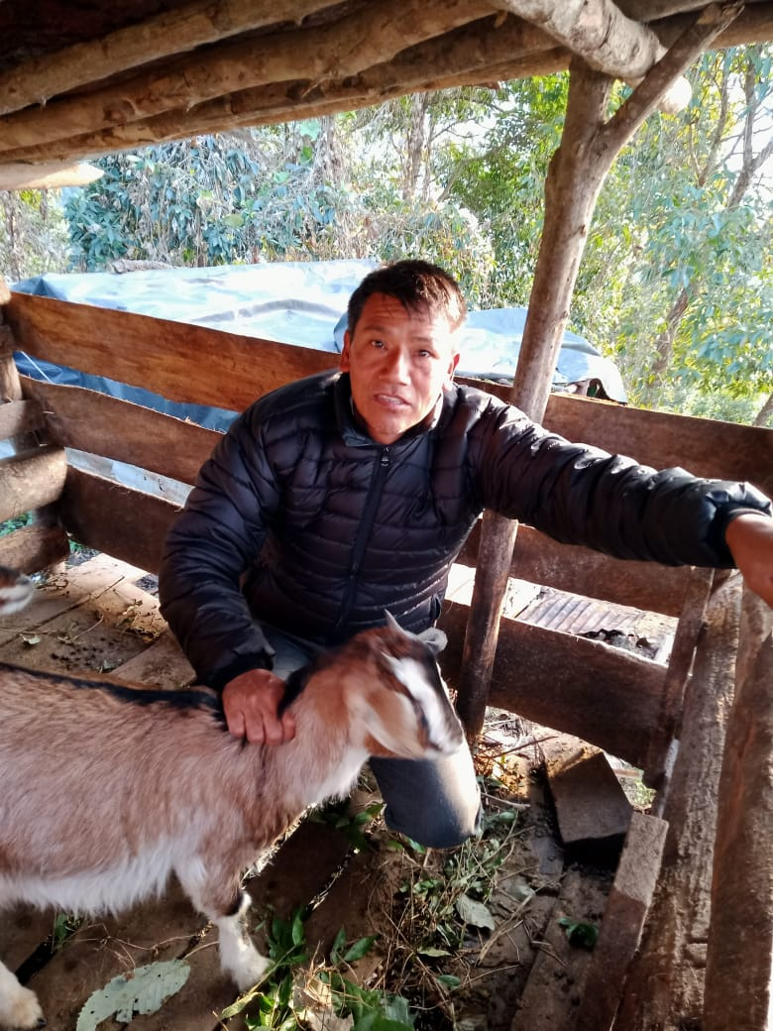
Ps. Birkha Tamang (2 kids)

Slide 10
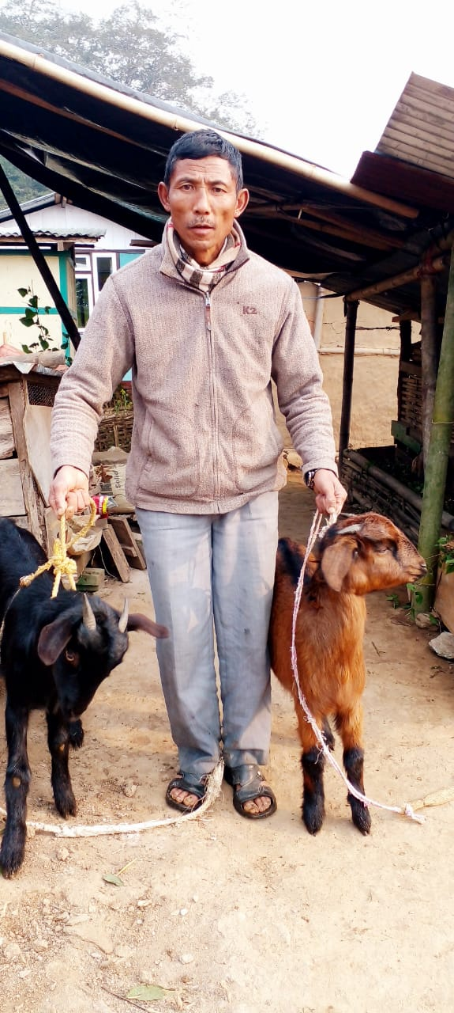
Prakash Rai

Slide 11
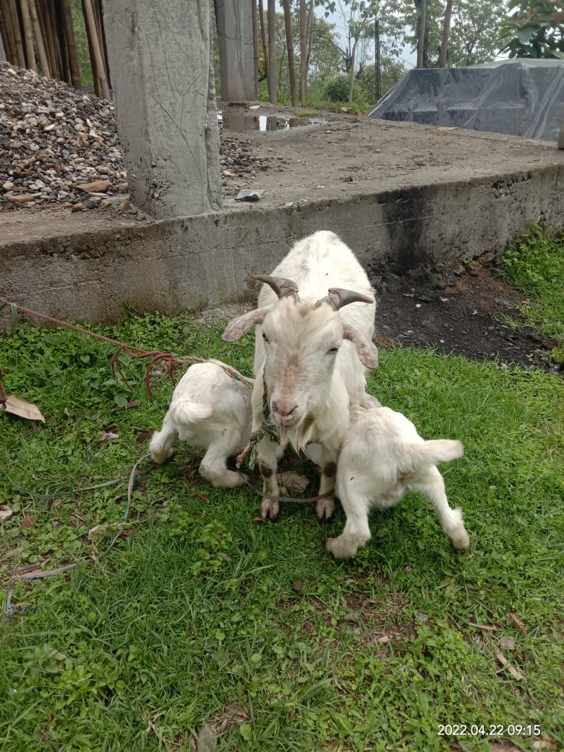
Pastor Philip (2kids)

Slide 12
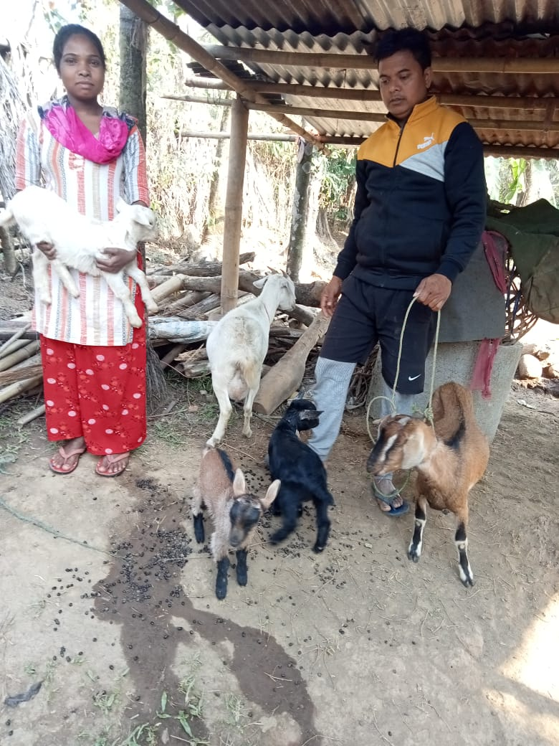
Group James -West Bengal Subidas(Amosh) Oraon goat (4 kids)

Slide 13
Samuel Santal (2 kids)

Slide 14
Samir Oraon (1Kids)

Slide 15
Subir (Expected)

Slide 16
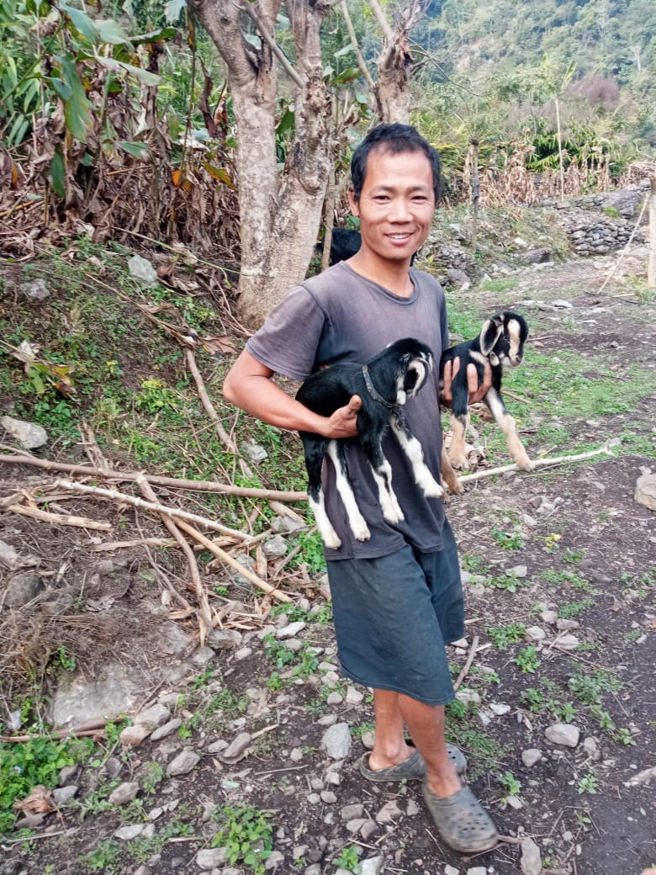
Group Mathew - North Bengal David (2 Kids)

Slide 21
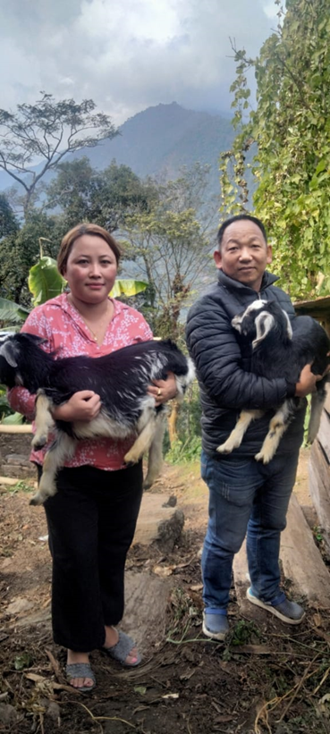
Philip Rai

