Slide 1
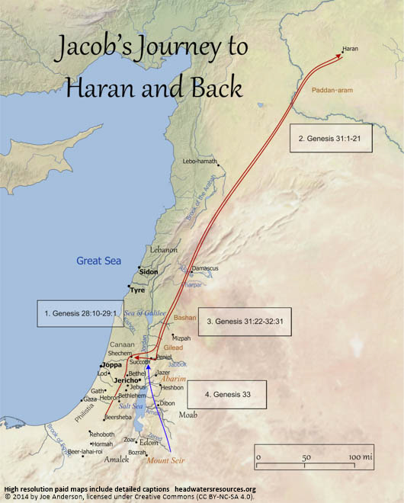
Jacob’s journey to Haran (part of Turkey today) and back
Jebus = Jerusalem
Source: https://headwatersresources.org/map-of-jacobs-journey-to-haran-and-back/

Slide 2
AdSS18- Joseph and his brothers
Background: Jacob and family moved from Shechem to Bethel and finally settled in Hebron (Gen 35:27).
Joseph (Gen 37:1-14)

Slide 3
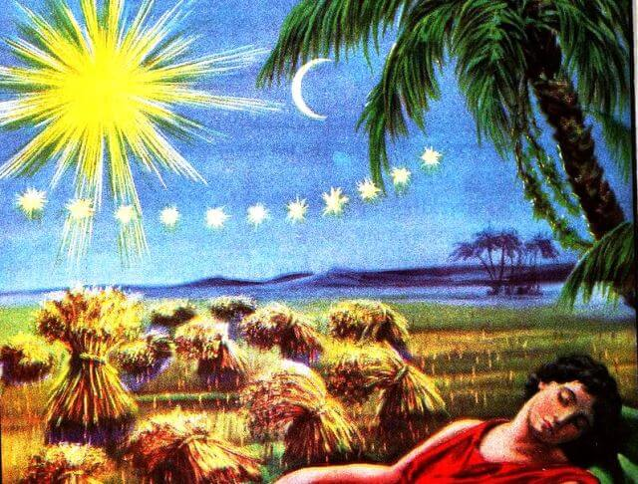
“your sheaves gathered around mine and bowed down to it.”
Gen 37:7
“”the sun and moon and eleven stars were bowing down to me.”
Gen 37:9
https://ravkooktorah.org/joseph-dream.jpg

Slide 4
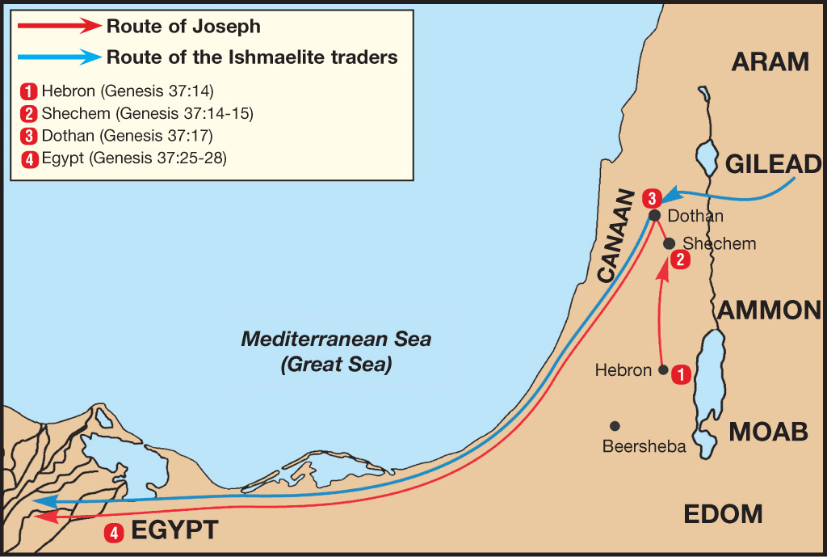
From their home in the Valley of Hebron, Shechem was about 50 miles, and Dothan was another 15 miles north. (65 miles= 105 km. Approx. the distance from Tuas to Changi and back to Tuas.)
Source: https://mlgahbuenlkv.i.optimole.com/4dIftL4-bWFsouR7/w:auto/h:auto/q:90/https://biblestudydaily.org/wp-content/uploads/2021/01/Route-of-Joseph-Gen-37.png

Slide 5
(3) Video: 1:14:00-1:16:57
(Viewers are cautioned on the inaccurate parts of the video)
Source: Abraham, Sarah, Isaac, Jacob, Joseph (movie)
(4) Comments:
Favouritism
Jealousy and Hatred
Violence
Isaac favoured Esau, Rebekah favoured Jacob.
Jacob favoured Rachel and not Leah.
Jacob favoured Joseph among the sons.

Slide 6
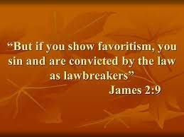
(5) The brothers threw Joseph into a pit. (Gen 37:15-36)
(6) Video: 1:16:57- 1:20:09
(Viewers are cautioned on the inaccurate parts of the video)
Source: Abraham, Sarah, Isaac, Jacob, Joseph (movie)

Slide 7
(7) Comments:
Why did the brothers want to kill Joseph?
Ans: The brothers were jealous of Joseph because Joseph was Jacob’s favourite son. The brothers also hated Joseph who told them of his dreams that his brothers and parents would one day bow down to honour Joseph.
[Self reflection- Were we the victims of favouritism or were we the favoured?
Do we practice favouritism in the family?
Do we practice favouritism at the workplace?
When you were young, were you jealous and hateful of your sibling who was
the favourite?
Were you jealous and hateful of your colleague who was the
favourite?
Favouritism leads to jealousy and hatred.]

Slide 8
(b) Why did the brothers not kill Joseph?
Ans: The brothers were persuaded by Reuben not to kill their own brother, Joseph, but to just throw Joseph into a pit. (Gen 37:22)
(c) The brothers sold Joseph as a slave to the Ishmaelites. (Gen 37:28)
(d) The brothers went back to Jacob to tell him that Joseph had been devoured by a wild animal by showing Joseph’s bloodied coat. (Gen 37:32)
(e) Jacob was very sad and refused to be comforted. (Gen 37:35)
[Self-reflection: No parent could be comforted if their child met with a fatality.]

Slide 9
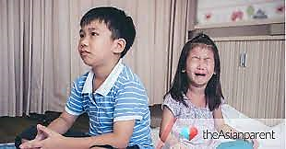
(8) Spiritual Lesson:
TODAY. Published December 16, 2017. SINGAPORE
Parents are sometimes guilty of practising favouritism with their own children too. This could range from just siding with one particular child in arguments, to as serious as punishing one child more than the others, for no obvious reason whatsoever.
Source: https://sg.theasianparent.com/studies-reveal-parents-favourite-child

Slide 10
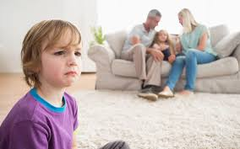
Ms Swanie Khoo, a marriage and family therapist at Relationship Matters explained that parental favouritism can have detrimental and long-lasting effects on children.
Issues of favouritism do not go away if they are unaddressed. Many adults remember how they were unfavoured when they were children. This affects their sense of self and their relationships in adult life. Also, having been unfavoured as a child can create a strong desire to fight back.
(Source: https://www.todayonline.com/singapore/do-you-have-favourite-child)
Source: https://www.rnz.co.nz/programmes/are-we-there-yet/story/2018762908/how-to-make-sure-we-treat-our-children-fairly

Slide 11
Deal with the issue:
“Take a step back and evaluate your emotions underlying those actions that may have favoured one child over the other, and make repair – apologise and acknowledge how you have caused hurt, and make changes,” said Ms Khoo.
“Do not just let it slip or get defensive. Instead, address the issue and give an ear to what your child has brought up and talk about the issues. When issues are not dealt with, they could cause further resentment in the relationships,” Ms Khoo added.
Source: https://www.todayonline.com/singapore/do-you-have-favourite-child

Slide 12
Favouritism at the workplace:
“Ling was an exceptional employee in the sales team of a banking corporation in Singapore. Her boss, Ivy, had enjoyed their first conversation and from the start had decided that Ling was extremely bright.
Ivy gave Ling more work than the others on the team because she felt that Ling was more able to cope.
At the same time, Ling was showered with praise for her achievements and attitude. Other members of the team felt cheated and became despondent towards Ling. Ling herself felt uncomfortable, as well as unfairly overworked.”
https://www.onrec.com/news/news-archive/workplace-favouritism-an-issue-for-singapore

Slide 13
“The end result was that the performance of the other members of the team declined along with morale and Ling ultimately gave her notice and took her exceptional skills elsewhere.
Overall, a costly situation resulting in not only losing a good staff, but also declining morale within the organization.”
[Self-reflection: Don’t overload your good staff with work. Also, may not be a good idea to praise the good staff in front of the other staff. Just point out the good performance without attributing to any particular staff. Encourage the other staff to do better without putting them down.]
https://www.onrec.com/news/news-archive/workplace-favouritism-an-issue-for-singapore

Slide 14
(9) Sharing in a group of 2 to 4 persons
Your observation of favouritism in the family or workplace.
How to overcome favouritism.

