Slide 1
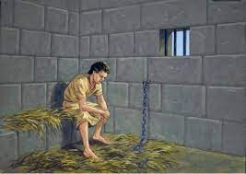
AdSS20- Joseph imprisoned
Background:
Due to Potiphar’s wife, Joseph was framed for wanting to sleep with her.
Joseph was thrown into prison.
Source: https://medium.com/@isabelleesling/joseph-in-egypt-favored-by-god-despite-all-tribulations-by-isabelle-esling-7cbe69983d86

Slide 2
Genesis 37:3,4:
3 Now Israel loved Joseph more than any of his other sons, because he had been born to him in his old age; and he made an ornate robe for him.
4 When his brothers saw that their father loved him more than any of them, they hated him and could not speak a kind word to him.
Matthew Henry Concise Commentary on Genesis 37:3,4:
But Jacob made known his love, by dressing Joseph finer than the rest of his children. It is wrong for parents to make a difference between one child and another, unless there is great cause for it, by the children's dutifulness, or undutifulness. When parents make a difference, children soon notice it, and it leads to quarrels in families.

Slide 3
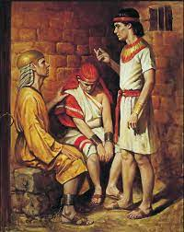
(2) The King’s butler and baker (Gen 40:1-4)
Source: https://simlachandigarhdiocese.wordpress.com/tag/joseph-in-prison/

Slide 4
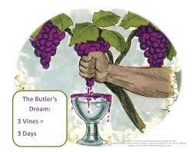
The dream | The interpretation
The butler saw a vine. On the vine were 3 branches. It budded, blossomed and ripened into grapes. The butler squeezed the grapes into the Pharoah’s cup. | 3 branches = 3 days Within 3 days, Pharoah would restore the butler to his former position.
(3) The butler’s dream (Gen 40:9-15)
Source: https://www.biblefunforkids.com/2019/09/life-of-joseph-series-4-joseph-with.html

Slide 5
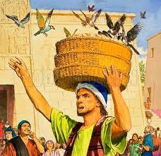
The dream | The interpretation
On the baker’s head were 3 baskets of bread. In the top basket were all kinds of baked food for Pharoah. The birds were eating them out of the basket on the baker’s head. | 3 baskets = 3 days Within 3 days, Pharoah shall lift off the baker’s head and hang him on a tree. The birds shall eat away his flesh.
(4) The baker’s dream (Gen 40: 16-19)
Source: https://www.lookandlearn.com/history-images/A005712/The-bakers-dream

Slide 6
(5) Pharoah fulfilled Joseph’s interpretation of the 2 dreams:
Restoring the butler to his former position.
Executing the baker
(6) After being restored by Pharoah, the butler forgot Joseph.

Slide 7
(7) Spiritual Lessons:
Despite being thrown into prison, God was with Joseph. He was put in-charge of all the prisoners. God may also be with us in whatever low position we occupy. And we will be blessed in our work.
Joseph did not blame God for being thrown into jail on a false charge. He continued to be faithful to God. In the same way, there will be setbacks in our lives. We must bear the setbacks and continue to be faithful.
In prison, he continued to do good as a faithful servant of God. He assisted in the interpretation of the butler and baker’s dreams. This led to the important connection with Pharoah later. Where we are able to help others, we should do so too. We will never know how God will bless us for helping others later.

Slide 8
(d) The butler forgot Joseph – Isn’t this true in the world? People may forget us after we’ve done good for them. But God doesn’t forget. Since God remembers us, that is good enough for us.
(8) Pharoah’s dream. (Gen 41:1-14)
(9) Joseph’s reply to Pharoah. (Gen 41:15-16)

Slide 9
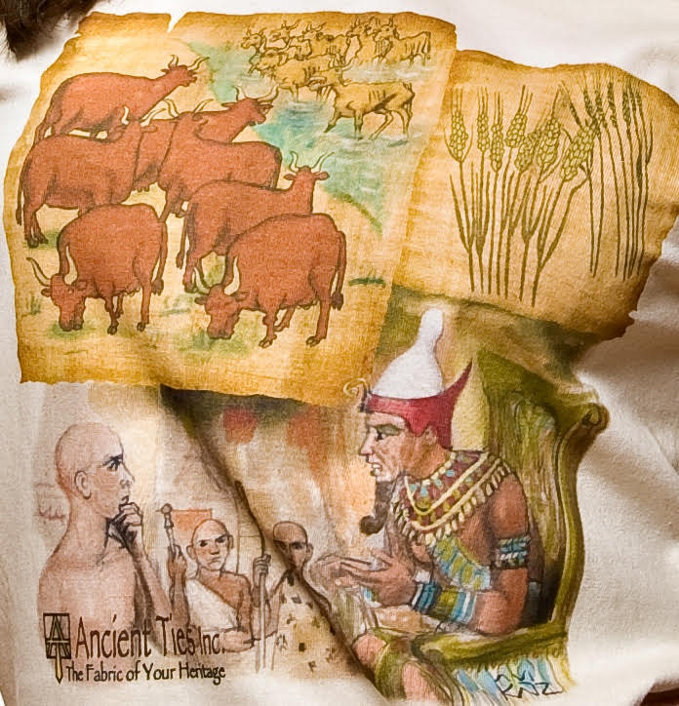
Pharoah’s 2 dreams
Source: https://exeraunao.com/2015/06/26/genesis-59-joseph-interprets-pharaohs-dream/

Slide 10
(10) Pharoah’s dream and Joseph’s interpretation
Pharoah’s 1st dream | Pharoah’s 2nd dream | Joseph’s interpretation
7 fat cows feeding in the meadow. Then, 7 thin and scrawny cows came and ate up the 7 fat cows. After eating, the 7 thin cows looked just as thin as before. | 7 heads of good grain growing on a stalk. Then, sprouted 7 withered and thin grains. The 7 thin grains swallowed up the 7 good grains. | The 2 dreams were the same. 7 good cows = 7 good grains = 7 good years. 7 thin cows = 7 thin grains = 7 years of famine. In summary, there would be 7 years of plenty followed by 7 years of famine.

Slide 11
(11) Watch video: 1:27:58 – 1:31:45
(Viewers are cautioned on the inaccurate parts of the video)
(Source: Abraham, Sarah, Isaac, Jacob, Joseph, the movie)
(12) Comments
Through his imprisonment, Joseph was connected to the Pharoah because of his ability to interpret dreams.
This divine ability to interpret dreams was God’s blessing. Joseph was faithful and obedient to God despite being falsely accused and imprisoned.

Slide 12
(c) God’s objective was for Joseph to save Jacob and family from famine in Canaan.
In training Joseph as prime minister of Egypt, God sets a series of setbacks for Joseph.
Consider setbacks in Abraham’s life, Jacob’s life, Moses’ life
Ultimately through Joseph’s imprisonment, he was connected with Pharoah.
Joseph became Prime Minister of Egypt and saved Jacob and family.

Slide 13
(d) Joseph’s difficult life
Joseph, at 30 years old, became Prime Minister of Egypt
17-year old Joseph went to look for his brothers
The brothers threw Joseph into a pit
As a slave, Joseph was favoured by Potiphar
Joseph interpreted Pharoah’s dream
Joseph was sold as a slave
Joseph was thrown into prison
The butler forgot Joseph

Slide 14
(13) Spiritual Lessons:
Setbacks in our lives may be God’s:
opening of a new opportunity, eg. new job.
strengthening of our faith in Him.
Punishment of us for our sin.
Look at how Joseph’s imprisonment led him to the butler and then to Pharoah.
“Man’s goings are of the LORD; how can a man then understand his own way?” (Proverbs 20:24)
(b) My 2 personal setbacks and restoration.

Slide 15
(c) So continue to be faithful to God and serve wherever God places you. And when
God has blessed you, remember to give God the glory!
When questioned by Pharoah whether Joseph could interpret dreams, Joseph said,
“It is not me: God shall give Pharoah an answer of peace.” (Gen 41:16)

Slide 16
In groups of 2 to 4 persons:
(a) Share how setbacks in your life turned to good and to give God the glory.

