Slide 1
AdSS22-Joseph and brothers were reunited
Background: Joseph invited his brothers including Benjamin for a feast. The brothers did not recognise Joseph.
The brothers prepared to go back to Canaan with the food from Egypt.
Joseph instructed his servant to put his silver cup into Benjamin’s sack. (Gen 44:2-13)
Source: https://www.biblefunforkids.com/2019/11/life-of-joseph-series-9-benjamin-has.html

Slide 2
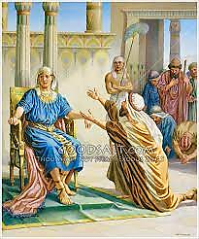
(4) Joseph wanted to detain Benjamin. (Gen 44:15-17)
(5) Judah pleaded with Joseph to release Benjamin. (Gen 44:27-34)
(6) Joseph could no longer control himself and wept aloud. (Gen 45:1-15)
Source: https://www.goodsalt.com/details/stdas0494.html

Slide 3
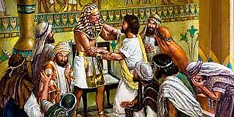
Source: https://jaymack.net/kh-joseph-made-himself-known-to-his-brothers-45-1-15/

Slide 4
(7) Comment:
(a) Genesis 45:
“5Now therefore be not grieved, nor angry with yourselves, that ye sold me hither: for God did send me before you to preserve life. ”
“7And God sent me before you to preserve you a posterity in the earth, and to save your lives by a great deliverance. ”
“8So now it was not you that sent me hither, but God: and he hath made me a father to Pharaoh, and lord of all his house, and a ruler throughout all the land of Egypt.”

Slide 5
(b) God fore-ordained the events such that Joseph would be in Egypt to become the Prime Minister and to save his family.
(8) Joseph sent his brothers back to Canaan to bring Jacob and the whole family to Egypt. (Gen 45:27-28)
(9) Watch video: 1:38:58-1:45:40
(Viewers are cautioned on the inaccurate parts of the video)
(Source: Abraham, Sarah, Isaac, Jacob, Joseph)

Slide 6
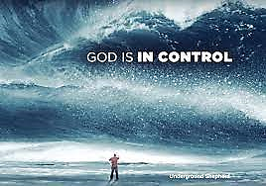
(10) Spiritual Lessons:
(a) God is in control and fore-ordains events and circumstances in our lives including troubles.

Slide 7
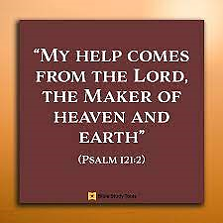
When we are in trouble, it is hard to bear.
But He will hear you in your prayer because the troubles are from Him to build up our faith.
Abraham, Isaac, Jacob and Joseph were afflicted with numerous troubles.
They continued to have faith in God and were delivered.
Despite our troubles, we must have faith.

Slide 8
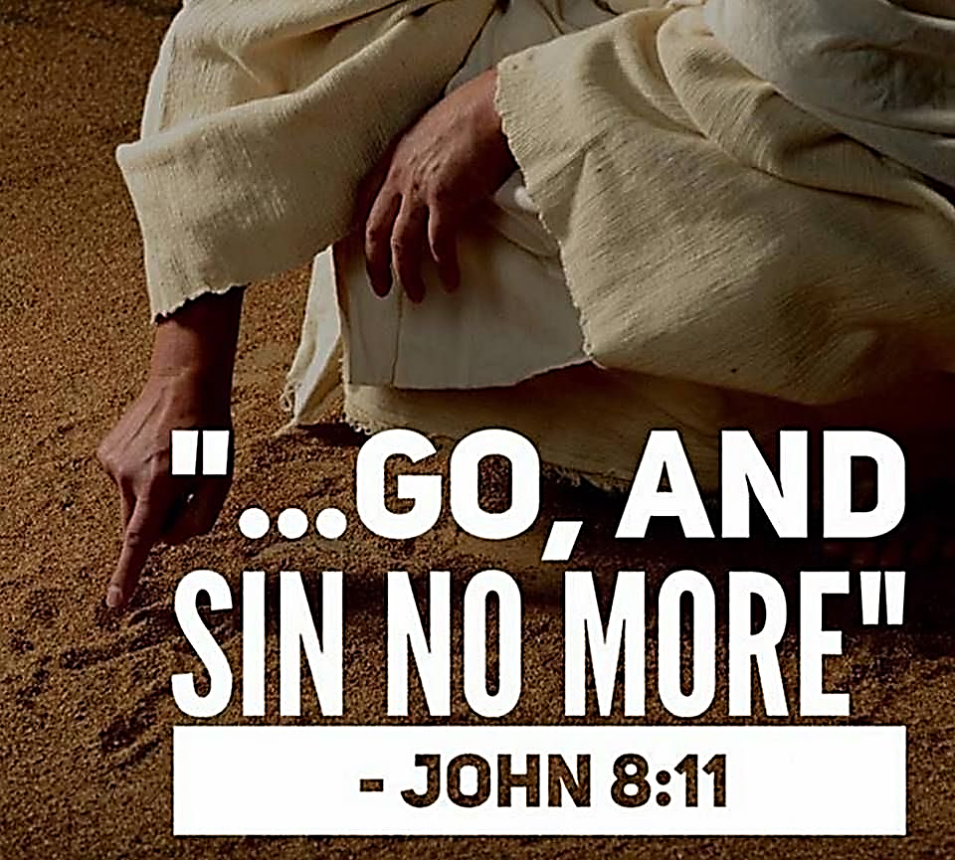
(b) Repent and turn away from sin.
If we sin, God will deal with us because of our sin. Eg. Jonah, David, Solomon.

Slide 9
(c) When we are in trouble, we have to do some soul-searching:
Have we sinned, for example:
Have we behaved badly towards others,
Have we been selfish,
Have we been covetous,
Have we been gossipy,
Have we been envious or jealous of another,
Have we lusted in our hearts,
Have we been proud and boastful,
Have we character-assassinated another person,
Have we lied (albeit harmless),
Have we been unforgiving,
Etc…

Slide 10
(d) If answer to (c) is “Yes, we have sinned”, then we have to:
Repent,
Seek forgiveness, and
Turn away from our sin.
God, our loving heavenly Father, will surely forgive us.
We may have to bear with the trouble due to our own sin. But, we know that God has forgiven us and will deliver us ultimately.

Slide 11
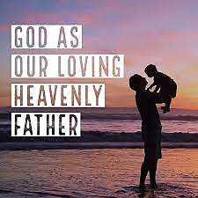
(d) If answer to (c) is “No, we have not sinned”, then we have the peace that God will deliver us from our troubles according to His will.
God’s answer may be to:
Grant deliverance, or
Postpone deliverance
Either way, God’s way is the best for us. He is our loving heavenly Father.

Slide 12
In groups of 2 to 4 persons:
Share how God is faithful in delivering us from trouble.
Read Psalm 18:20-24 – God rewards those who keep away from sin.

