Slide 1
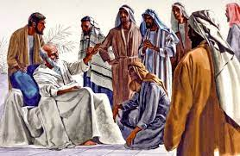
AdSS24- You thought evil, but God meant good
Background: Jacob reunited with Joseph in Egypt
Jacob promoted to glory. (Gen 49:33)
Source: https://pilgrimwatch.com/jacobs-death/

Slide 2
(3) Fear of Joseph’s brothers. (Gen 50:14-21)
Gen 50:
”19 And Joseph said unto them, Fear not: for am I in the place of God?”
“20 But as for you, ye thought evil against me; but God meant it unto good, to bring to pass, as it is this day, to save much people alive.”

Slide 3
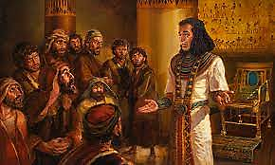
Source: https://www.biblword.net/what-can-we-learn-from-the-life-of-joseph/

Slide 4
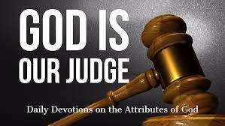
(4) Comments:
Joseph never intended to use his power against his brothers.
Joseph was conscious that God was the one who judged and avenged, not him.
“Fear not: for am I in the place of God?”
(Gen 50:19)
Source: https://www.jtdyer.com/god-is-our-judge/

Slide 5
(c) Joseph understood that God ruled over all circumstances including evil ones.
(d) He saw that his brothers intended evil to come upon him by throwing him into a pit and selling him to slave traders.
(e) But God ruled over the event for good for Joseph to go ahead to Egypt and subsequently become Prime Minister to save Jacob and family from famine.
“ye thought evil against me; but God meant it unto good” (Gen 50:20)

Slide 6
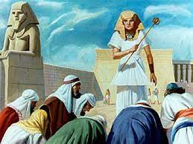
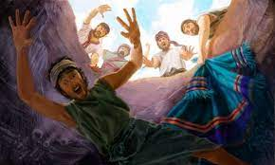
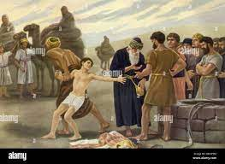
(5) Joseph
Source: https://www.alamy.com/joseph-sold-as-a-slave-image184217172.html
Source: https://www.pinterest.com/pin/367113807100173155/
Source: http://ubdavid.org/bible/characters1/characters1-6.html
“Ye thought evil”
“God meant it unto good”

Slide 7
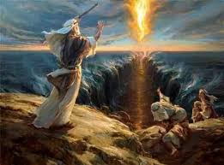
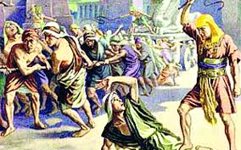
(6) Slavery in Egypt
Source: https://www.jewishnews.co.uk/the-bible-says-what-how-does-the-torah-tackles-slavery/
“Ye thought evil”
Source: https://www.jewishpress.com/indepth/opinions/leaving-egypt-to-cross-the-metaphorical-seas/2019/04/25/
“God meant it unto good”

Slide 8
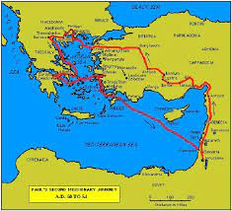
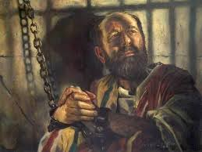
(7) Apostle Paul
Source: https://www.pinterest.com/pin/205124957998103547/
Source: https://jesusfootprints.wordpress.com/2015/09/19/from-trials-to-triumph/
“Ye thought evil”
“God meant it unto good”

Slide 9
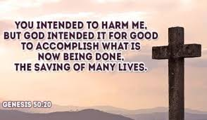
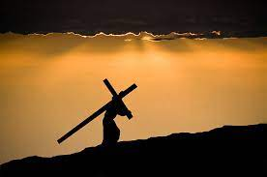
(8) Jesus Christ
Source: https://www.biblestudytools.com/genesis/50-20.html
Source: https://www.istockphoto.com/hk/search/2/image?phrase=jesus+carrying+cross
“Ye thought evil”
“God meant it unto good”

Slide 10
(9) Spiritual Lessons:
Our lives: Contemplate whether “Ye thought evil, but God meant good” applies to our lives.
We are bullied, oppressed leads to a good outcome.
We should not be fearful because God is in control even of the difficult circumstances.
Personal sharing:
Job S1
Job S2

Slide 11
(d) Our part:
Close walk with God in prayer and reading the Word.
(ii) Do things which please God.
(iii) Flee from sin.
(iv) Don’t take revenge.

Slide 12
In groups of 2 to 4 persons:
(a) Share your observation of how others caused you trouble but God led you to a good outcome.

